Slide 1
Pushing Light to the Edge
…and why it probably doesn’t matter!

Slide 2
The Photon Wars: A Short Story
The First to Execute Wins
Be Smarter or Be Faster
Notes:
The Short Story:
There are many ways to trade. Latency matters most to three types of traders:
HFT Arbitrageurs: submit trades which eliminate inconsistencies in perceived equivalent products.
Market Makers: guarantee liquidity in the market trading a bid/ask spread
HFT Scalpers: submit trades which push a single product to align to an expectation.
With many people trying to make the same trades, the first to execute wins
Strategic advantage comes two ways:
Being faster than your competitors
Being smarter than your competitors
The dirty truth:
This is a war.
It is treated like a war.
Espionage is at play.
It costs money like a war.

Slide 3
Set the Scene
Event Published
Event Received
Market Event
Decision Logic
Execution Received
Execution Sent
Matching Logic
Position Update
Confirm Published
Confirm Received
SOFTWARE
HOST/OS
NETWORK
HOST/OS
SOFTWARE
EXCHANGE
TRADER
Notes:
A standard electronic trading logic cycle.

Slide 4
Distance Matters
$$latency=\frac{distance}{velocity}$$
Velocity is constant
Notes:
Since the speed of light is constant, distance matters.
Because we are working with micro/nano-second level differences, this is important for short and long distances.
Because so much money was at play, whole new fiber networks were built just for this war.
To get access to these special fibers, companies paid hundreds of thousands of dollars a month.

Slide 5
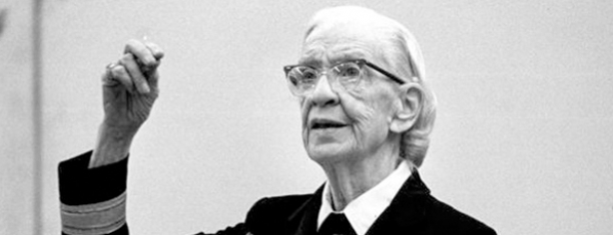
Shave and a Haircut
"Please cut off a nanosecond and send it over to me.“
-Admiral Grace Hopper, The Queen of Code
Notes:
Even Admiral Grace Hopper was used as an example.
Shave a foot of patch cable = gain a nanosecond.
Use RAMAN amplification instead of EDFA = shave 600+ meters of fiber from your Chicago to NY path = gain almost 4 microseconds round trip.

Slide 6
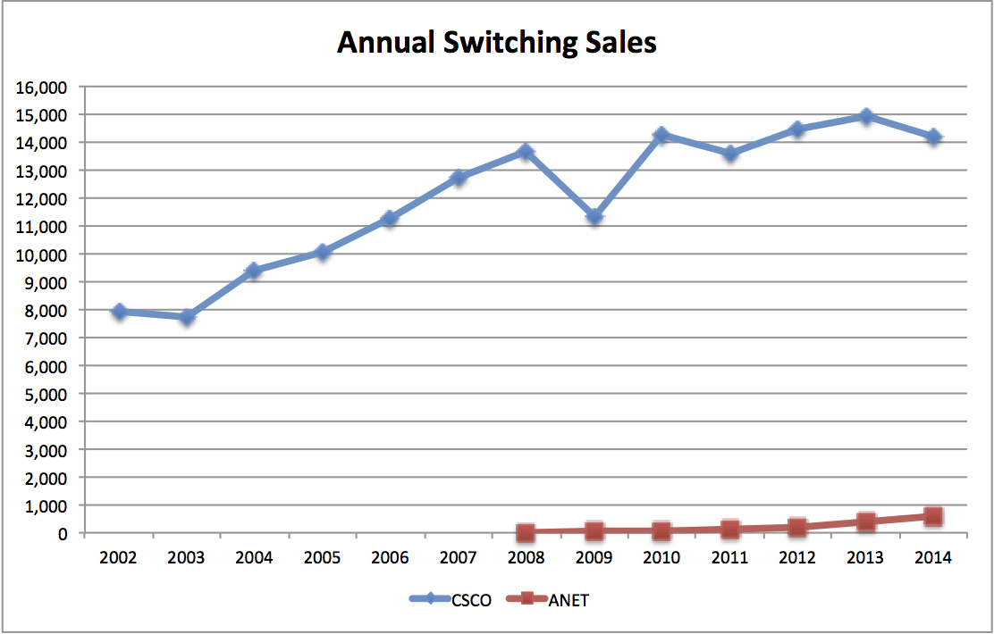
Thinking Inside the Box
Arista Networks offers trading firms a lower latency switch alternative
Firms start replacing whole installations of Cisco top of rack switches almost overnight
Juniper, Voltaire, Brocade, Force 10, others join in to challenge Cisco hegemony
Graph courtesy of W.R. Koss http://siwdt.com/2015/03/08/if-a-butterfly-flaps-their-wings-should-you-care/
Notes:
I’ll be more enthusiastic about encouraging ‘thinking outside the box’ when I see any evidence of thinking going on inside it. – Terry Pratchett
A small group of people realized right away that the near hegemony of Cisco and its complacency in technical innovation offered a lucrative opportunity.
Welcome to the world Arista Networks – born out of Cisco’s initial failures with the 4948-G switch and a lack of innovation in the later 4948 platform.
Once the latency claims from Arista were validated, we saw whole cage/rack conversions happening literally overnight. This occurred week after week.
The non-cisco SFP world really heated up as well.
Cisco has responded with the Nexus solutions. Originally, not very successful as it was less of a drop in alternative and required a specific pattern for network implementation. Seeing greater growth and success now.

Slide 7
History Repeats Itself
Old ideas are sometimes the best:
Cut-through switching
Circuit switched topologies
Passive WDM
Clos networks
TRILL -> Cisco FabricPath, Brocade VCS
IEEE 1142 (IS-IS) -> Juniper QFabric
The truth?
Maybe some of these don’t help all that much as the packet sizes are so small.
Notes:
Old ideas are sometimes the best – welcome back cut-through switching.
A less viable solution in a world of WAN connectivity and high LAN segment collision rates – or over any medium where packet loss or corruption are an issue - it yielded a perceived optimization in a data center world where packets were travelling less than 20 feet from source to destination through optical fiber and are less likely to incur loss or corruption.
The truth? Maybe it doesn’t help all that much when the packet sizes are so small.

Slide 8
Examining Host OS & Hardware
To find additional optimizations we started looking further up the stack.
Kernel Bypass The network card has to interrupt the CPU to transfer data from the memory buffers on the card into user space, we can’t be performing business logic at the same time on that core.
Cgroup/cpuset and NUMA memory alignment When the CPU accesses RAM we want it to be local to the CPU, not crossing the bus/QPI bridge
Again, once claims were validated, near overnight whole system upgrades started to occur. But there’s a catch….
Notes:
To find additional optimizations we had to start looking further up the stack. Improvements began through the realization that newly enabled extreme packet rates were causing high CPU utilization in systems.
Why?
If the network card has to interrupt the CPU to transfer data from the memory buffers on the card into user space, we can’t be performing business logic at the same time on that core.
So let’s skip the interrupt.
Kernel bypass technology comes out of 1997 efforts of Microsoft, Compaq, and Intel. For the industry, it became available through the SolarFlare series of network cards supporting OpenOnload, and today extends to DDIO.
Again, once claims were validated, near overnight whole system upgrades started to occur. But there’s a catch….

Slide 9
Just the Facts, Ma’am
Kernel bypass is no holy grail.
And cpuset only aligns the access –
not the arrangment of memory.
We need custom application protocols
Binary protocols like SBE, Fast, etc - allow data to be memory mapped directly into place.
We need data structure intelligence
Fixed packet size and format which align the software, operating system, and network boundaries
Notes:
Kernel bypass is no holy grail. It is merely a good tool in the hands of the right software architect.
Custom application protocols become a requirement to see the greatest advantage.
Binary protocols like SBE, Fast, etc. – not text like FIX – take away that one little step of parsing and allow data to be memory mapped directly into place.
Fixed fact size and format vs. variable size tagged data (e.g. FIX protocol) becomes more valuable in a deterministic world.

Slide 10
Throw out the Book
“If I am building a point to point network where my goal is to get a fact in the form of bitwise data from point A to point B – why do I need a switch or router or network addressing at all?”
Market event code becomes nothing more than distributed event sources which translate an event into a fact and ‘broadcast’ the fact out unaddressed.
Custom network drivers and firmware have been developed that allow a bitstream to be delivered over standard optics without IP at all.
Notes:
Then, someone asked:
“If I am building a point to point network where my goal is to get a fact in the form of bitwise data from point A to point B – why do I need a switch or router or network addressing at all?”
Non-IP media enter the picture: infiniband, PCIe bus transport, etc..
Market event code becomes nothing more than distributed event sources which translate an event into a fact and send the fact out unaddressed.
If I can split the signal without any parsing, I can even build point to multipoint networks. No switch at all: Host->NIC->SFP->Glass->SFP->NIC->Host
Custom network drivers and firmware have been developed that allow a bitstream to be delivered over standard optics without IP at all.

Slide 11
Case Example: Company X
Let’s imagine these are the techniques they used:
Contracted for shortest dark fiber paths in the metro area
Implemented a custom network driver that allowed them to broadcast events as non-addressed/non-switched data
Wrote custom software to take advantage of the kernel bypass capability
In addition, let’s imagine they:
Installed multiple tunable optics in systems with custom network driver
Used passive CWDM/DWDM filters to build a switchless distribution network
Like legacy telephone operation, circuit switched
Each wavelength could be switched at source/destination endpoint
Notes:
Let’s imagine these are the techniques they used:
Contracted for shortest dark fiber paths in the metro area
Implemented a custom network driver that allowed them to broadcast events as non-addressed/non-switched data
Wrote custom software to take advantage of the kernel bypass capability
In addition, let’s imagine they:
Installed multiple tunable optics in systems with custom network driver
Used passive CWDM/DWDM filters to build a switchless distribution network
Like legacy telephone operation, circuit switched
Each wavelength could be switched at source/destination endpoint

Slide 12
A Pretty Picture

Slide 13
Chasing the White Rabbit
What are the Obstacles to Long term success?
High implementation costs,
hard to maintain,
hard to scale solution
Retention of experienced staff is challenging
Finding new technicians with the specialized skillset is difficult
When should an organization go down this path?
When the true cost/benefit analysis shows you can afford to go in the race
When you know that going faster will be possible
When you have network engineers and software developers that will work as a cohesive unit
Notes:
So what about Company X?
They were faced with high implementation cost, and a hard to maintain, hard to scale solution.
Their CTO was likely fired – didn’t see the forest for the trees.
Their networking team probably dissolved into other firms the way it happens in the financial industry – all that intellectual experience flows away.
Could there be any lessons for us to become wiser for?
The challenge of performing an accurate and true cost/benefit analysis is essential to determining how far you can afford to go in the race.
The promise of possible profit is a tantalizing but poisonous pill – be sure you have the antidote: reasonable and rational expectations of revenue.
Network engineers must understand the software side of the challenge and the software side folks must take the time to understand the limits of the networking capability. Otherwise, they will chase each other in circles.

Slide 14
Distance May Matter
There are firms that have done the cost vs. benefit analysis and see increased revenue in cutting distance from their network.
Thus, the advent of ‘good when you can get it’ networking techniques using RF/Microwave or free space optics in conjunction with stable standard optical networks.
Saves approximately:
7.5 mi = 39k feet = 78 us r/t
Notes:
Even with all the previous assertions made, there are still firms that have done the cost vs. benefit analysis and see revenue in cutting distance from the network.
Thus, the advent of ‘good when you can get it’ networking techniques using RF/Microwave or free space optics in conjunction with stable standard optical networks.
Saves approximately:
7.5 mi = 39k feet = 78 us r/t

Slide 15
Broaden Your Focus
When do you know you are to narrowly focused?
When you find yourself consulting physicists and asking questions like “how can I make light go faster”
When you find yourself consulting geologists and asking questions like “how much distance could I save if I tunneled through the earth along a chord path instead of along the surface/circumference”
When someone asks “When will TCP/IP over quantum entanglement be available?”
“They spent so much time thinking about whether they could, they never stopped to think whether or not they should.” – Ian Malcolm, Jurassic Park
A more holistic view is required
Strategic advantage comes from two paths
Being faster than your competitors (CHECK)
Being smarter than your competitors
Notes:
When is it time to bow out of the race?
When you find yourself consulting physicists and asking questions like “how can I make light go faster”
When you find yourself consulting geologists and asking questions like “how much distance could I save if I tunneled through the earth along a chord path instead of along the surface/circumference”
When someone starts talking about how to use TCP/IP over quantum entanglement.
{all of which I actually endured someone asking )
The limits of modern physics mean it is time to tag-out.

Slide 16
Set the Scene
Event Published
Event Received
Market Event
Decision Logic
Execution Received
Execution Sent
Matching Logic
Position Update
Confirm Published
Confirm Received
SOFTWARE
HOST/OS
NETWORK
HOST/OS
SOFTWARE
EXCHANGE
TRADER
Notes:
A standard electronic trading logic cycle.

Slide 17
A More Holistic Focus
Event Published
Event Received
Market Event
Decision Logic
Execution Received
Execution Sent
Matching Logic
Position Update
Confirm Published
Confirm Received
SOFTWARE
HOST/OS
NETWORK
HOST/OS
SOFTWARE
EXCHANGE
TRADER
Notes:
A standard electronic trading logic cycle.

Slide 18
Networking Aces
It is time for those who truly understand networking – to embrace their software development siblings.
The Modern Network Architect/Engineer’s Mantra
I will:
learn the details of protocols I implement
not blindly apply commands to configurations
help software developers fine tune the facets of the solution, understand and choose network protocols, and optimize data structures
push back on lemming-like rushes to reduce latency where it is unwarranted or done just for latency’s sake
encourage solutions that meet economic and scientific reality
gain strategic advantage through solving problems holistically (network, hardware & software)
Notes:
It is time for those who truly understand networking – and I mean understand, not just implement – to embrace their software development siblings.
The Modern Network Architect/Engineer’s Mantra
I will work to understand the protocols I implement and not blindly apply commands to configurations.
I will help others understand how network protocols work.
I will help others understand how to write software that works with the network protocols and hardware, not just over it.
I will help others understand how we can - and cannot – tune the facets of our solutions.
I will understand concepts of data structure to help align software with hardware
I will push back on lemming-like rushes to reduce latency wherever it is unwarranted or done just for latency’s sake.
I will continue to implement and pursue optimal solutions within the confines of economic reality and physics.

Slide 19
Acknowledgements / Thanks
Brian S. Martin
bsm@uchicago.edu bmartin@sapient.com

