Slide 1
Open-IX: Improving Interconnection Through Industry Standards
Chris Malayter
<chris@open-ix.org>
CHINOG 2016
May 12, 2016

Slide 2
Open-IX Association
The Open-IX Association (OIX) is an Internet community-based effort to improve Internet peering and interconnection globally
United States 501(c)(6) non-profit Trade Association
Develops common and uniform standards for data transfer and physical connectivity at IXPs and data centers
Certifies and promotes IXPs and data centers that meet the community-developed standards

Slide 3
Value Proposition
Improve interconnection with common methods of measurable criteria that reduce complexity for network operators globally
Standards that focus on critical physical, technical and operational requirements developed by the community
Transparent, member supported organization
Clear and open certification process
Database of data centers and IXPs that meet requirements

Slide 4
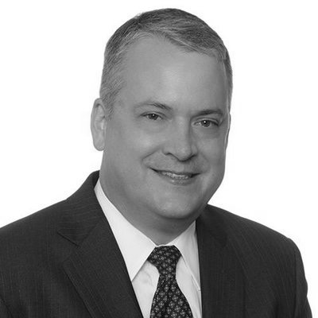
Board of Directors
Will Charnock Chairman | Christian Koch Vice Chairman | Greg Hankins Treasurer | Gabe Cole Executive Director and Secretary
Chris Malayter Board Member | Vinay Nagpal Board Member | Josh Snowhorn Board Member | David Temkin Co-Founder and Board Member

Slide 5
Committees
IXP Standards Committees | Data Center Standards Committee | Marketing Committee | Membership Committee
Matt Griswold Board Liaison and Chair | Eli D. Scher Board Liaison and Chair | Vinay Nagpal Board Member and Chair | Joseph Perez Board Liaison and Chair
Development and Maintenance of Standards for Internet Exchange Points (IXPs) OIX-1 Standard | Development and Maintenance of Standards for Data Centers OIX-2 Standard | Promoting Open-IX in the Community, Working with Certified Companies to Promote Membership | Recruiting and Retaining Members, Membership Management

Slide 6
Certification
Any company can adopt Open-IX standards and apply for certification
Certification signifies implementation and compliance with OIX standards
Provides company the ability to use the certification marks publicly
Provides network operators an easy way to see compliant companies
Companies may choose to be compliant without being certified

Slide 7
Standards
OIX-1 IXP
OIX-2 Data Center
Infrastructure: switching platform, IP space, route server
Standard physical interface
Best practices for traffic forwarding
Clear customer interface demarcation points
Operational: NOC, monitoring, statistics reports
Current peering contact information
Accessible information on public website
Infrastructure: utility feeds, transformers, water sources, network access, MMR, interconnection
Operational: rules, licensing, commissioning, maintenance, operating procedures, change management
Service levels for generator(s), UPS, cooling, interconnect delivery, electrical circuit
Open, non-discriminatory access and pricing
Accessible information on public website

Slide 8
International Certification
Growing demand for neutrality, open service offerings, and infrastructure and operations standards in data centers and IXPs around the world
Current international certified data centers and IXPs
AMS-IX Amsterdam, Amsterdam, NL (OIX-1)
AMS-IX Hong Kong (OIX-1)
Jaguar Network, Marseille, FR (OIX-2)
MIX, Milan, IT (OIX-1)

Slide 9
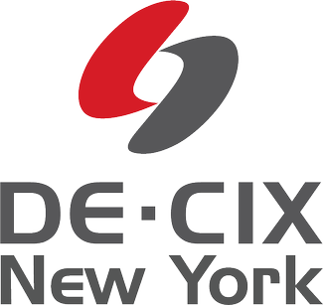
OIX-1 IXP Certifications
AMS-IX Amsterdam Amsterdam, NL | AMS-IX Bay Area San Francisco, CA, US | AMS-IX Chicago Chicago, IL, US | AMS-IX Hong Kong Hong Kong | AMS-IX New York New York, NY, US
DE-CIX New York New York, NY, US | Fl-IX Miami, FL, US | LINX NoVa Ashburn, VA, US | Mass IX Boston, MA, US | MIX Milan, IT
10 IXPs, 6 Companies

Slide 10
OIX-2 Data Center Certifications
Austin, TX, US Cincinnati, OH, US Cincinnati, OH, US Dallas, TX, US Houston, TX, US Phoenix, AZ, US | Richardson, TX, US | New York, NY, US | Dallas, TX, US Los Angeles, CA, US New York, NY, US San Francisco, CA, US | Ashburn, VA, US Chicago, IL, US Piscataway, NJ, US | Houston, TX | Manassas, VA | Marseille, FR
Chicago, IL, US | Phoenix, AZ, US | Atlanta, GA, US Suwanee, GA, US Richmond, VA, US | New York, NY, US | Durham, NC, US Somerset, NJ, US | Santa Clara, CA, US | Garden City, NY, US | Atlanta, GA, US Miami, FL, US
30 Data Centers, 16 Companies

Slide 11
Certifications Global View

Slide 12
Membership
Open to anyone with an interest in interconnection that wants to participate in the future of Internet interconnect
Members benefits
Vote in all Open-IX elections
Nominate and elect the Board of Directors
Serve on volunteer committees
Provide input on certification applications
One class of membership, $50/year

Slide 13
Initiatives for 2016
Several initiatives from Board of Directors and committees planned to grow Open-IX and the global interconnection community
Tactical short term initiatives
Revitalize committees with new members and elect chairs
Streamline operations and infrastructure
Plan 2016 Americas Interconnection Summit (AIS) and Annual General Meeting (AGM)
Strategic long term initiatives
Expand certifications around the world
Redefine and promote value proposition of membership and certifications
Develop new OIX-1 standards for smaller and remote peering IXPs
Develop new OIX-2 standards for smaller and lights out data center
Develop collateral to simplify IXP and data center procurement: educational resources, model RFPs, questionnaires, model contracts

Slide 14
Contact Us
General information: www.open-ix.org
Certification: info@open-ix.org
Board of Directors: board-voting@open-ix.org
OIX-1 IXP Committee: ix-group@open-ix.org
OIX-2 Data Center Committee: dc-group@open-ix.org
Marketing Committee: marketing@open-ix.org
Membership Committee: membership@open-ix.org

Slide 15
Questions?
www.open-ix.org

