Slide 1
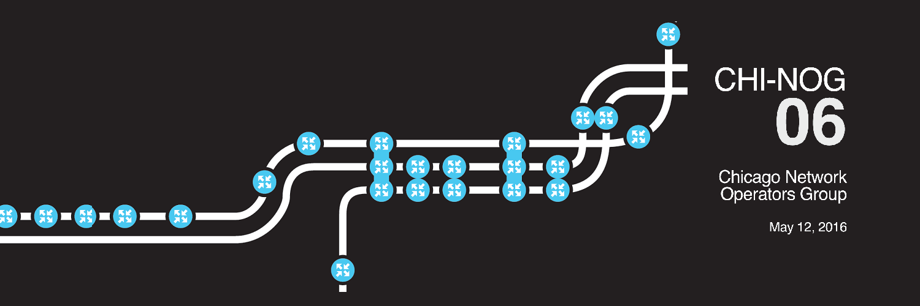
EVPN:
Or how I learned to stop worrying and love the BGP
Tom Dwyer, JNCIE-ENT #424
Clay Haynes, JNCIE-SEC # 69 JNCIE-ENT # 492

Slide 2
So what is EVPN?
EVPN is a VPN technology that provides L2 or integrated L2+L3 VPN.
EVPN uses a control plane methodology ( BGP ) for MAC learning over
traditional data plane methodologies. Learning from the sins of the past.
Minimizes flooding with the use of proxy arp.
Supports an active/active multi-homing with load balancing.
EVPN can use fast convergence for ethernet segment failures.

Slide 3
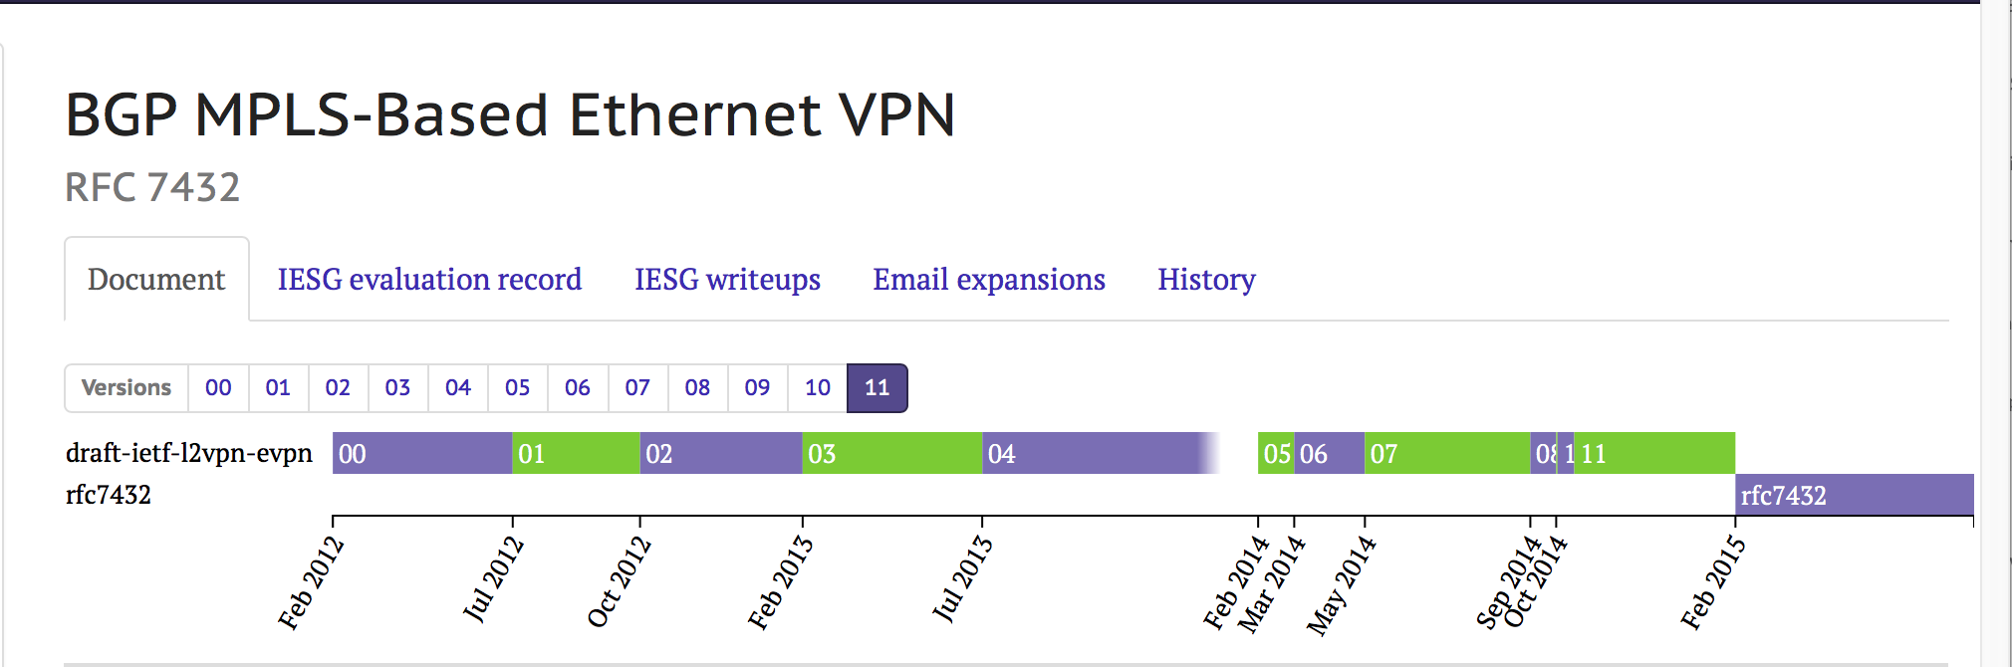
MPLS-Based Ethernet VPN
RFC 7432

Slide 4
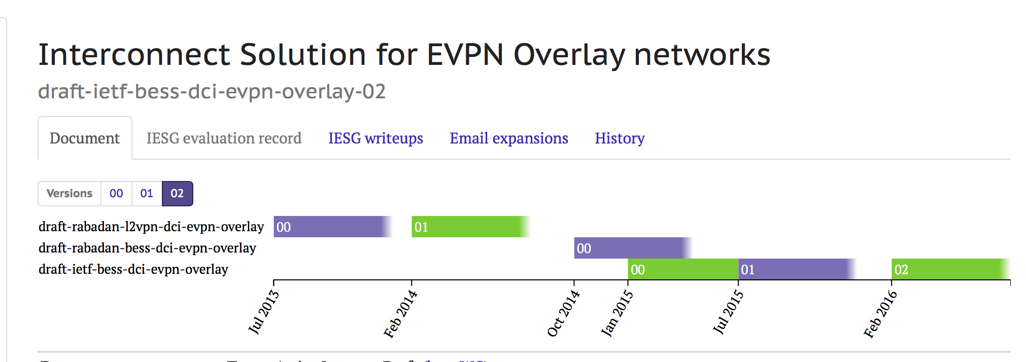
EVPN Overlay ( NVO )

Slide 5
BGP to the rescue
MAC/IP routes are now advertised via the control plane by BGP
( PE to PE ).
We use a new BGP NLRI ( AFI =25 ) and ( SAFI=70)
BGP allows for greater scale ( can use route reflectors )
Supports all active multi-homing
Supports ECMP MAC routes.
Supports Mass withdrawal for segment failure

Slide 6
EVPN Terms
Ethernet Segment : For multi-homed CE’s the set of Ethernet links from the PE’s to the CE’s form
Ethernet Tag = identifier for a broadcast domain. Such as a VLAN. Each PE will map between the different identifiers.
Ethernet Segment Identifier ( ESI) A unique nonzero identifier that represents a Ethernet segment across the network
EVPN Instance ( EVI ) A routing and forwarding instance that spans across all PE routers for that VPN.

Slide 7
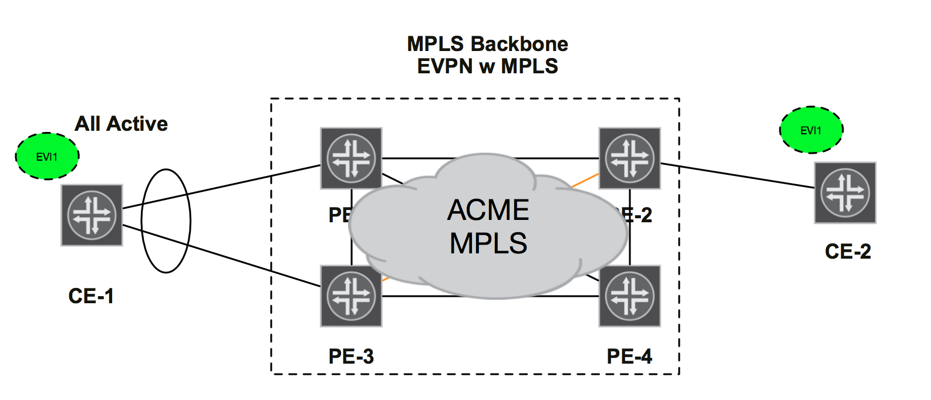
EVPN Sample Topology

Slide 8
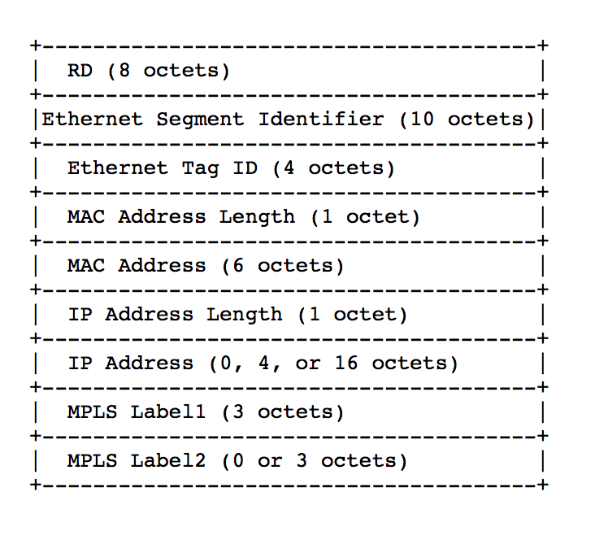
MAC Advertisement
Each PE will learn mac’s from the attached CE via traditional data plane methods.
The MAC address is learned and is now advertised to remote PE’s as a MAC Address Route Type 2 via BGP.

Slide 9
MAC Advertisement
When used with Integrated Routing and Bridging ( IRB ) the MAC address route has an extended community for the Default GW.
PE’s can proxy-ARP
Minimizes flooding across the WAN

Slide 10
MAC Advertisement – Services
Vlan Base Service Interface
Single bridge domain per EVI
1:1 mapping between Vlan ID and EVI
Ethernet tag in route update set to 0
Vlan translation can occur at Egress PE
Label created per EVI
Vlan Aware Bundle
Multiple VLANs
N:1 mapping between Vlan ID and EVI
Ethernet tag in route is set to the tag value
Mutiple bridge domains, one per vlan
Label created per vlan

Slide 11
MAC Advertisement – Services
Vlan Bundle Service Interface
Single bridge domain per EVI
Many –to-one mapping VLAN ID and EVI
Ethernet tag in route update set to 0
MACs unique across VLANs
Vlan translation NOT ALLOWED

Slide 12
EVPN Multi-homing
Single—A CE connected to one PE. No Ethernet segment value is required.
Active-Standby— CE is connected to more than one PE. Only of the PE’s forward traffic from that Ethernet segment. One PE is selected as the Designated Forwarder. This is a redundancy mode. Ethernet Segment Identifier is included with Ethernet Segment route with the ES-Import extended Community. DF election is based on Ethernet Segment Routes.
Active-Active – CE is connected to more than one PE. All the PE routers connected to this CE are allowed to forward to and from that Ethernet segment.

Slide 13
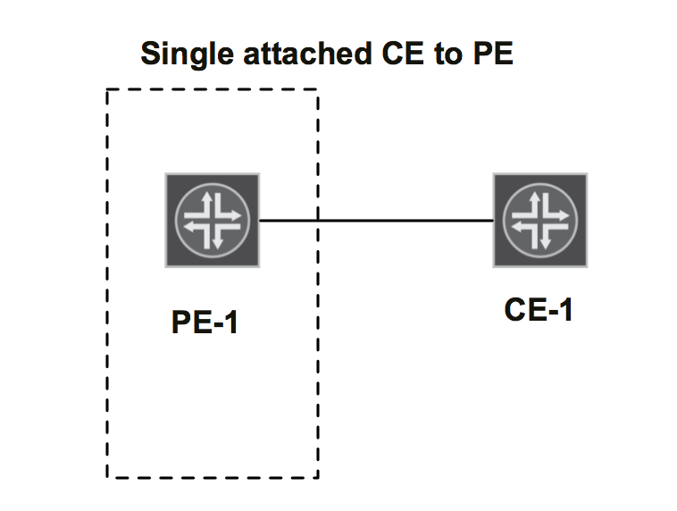
EVPN Multi-homing
Single—A CE connected to one PE. No Ethernet segment value is required.

Slide 14
EVPN Multi-homing
Active-Standby— CE is connected to more than one PE. Only of the PE’s forward traffic from that Ethernet segment. One PE is selected as the Designated Forwarder. This is a redundancy mode.

Slide 15
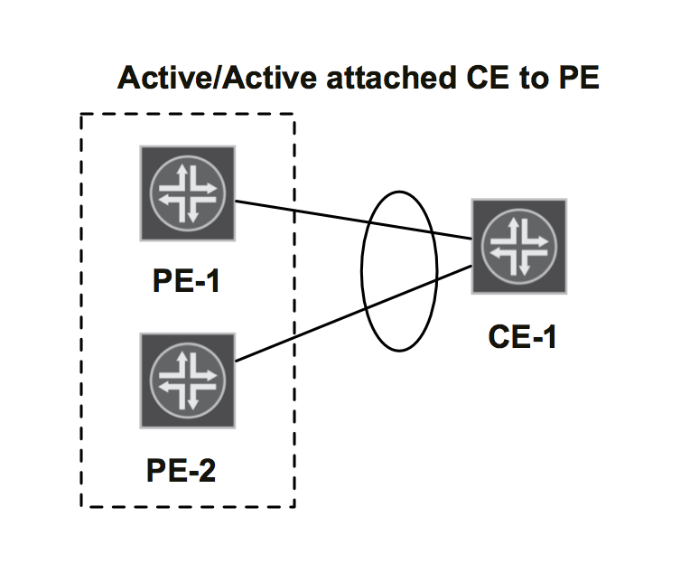
EVPN Multi-homing
Active-Active – CE is connected to more than one PE. All the PE routers connected to this CE are allowed to forward to and from that Ethernet segment. BUM traffic is blocked to the CE from non-DF PE’s

Slide 16
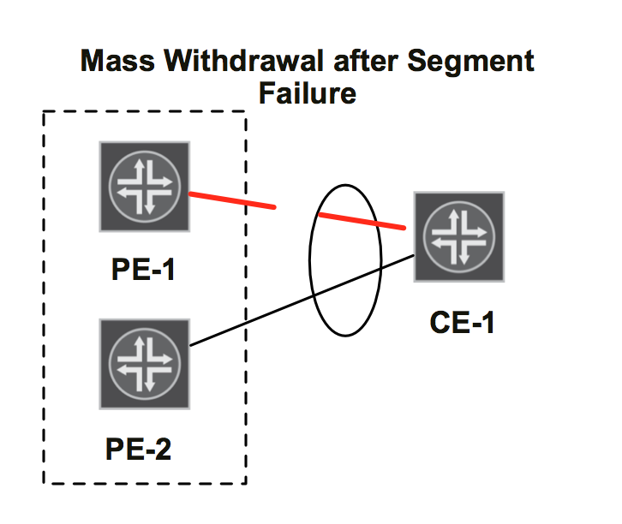
EVPN MAC Mass withdrawal
When an ESI link failure occurs, the PE will withdraw the Auto Discovery route
Next Hops are removed or updated from the associated PEs for MAC/IP routes.
Per ESI and EVI instead of per mac address

Slide 17
Unknowns and ARP
So how do we deal with ARP?
EVPN uses Proxy-ARP. The PE will respond to all arp requests it knows about. Will proxy arp for remote hosts locally.
What if none of the PE’s know about it?
We drop the trafffic. Limiting flooding.
Each PE will learn the MAC or ARP entry before we allow the traffic to pass.

Slide 18
EVPN MAC Mobility
During VMotions the PE may not detect the move and may not withdraw the mac route.
MAC routes have an extended community with a MAC mobility sequence number.
The new PE will see the new mac address being advertised locally and will advertise it with a MAC mobility sequence number.
The remote PE’s will see this advertisement with the higher sequence number and will prune the mac route replacing the old one with the new one.
The original PE will see the new route and will withdraw the old route.

Slide 19
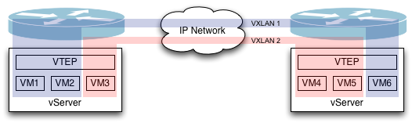

VXLAN : Building blocks
VM₁
VM₂
VM₃
Bridge Domain 1
VNI : 100
Bridge Domain 2
VNI : 200
vSwitch (Virtual Switch)
Virtual Tunnel End Point (VTEP, lo0)
Kernel IP Stack
vServer
24 bits = 16 M VNIs
IP Network
Notes:
19
Technical details:
1- Move from data plane to control plane learning
2- BGP in control plane
3- Concept of ESI. 10 octect globally unique identifier that enables multihoming
4 EVPN advantages apply to all domains
1- Active-Active Multihoming or Load balancing
2- L3 Integration
3- Faster error recovery
4- Finer grain policy control due to BGP
5- VM Mobility

Slide 20
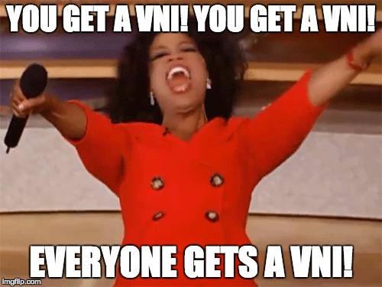

Slide 21

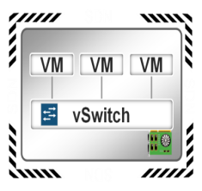

VXLAN – Putting it Together
VTEP: Virtual Tunnel End Point
A
B
Routers
VXLAN tunnels
TOR Switches
A
B
C
D
E
F
Servers
A
B
C
D
E
F
Notes:
Things to highlight – VTEPs are on both servers and network gear alike
LHS shows typical DC clos architecture. RHS shows logical and physical overlay/underlay for the same DC.
A Vrouter maps the overlay to underlay. VTEP tunnel is typically linked to lo0. So you have one VTEP tunnel for many VMs.

Slide 22
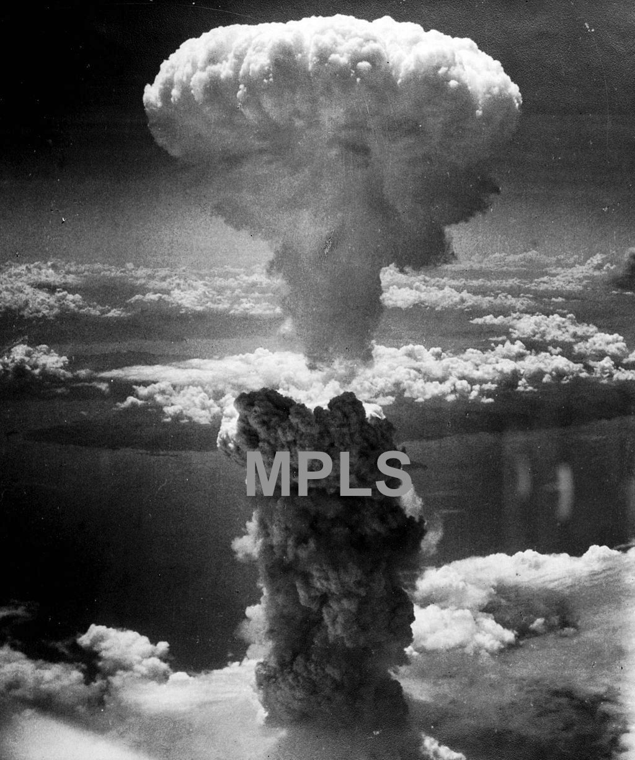
Why VXLAN/EVPN?
Limited hardware specs
GRE hashing across WAN limits
IP Fabrics are becoming more popular
In enterprise, MPLS is really HARD! …Or so they say
National Archives image (208-N-43888)
Notes:
VXLAN in DC:
TORs do not have label processing capabilities. Hence IP is preferred.
MPLS-phobia inside DCs: Cost and (perceived) complexity
VXLAN in WAN:
Source port is hash of 5 tuple. This UDP port is used for load balancing. Extra label pop, i.e entropy label is not needed to load balance for VXLAN
2 use cases; first is OTT and the second is extending SP reach where it does not have presence.

Slide 23
VXLAN Deployment Options
Data plane Based | Control Plane Based
Virtual Networks created using Multicast (PIM) groups. Susceptible to data trombone effects across DC’s | Virtual Networks created using 3rd party controllers Virtual Networks with benefits such as VM traffic optimization
PIM creates fully meshed P2P tunnels for known unicast PIM creates multicast tunnels for L2 BUM | Virtual Network IDs (VNID) communicated using EVPN Fully meshed VXLAN tunnels forward traffic

Slide 24
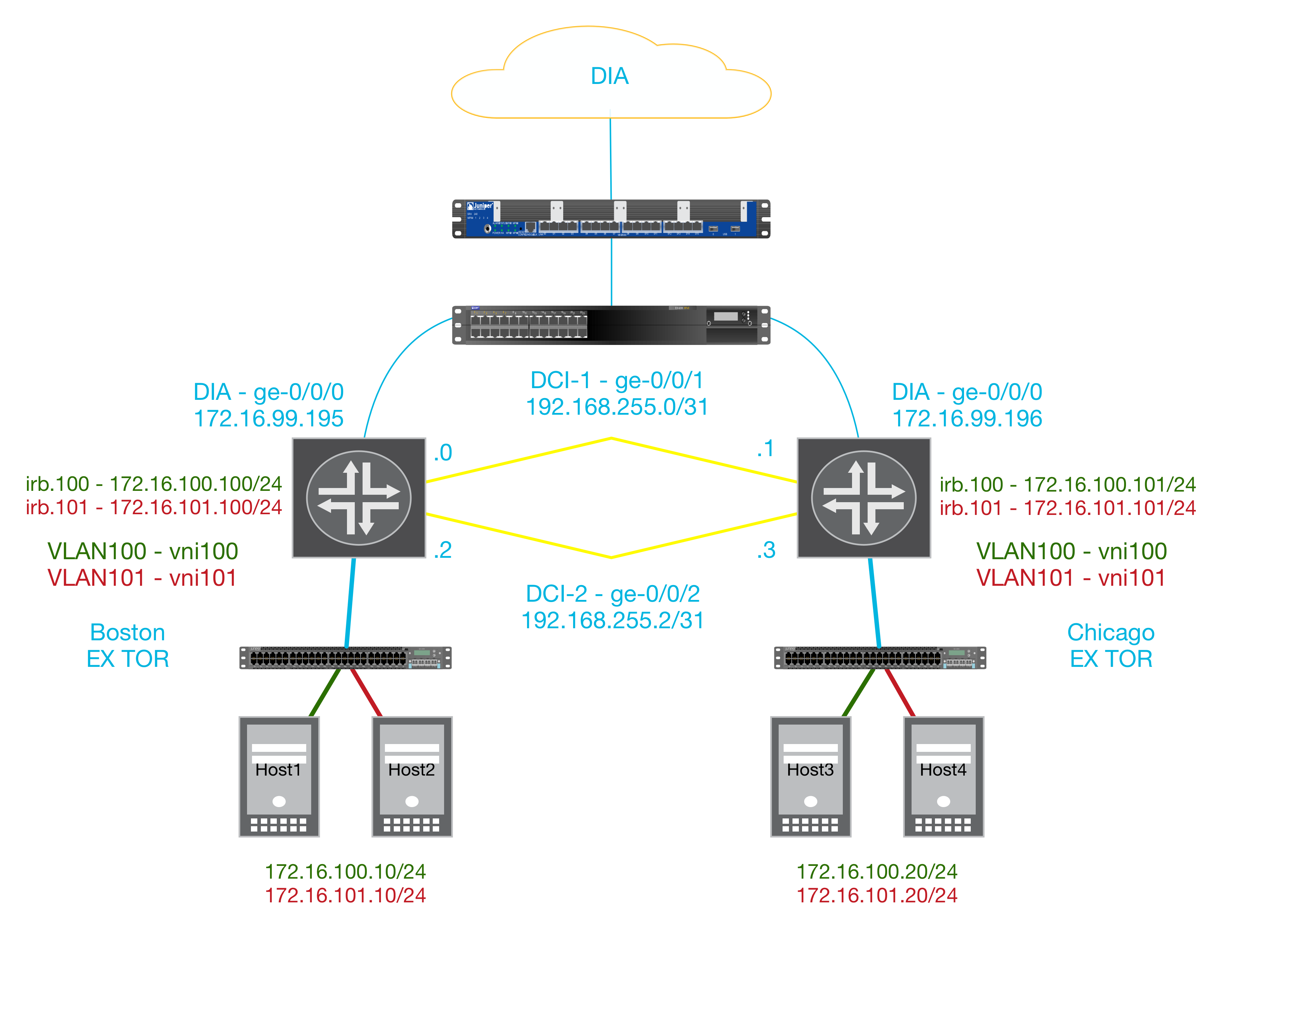
Lab Layout

Slide 25
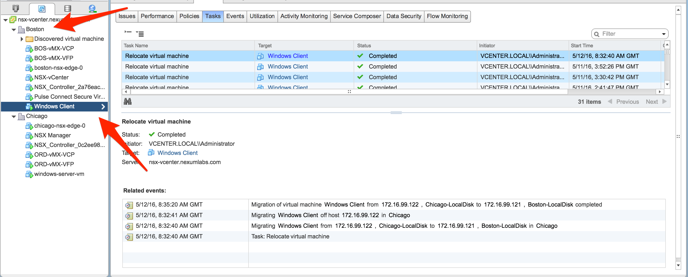

Slide 26
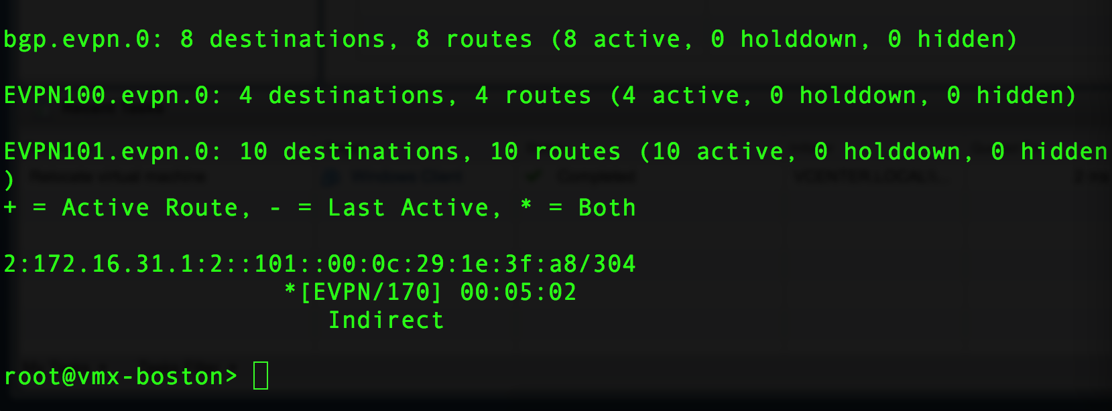
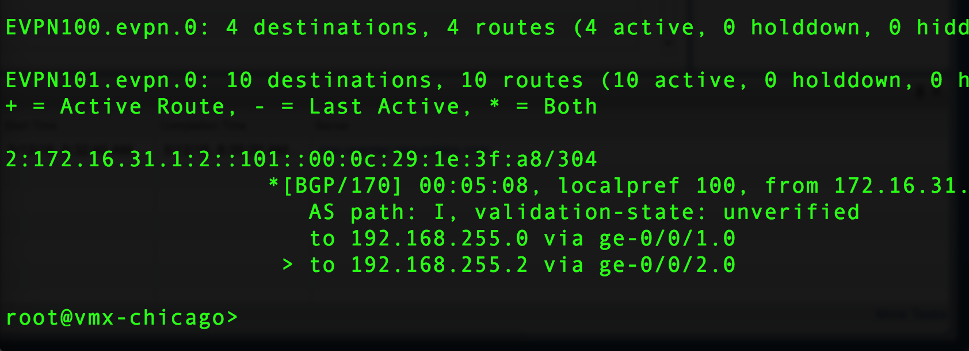
Boston
Chicago

Slide 27
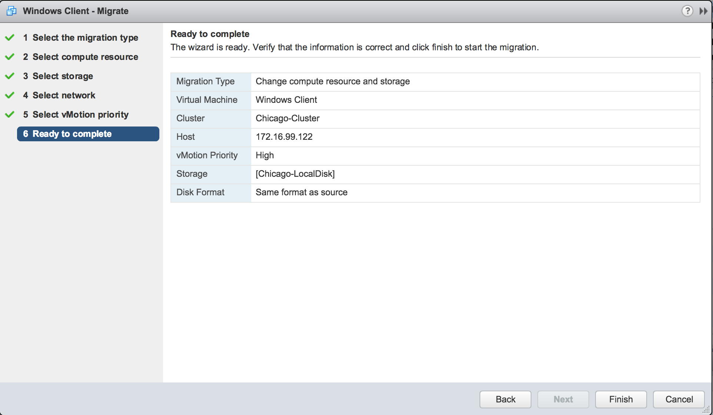

Slide 28
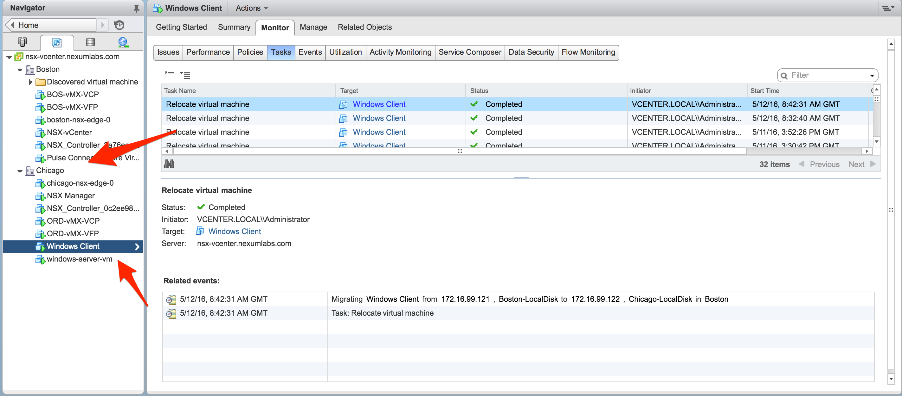

Slide 29
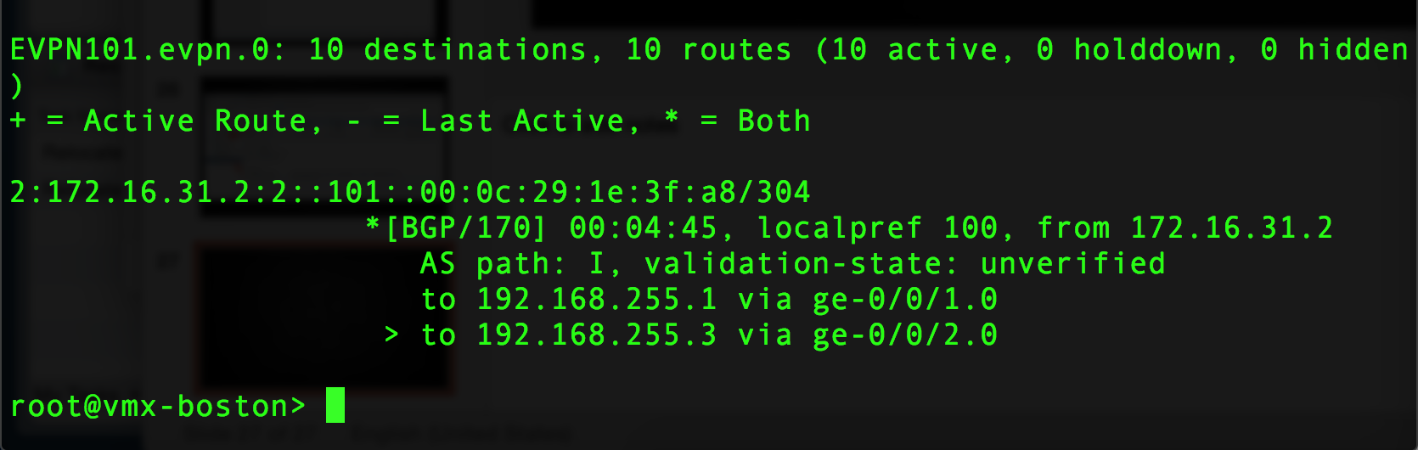
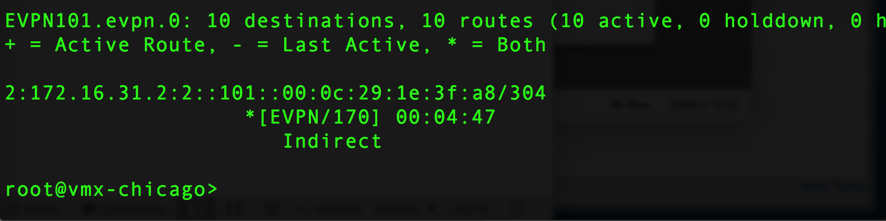
Boston
Chicago

