Slide 1
Welcome and Introduction
Tom Kacprzynski
CHI-NOG Organizer
Notes:
Welcome
Intro Tom Kacprzynski

Slide 2
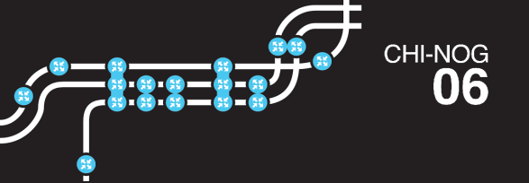
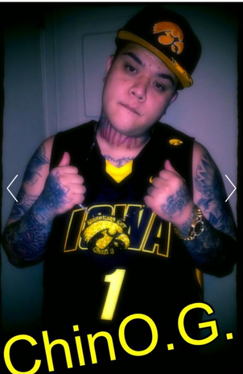
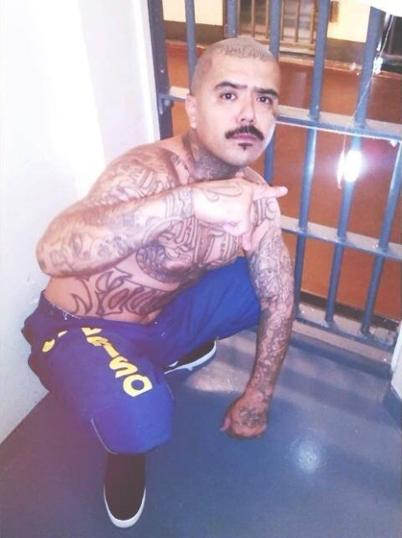
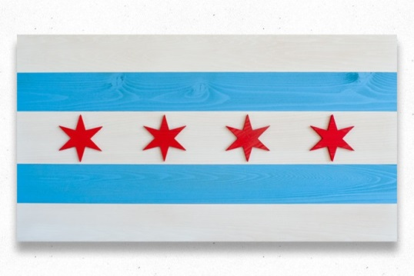
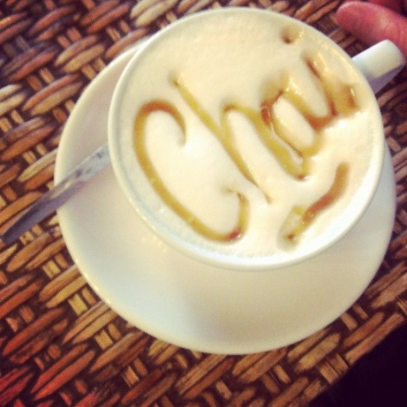
How do you pronounce CHI-NOG?
It’s not like Chai-NOG
Nor is it like the ChinO.G.
CHI-Town
Chino G
Notes:
We have people us ask, how do you actually pronounce that?
These are real rappers. First time we started that’s what you would see when searching for Chinog.

Slide 3
CHI-NOG Background
Started in 2013 as meetups. In 2015 moved to an annual full day event format.
This is our 6th event.
Created by network engineers/architect to establish a technical community in Chicago and the Midwest.
This year, we received an overwhelming response to our call for presentations, thank you to everyone who applied.

Slide 4
CHI-NOG Background
Vendor neutral conference.
The need for regional independent organization.
Directly Inspire:
Boston NOG (BOSNOG)
Indianapolis NOG (Indy-NOG)
New York NOG (NYNOG)

Slide 5
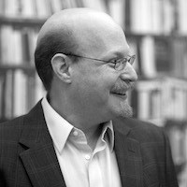
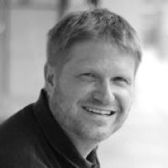
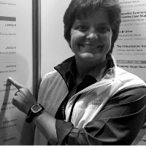
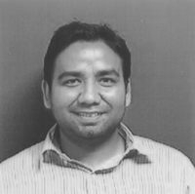
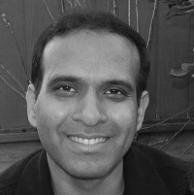
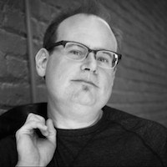
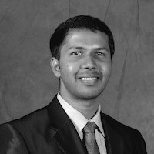
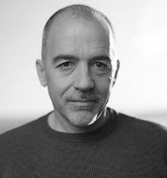
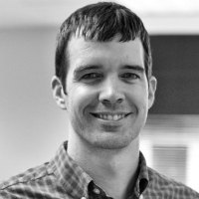
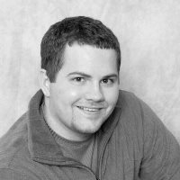
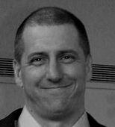
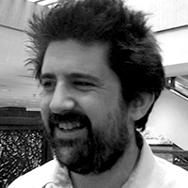
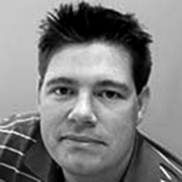
Speakers

Slide 6
Schedule
8:30 – 10:00 Sessions
10:00 – 10:15 Break 1
10:15 – 11:45 Sessions
11:45 – 1:00 Lunch (where?)
1:00 – 2:30 Sessions
2:30 – 2:45 Break 2
2:45 – 3:45 Sessions
3:45 – 4:00 Break 3
4:00 – 5:00 Sessions
5:00 – 7:00 Dinner, social and a giveaways ( where? ).
Meeting Rooms Available

Slide 7
Program Committee
Tom Kacprzynski (Chair)
Brian McGahan
Jason Gooley
http://chinog.org/meetings/chi-nog-06/program-committee/

Slide 8
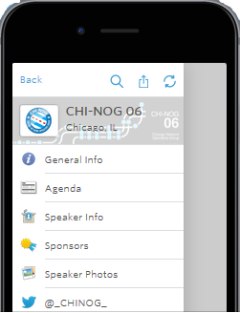
Mobile App
Agenda
Speakers’ info
Presentation Slides
WiFi Access
SSID: PSAV_Event_Solutions
Pass Chinog
Previous Events
Sponsors’ details
Social media check-in
Links to the survey
http://guidebook.com/g/chinog06
chinog.org link.

Slide 9
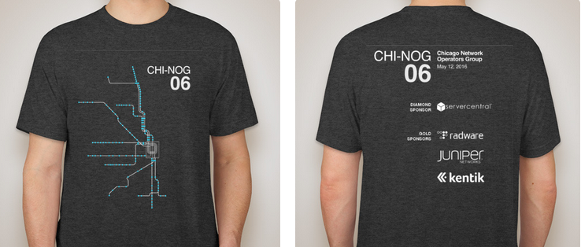
T-Shirt
Special thanks to Jeff Mauricio from ServerCentral for designing the official t-shirt.
Notes:
In case you are wondering, design is based of the Chicago CTA’s train map that interconnects the city.

Slide 10
Sponsors
Diamond
Gold
Notes:
Very gratefully for all of the sponsor’s support of our community. Sponsorship keep the prices low and affordable.
If you see anyone with the sponsors label on the badge, please let them know that you appreciate their support of our community.
ServerCentral (3nd time sponsor, twice Diamond)
Radware (1st)
Juniper (2nd time gold)
Kentik (1st)

Slide 11
Sponsors
Silver
Lunch Break
Break
Notes:
For future conferences, if you think your company would find it valuable to sponsors please contact me.
Nexum (2nd)
Megaport (1st)
AMS-IX (3rd)
Cisco (1st)
1547 (1st)

Slide 12
Special Thanks
Traci Wei and Kenny Brodbeck for event management.
Amy Sesol and the iMPR for the PR work.

Slide 13
Survey and Prizes
To fill out please navigate homepage chinog.org.
Prizes:
Apple Watch - Kentik
$100 Amex Gift Card - Radware
Juniper Backpack with Headphones- Juniper
Logitech Mobile Wireless Stereo Speaker - Nexum
To enter for prizes make sure to fill out your contact info.
Random drawing at the social at 6:45 PM.
Notes:
We learn a lot from these surveys, it helps us shape the direction of the organization, running conferences and the technical content. Appreciate your honest feedback.

Slide 14
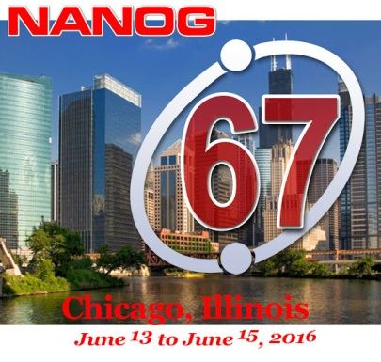
Other Announcements
NANOG 67 coming to Chicago June 13-15. (2nd time hosted here after 13 years).
Internet2 Global Summit hosted in Chicago May 15-18.

Slide 15
Opening Remarks (Diamond Sponsor)
Jordan Lowe
President and CEO of ServerCentral

Slide 16
Thank you

