Slide 1
Welcome and Introduction
Tom Kacprzynski
CHI-NOG Organizer & Program Committee Chair
Notes:
Welcome
Intro Tom Kacprzynski

Slide 2
CHI-NOG Background
Started in 2013 as meetups. In 2015 moved to an annual full day event format.
This is our 7th event.
Vendor neutral conference.
Created by network engineers/architects to establish a technical community in Chicago and the Midwest.
Inspired other regional groups such as NYNOG and BoSNOG.

Slide 3
Slack and Twitter
Launching CHI-NOG Slack. To register to go https://chinog.herokuapp.com
Join the conversation and the community discussing this event, peering, certifications, jobs, outages along with other topics.
Tweet about this event using #chinog07 and help us spread the word. @_CHINOG_

Slide 4
Schedule
8:30-9:00AM | Session 1 | CHI-NOG 07 Welcome + Diamond Sponsor
9:00-9:30AM | Session 2 | Flexible Network Analytics in the Cloud
9:30-10:00AM | Session 3 | Open/R - The joy of packet routing
10:00-10:15AM | Break 1
10:15-10:45AM | Session 4 | Isolario - the real-time Internet routing observatory
10:45-11:20AM | Session 5 | Containers: The new network endpoint
11:20-11:50AM | Session 6 | Multiple Generations of Mobile Backhaul Technologies
12:00-1:30PM | Lunch
1:30-2:30PM | Session 7 | The Latest in Optical Networking
2:30-3:00PM | Session 8 | EDA - Event Driven Automation (Automation 5.0+)
3:00-3:15PM | Break 2
3:15-3:45PM | Session 9 | How to Use Flow Data Enhanced with BGP, Performance, DNS and URLs
3:45-4:15PM | Session 10 | The Hidden Face of The Darknet
4:15-4:30PM | Break 3
4:30-5:00PM | Session 11 | Evolution of The Internet Peering Landscape 2001-2017
5:00-7:00PM | Social

Slide 5
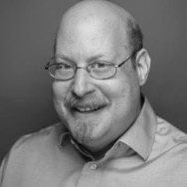
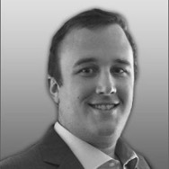
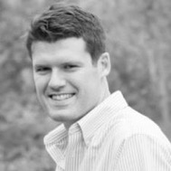
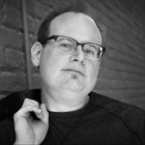
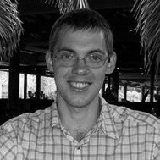
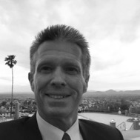
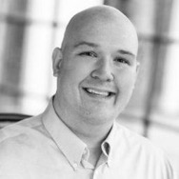
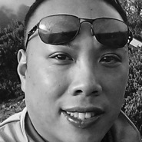
Speakers
Avi Freedman Avi is co-founder and CEO of Kentik. As a leading technologist and executive in networking, Freedman was previously at Akamai for over a decade, as VP of Network Infrastructure and then Chief Network Scientist. Prior to that, Avi started Philadelphia’s first ISP (netaxs) in 1992, later running the network at AboveNet and serving as CTO for ServerCentral.
Daniel Smith Daniel Smith is an information security researcher for Radware’s Emergency Response Team. He focuses on security research and risk analysis for network and application based vulnerabilities. Daniel’s research focuses in on Denial-of-Service attacks and includes analysis of malware and botnets. As a white-hat hacker, his expertise in tools and techniques helps Radware develop signatures and mitigation attacks proactively for its customers.
Jon Langemak Jon has over 10 years of experience designing, building, and maintaining high performance networks. He is passionate about network operations, automation, and open source tooling. His current focus is on disruptive technologies and the impact they have on network operations. Outside of work Jon blogs at dasblinkenlichten.com and is the author of the book ‘Docker Networking Cookbook’. He enjoys collaborating with others in the network community on new ideas and concepts.
Jon M. Dugan Jon is a software developer and a former network engineer at ESnet, the US Department of Energy high performance science network. His professional interests include building tools to help network engineers, network monitoring and visualization, network automation and high performance networking. He is currently a technical lead in the Software Engineering Group at ESnet. After graduating from the University of Illinois (UIUC), he spent the early part of his career as a network engineer at the National Center for Supercomputing Applications (NCSA). He was very active in the joint IEEE/ACM Supercomputing conference series. Dugan is based in Chicago, Illinois. When not working he enjoys cooking, woodworking and tinkering with electronics.
Khalid Samara Khalid is the PC Chair of the Middle East Network Operators Group (MENOG), an international forum dedicated to education and raising awareness of Internet best practices. Khalid is a telecommunications and ISP expert with more than ten years' experience in operational, Internet, mobile, engineering and security technologies. He has practical experience in network planning, network operations management, security and telecommunications policy development. Khalid has served as a Consulting Telecommunications IP and Security Specialist since 2005 and has worked extensively with several telecommunications and ISP operators in the region. Khalid has a wide range of experience and several certificates on this field."
Luca Sani Luca received his B.Sc. and M.Sc. in Computer Engineering from the University of Pisa, respectively in 2008 and 2010. In 2014 received his Ph.D. in Computer Science and Engineering from IMT School for Advanced Studies Lucca. In 2013 he was a visiting researcher at the Computer Science Department of the Colorado State University, working on a BGP monitoring project. Since 2014 he is researcher at with the Institute of Informatics and Telematics (IIT) at the Italian National Research Council (CNR) in Pisa. His research interests are in Internet mapping, monitoring and analysis.
Petr Lapukhov Petr is a network and software engineer at Facebook. Prior to that he worked at Microsoft as a data-center network engineer, and before that he was a CCIE instructor at INE. He is the author of RFC 7938 "Use of BGP for Routing in Large-Scale Data Centers". He holds a master degree in Mathematics and is a 4xCCIE and CCDE.
Phil Matte Phil has a richly decorated and successful history in the Telecommunications and Internet world. He has been a major player as a member of the peering landscape since 2001 when he jumped into it as a National Account Manager with The Palo Alto Internet Exchange (PAIX). In 2003 PAIX was sold to Switch and Data where Phil led the SDFC peering and colocation efforts in aggregate new revenue sales until 2009. Today he is Peering Facilitator for AMS-IX, USA. In this role he facilitates new peering agreements for the AMS-IX, USA exchanges and is expanding their domestic USA footprint. Phil is widely known throughout the global peering community. He is highly respected and recognized as one of the top consultants to NANOG and peering coordinators worldwide.
Richard Steenbergen Richard Steenbergen is co-founder and Chief Technology Officer of PacketFabric, a next-generation Network-as-a-Service interconnection and transport solutions provider. Prior to starting PacketFabric, Richard served as CTO of GTT Communications, a leading global IP/MPLS backbone and Tier 1 network operator in over 80 countries. Richard was also the founder and CTO of nLayer Communications for 11 years, served as a Sr Network Architect for various large NSPs, and served as a Sr Software Engineer helping developed advanced optimized routing techniques. Richard has been attending NANOG since 1999, and is a frequent speaker and contributor.
Vincent Celindro Vincent Celindro has nearly twenty years of experience architecting, managing, deploying, troubleshooting networks and challenging the norm. He spent ten years at Northwestern University, where he was one of the pioneers running a MPLS/VPN network in a university environment. He joined Juniper Networks back in 2011 as a Senior SE, moving into a TLM (Tech Lead Manager) role and currently as a Juniper Architect. Vincent having worked both sides (customer/manufacturer) uses his vast expertise in datacenter, campus environments, wan and global availability to help well-known organizations ranging from Mega/HyperScale datacenters, tier2/tier3 service providers, the largest Colo-facilities globally, Higher Ed, retailers and online gaming companies – architect, maintain and advance their networks to support their respective services today and for the future. Network \R\evolutionist (JNCIE #69/CCIE #8630)
Avi Freedman Daniel Smith Jon Langemak Jon M. Dugan Khalid Samara
Luca Sani Petr Lapukhov Phil Matte Richard Steenbergen Vincent Celindro

Slide 6
Program Committee
Avi Freedman Avi is co-founder and CEO of Kentik. As a leading technologist and executive in networking, Freedman was previously at Akamai for over a decade, as VP of Network Infrastructure and then Chief Network Scientist. Prior to that, Avi started Philadelphia’s first ISP (netaxs) in 1992, later running the network at AboveNet and serving as CTO for ServerCentral.
Daniel Smith Daniel Smith is an information security researcher for Radware’s Emergency Response Team. He focuses on security research and risk analysis for network and application based vulnerabilities. Daniel’s research focuses in on Denial-of-Service attacks and includes analysis of malware and botnets. As a white-hat hacker, his expertise in tools and techniques helps Radware develop signatures and mitigation attacks proactively for its customers.
Jon Langemak Jon has over 10 years of experience designing, building, and maintaining high performance networks. He is passionate about network operations, automation, and open source tooling. His current focus is on disruptive technologies and the impact they have on network operations. Outside of work Jon blogs at dasblinkenlichten.com and is the author of the book ‘Docker Networking Cookbook’. He enjoys collaborating with others in the network community on new ideas and concepts.
Jon M. Dugan Jon is a software developer and a former network engineer at ESnet, the US Department of Energy high performance science network. His professional interests include building tools to help network engineers, network monitoring and visualization, network automation and high performance networking. He is currently a technical lead in the Software Engineering Group at ESnet. After graduating from the University of Illinois (UIUC), he spent the early part of his career as a network engineer at the National Center for Supercomputing Applications (NCSA). He was very active in the joint IEEE/ACM Supercomputing conference series. Dugan is based in Chicago, Illinois. When not working he enjoys cooking, woodworking and tinkering with electronics.
Khalid Samara Khalid is the PC Chair of the Middle East Network Operators Group (MENOG), an international forum dedicated to education and raising awareness of Internet best practices. Khalid is a telecommunications and ISP expert with more than ten years' experience in operational, Internet, mobile, engineering and security technologies. He has practical experience in network planning, network operations management, security and telecommunications policy development. Khalid has served as a Consulting Telecommunications IP and Security Specialist since 2005 and has worked extensively with several telecommunications and ISP operators in the region. Khalid has a wide range of experience and several certificates on this field."
Luca Sani Luca received his B.Sc. and M.Sc. in Computer Engineering from the University of Pisa, respectively in 2008 and 2010. In 2014 received his Ph.D. in Computer Science and Engineering from IMT School for Advanced Studies Lucca. In 2013 he was a visiting researcher at the Computer Science Department of the Colorado State University, working on a BGP monitoring project. Since 2014 he is researcher at with the Institute of Informatics and Telematics (IIT) at the Italian National Research Council (CNR) in Pisa. His research interests are in Internet mapping, monitoring and analysis.
Petr Lapukhov Petr is a network and software engineer at Facebook. Prior to that he worked at Microsoft as a data-center network engineer, and before that he was a CCIE instructor at INE. He is the author of RFC 7938 "Use of BGP for Routing in Large-Scale Data Centers". He holds a master degree in Mathematics and is a 4xCCIE and CCDE.
Phil Matte Phil has a richly decorated and successful history in the Telecommunications and Internet world. He has been a major player as a member of the peering landscape since 2001 when he jumped into it as a National Account Manager with The Palo Alto Internet Exchange (PAIX). In 2003 PAIX was sold to Switch and Data where Phil led the SDFC peering and colocation efforts in aggregate new revenue sales until 2009. Today he is Peering Facilitator for AMS-IX, USA. In this role he facilitates new peering agreements for the AMS-IX, USA exchanges and is expanding their domestic USA footprint. Phil is widely known throughout the global peering community. He is highly respected and recognized as one of the top consultants to NANOG and peering coordinators worldwide.
Richard Steenbergen Richard Steenbergen is co-founder and Chief Technology Officer of PacketFabric, a next-generation Network-as-a-Service interconnection and transport solutions provider. Prior to starting PacketFabric, Richard served as CTO of GTT Communications, a leading global IP/MPLS backbone and Tier 1 network operator in over 80 countries. Richard was also the founder and CTO of nLayer Communications for 11 years, served as a Sr Network Architect for various large NSPs, and served as a Sr Software Engineer helping developed advanced optimized routing techniques. Richard has been attending NANOG since 1999, and is a frequent speaker and contributor.
Vincent Celindro Vincent Celindro has nearly twenty years of experience architecting, managing, deploying, troubleshooting networks and challenging the norm. He spent ten years at Northwestern University, where he was one of the pioneers running a MPLS/VPN network in a university environment. He joined Juniper Networks back in 2011 as a Senior SE, moving into a TLM (Tech Lead Manager) role and currently as a Juniper Architect. Vincent having worked both sides (customer/manufacturer) uses his vast expertise in datacenter, campus environments, wan and global availability to help well-known organizations ranging from Mega/HyperScale datacenters, tier2/tier3 service providers, the largest Colo-facilities globally, Higher Ed, retailers and online gaming companies – architect, maintain and advance their networks to support their respective services today and for the future. Network \R\evolutionist (JNCIE #69/CCIE #8630)
Tom Kacprzynski
Brian McGahan
Jason Gooley

Slide 7
Future Speaker - you?!
Speak at the next CHI-NOG.
Tutorials, industry trends, something cool you’ve learned…
Look out for the next year’s call for presentations.

Slide 8
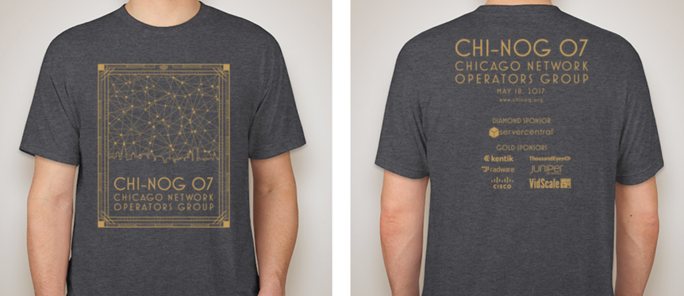
Official T-Shirt
Special thanks to Jeff Mauricio from ServerCentral for designing the official t-shirt (3rd design).

Slide 9
Sponsors
Diamond

Slide 10
Sponsors
Gold

Slide 11
Sponsors
Silver
Break

Slide 12
Raffle and Survey
To fill out please navigate feedback.chinog.org.
To enter for prizes make sure to fill out your contact info.
Random drawing at the social at 6:45 PM. Must be present to win.
Notes:
We learn a lot from these surveys, it helps us shape the direction of the organization, running conferences and the technical content. Appreciate your honest feedback.

Slide 13
Opening Remarks - ServerCentral
Eric Nickla
VP Sales

Slide 14
Questions?
Thank you
Notes:
Questions on the organization, feedback?

