Slide 1
Evolution of The Internet Peering Landscape 2001-2017 @ CHI-NOG7
Phil Matte
Peering Facilitator
AMS-IX, USA
May 18, 2017

Slide 2
I’ve been heavily involved in the Internet Peering landscape (what I call…“The Party”), since 2001 when after 14 years, I left the world of selling PBXs. I started with PAIX and began an immediate immersion into drinking from the proverbial fire hose. I loved it then and I have a passion for it now. I learn new things every single day from my colleagues, but even more from the “NOG”gers of the Internet…the self proclaimed “geeks and nerds” that invented The Net! I find them and “it” all absolutely fascinating. Sorely lacking, albeit improving, is the subsequent evolution of the education of new “NOG”gers. In this brief presentation I’d like to share some of my views and experiences of the ever evolving global peering landscape based on my travels and the incredible organizations I have been a part of. “Peering Product Specific Expert”? I think not, because the landscape changes perpetually and there is no such thing…there is always more to learn. However, I do believe I have a good handle on it based on my familiarity of the history of peering and it’s characters. It is my humble pleasure to present this to CHINOG on my home turf.

Slide 3
Presentation overview
What is this…“Peering”? “The Party!”
What are these…“Internet Exchange Points”? “The Party Venue!”
Who are these…“Peering Coordinators”? “The Guests at The Party”!
What are these…“NOGS and NOGgers”?
Who is this…”Peering Facilitator”? “The Host of The Party”!
What are these…“Data Centers”?
A couple of Fellows of the Peering / IXs niche and their impacts. Jay Adelson, Paul Vixie, Al Avery.
What does the future of Peering hold or look like??
Regional IXs – “The SIX” – Ahead of their time (and a terrific exchange) vs. Today and the many metro IXs globally.
Virtuality and it’s place in the peering world.

Slide 4
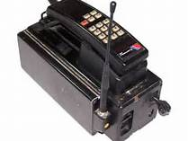
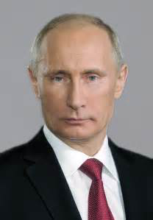
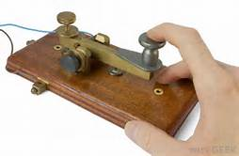
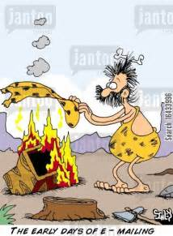
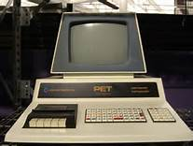
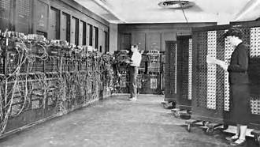
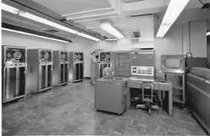
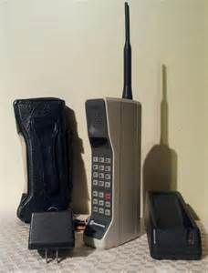
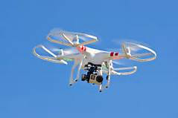
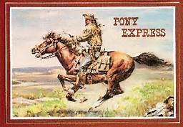
Where do you fit in? Drums, smoke signals, pony express, usps, word of mouth, carrier pigeons, telegraph, telephone, facsimile, television, fedex, super computers, car phones, bricks, cell phones, Internet, desktop computers, laptops, flip phones, smartphones, email, aol, tweets, video conferencing, facetime, texts, snapchat, instagram, fb, linkedIn, google, searches, maps, satellites, drones, Edison, Star Trek, DickTracey, Snowden, Putin, Trump, Hillary... Each of these congers up a different thoughts!

Slide 5
At the core of it all today, there's interconnections and peering...what is this thing called peering?? Huh?? What?? My daughter, “peering” from 13k feet.

Slide 6
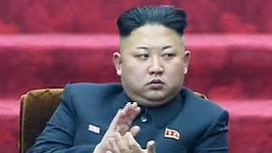
???Peering??? How do you explain it to your family, friends, others?? I present it as… …“The Party”

Slide 7
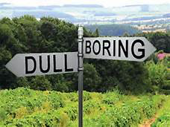
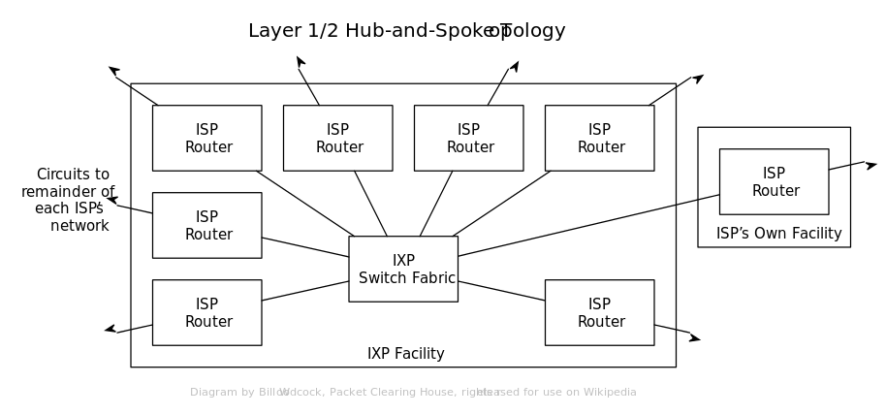
Peering (according to Wikipedia) “…a voluntary interconnection of administratively separate Internet networks for the purpose of exchanging traffic between the users of each network.” (Hmmmm…yeah...boooring...we can do better)

Slide 8
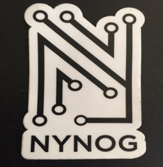
???Peering Coordinators??? “Guests at The Party”. NANOGers ChiNOGers NYNOGers All “NOG”ers Global “NOG”gers created the Internet ‘s global Landscape. Evolution of NANOG organization and it’s players. NANOG 22, Scottsdale, AZ in ‘01 ~560 Attendees 99.999% Engineers / Peering Coordinators (I was there) vs. NANOG 69, Washington, DC in ’17 ~1150 Attendees ~60% Engineers / Peering Coordinators and ~%40 Vendors (I was there) Stay involved!!

Slide 9
???Internet Exchange Point??? ???Peering Internet Exchange??? (according to Wikipedia) “…a physical infrastructure through which Internet service providers (ISPs) and Content Delivery Networks (CDNs) exchange Internet Traffic between their networks (autonomous systems)…” 2001 – Public Exchange Points ~50 vs. today - ~500 Public Exchange Points globally 2001 - “Big Fat Gige” ports @ $14,000/mo vs today - 100Gige ports @ ~$?000/mo Domestic USA $$$ vs Global / European Cumbaya strategies and motives

Slide 10
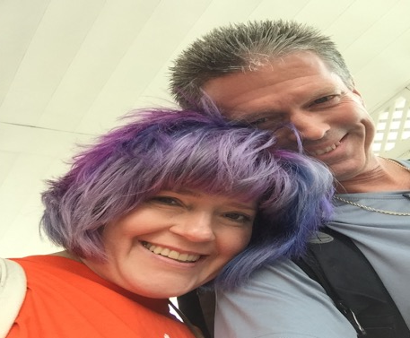
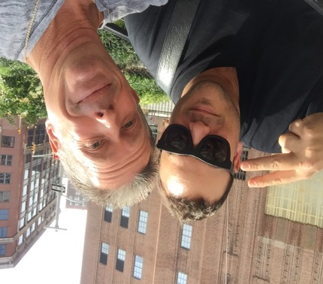
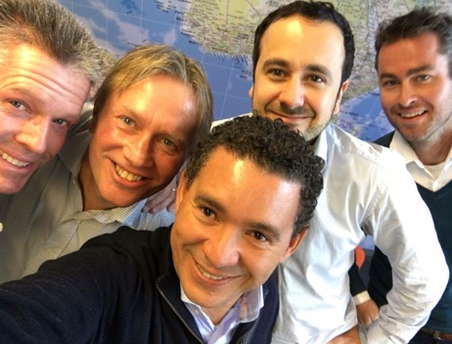
???Peering Facilitator??? “Me” “Host of a party”. Making it “Facile” or “Easy” to peer at ”The Party”. I am not in sales. Peering Coordinators know… ...where they want to peer …when they want to peer at a particular location ...who they want to peer with ...whether they want to peer publicly or privately ...and they know they don’t want to pay for it!

Slide 11
??Data Centers?? “The Party Place” Palo Alto Internet Exchange 529 Bryant Street, Palo Alto If you ever get the chance to see this facility…do! Initial days of IDCs, Ixs, all combined into one that started the evolution of the Domestic / National / Regional / Global, Peering Landscape EQIX Triple reverse split...PAIX wins!!! NOT!!! And then, the subsequent demise of PAIX during the “build it and they will come” mentality that lead to the nuclear winter of 2003. The failure of MFN which lead to the sale of PAIX and opened the door for Equinix to cash in on PAIX loss of traction in the market.

Slide 12
???PAIX??? What did the acronym PAIX stand for after being sold to Switch and Data? Importance to the early days of Internet Peering / Exchange Landscape

Slide 13
Switch and Data, 2003-2009 Peering And Internet Exchange PAIX acquired by SDFC in 2003. PAIX…from Peering organization to being owned by legacy colocation organization and it’s affects on the Internet Peering landscape

Slide 14
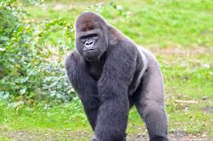
Switch and Data acquired by Equinix in 2009. One of the great business success stories of the Internet Infrastructure Era Partner, customer, reseller and competitor of my current employer, AMS-IX! Now that’s cumbaya! Co-Founders of Equinix were Jay Adelson and Al Avery

Slide 15
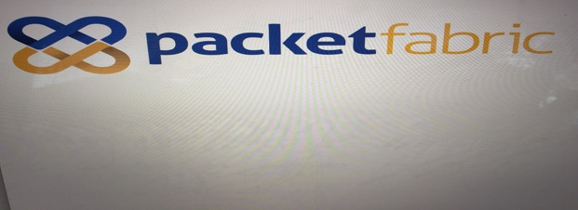
What does the future of peering look like? Virtual Cross Connect affects? Virtual Internet Exchange Affects? Need to continue with… ...SIXs, SF Mixes, United Ixs... …Regional, Domestic 2nd Tier expansions in underserved metros. ...Global Expansions...India, South America, Africa and other underserved markets. Your thoughts?

Slide 16
Phil “peering” from 13k feet.

Slide 17
Thank you very much!

