Slide 1

The Hidden face
of the Darknet
Daniel Smith
Head of ERT Research
© Radware 2016
Notes:
The Hidden Face of the Darknet
Daniel Smith, Head of Research Security at Radware, will walk you through how hackers access the Darknet. A playground for illegal activities, the Darknet includes a large number of marketplaces and forms for hackers who are willing to buy and sell digital attack services. Attend this "virtual visit" and see the different attack services and tools that can be purchased. Afterward, a large customer will share his experience the security of his company’s infrastructure.

Slide 2

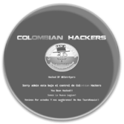




Emergency Response Team (ERT)
Protecting against top attack campaigns
24x7 dedicated team of security experts for fast mitigation under attack

Slide 3


What is the Darknet
How to access the Darknet
What can you find
What can you buy
Why hackers use the Darknet

Slide 4



What is the Darknet?
Overlay network
Private and encrypted
Requires specific tools
Origins
1970, Isolated network
from ARPANET
Uses
Email and social media
Hosting and file sharing
News and Media
E-Commerce

Slide 5
What is the Darknet
How to access the Darknet
What can you find
What can you buy
Why hackers use the Darknet

Slide 6

How to access the Darknet?
 | TOR | I2P
Software | The Onion Router | Invisible Internet Project
Two Dark-net Types | Anonymity | Friend-to-Friend
Uses | Privacy / Hidden Services | File sharing

Slide 7

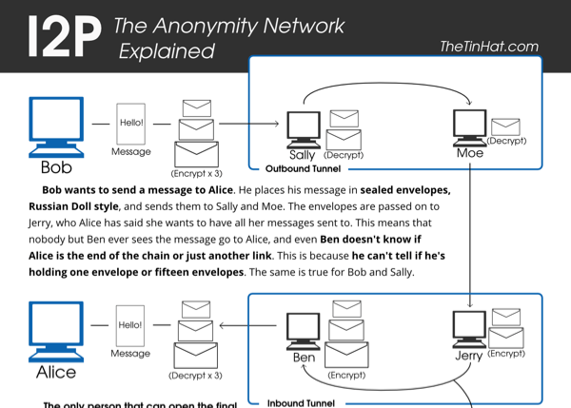
Type of Darknet – Friend-to-Friend – I2P
Data encapsulated in layers
of encryption
Bundling multiple messages together
Unidirectional tunnels

Slide 8


Type of Darknet – Anonymity - Tor
Data encapsulated in layers
of encryption
Each layer reveals the
next relay
Final layer sends data
to destination
Bi-Directional
Message
Destination
Router C
Router B
Router A
Source

Slide 9
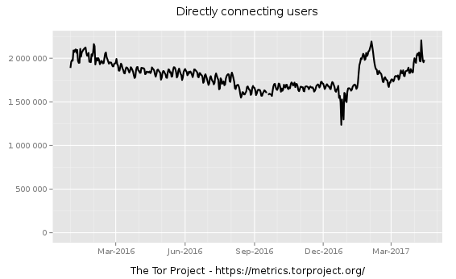
Metrics
Around 1.5 - 2 million relay users per day
United States has the most daily users
Just under 100,00 bridge users per day
Spikes of usage show possible censorship

Slide 10
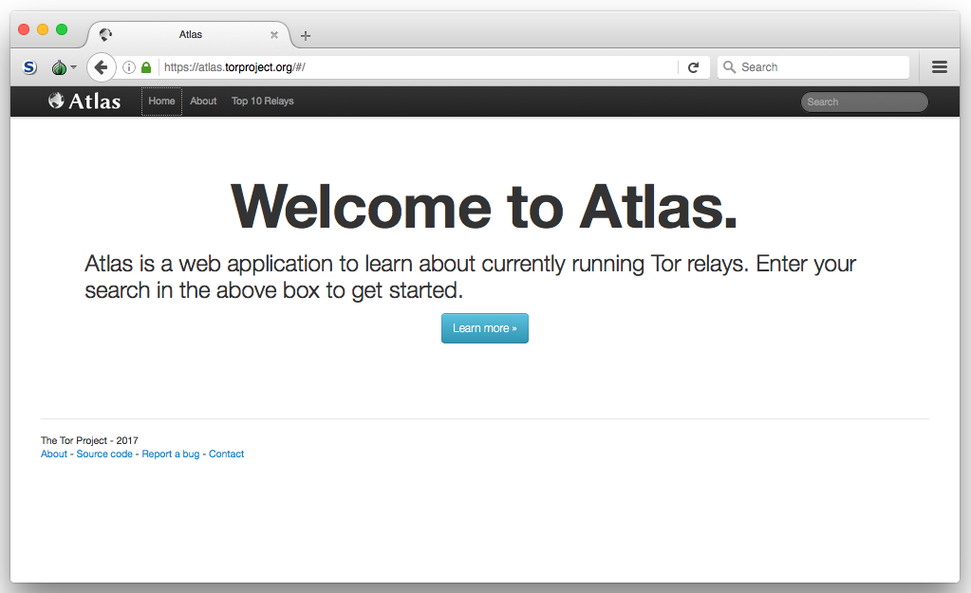
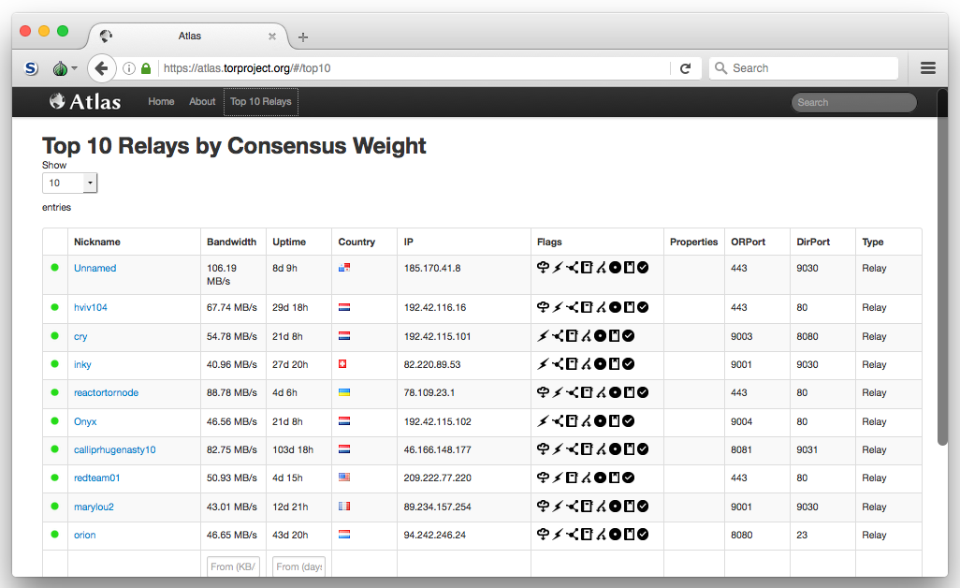
Atlas
Learn about current running Tor Relays
Atlas.torproject.org

Slide 11
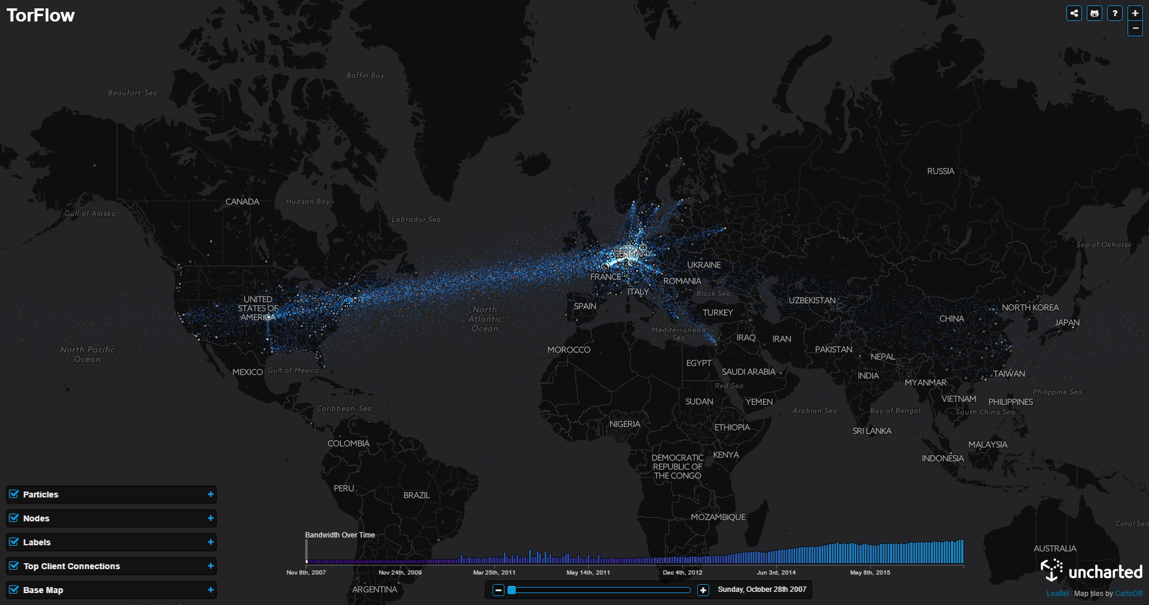
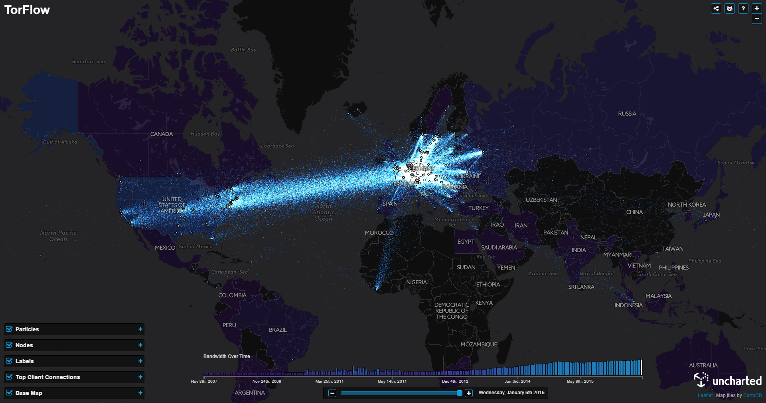

Slide 12
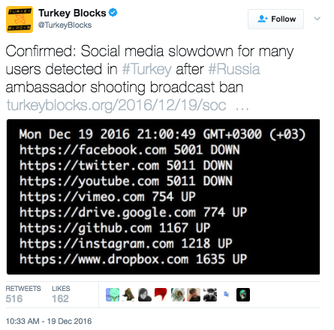
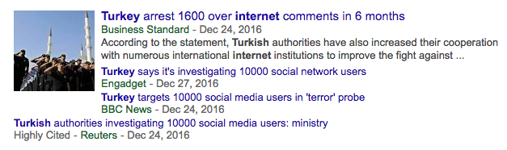
Censorship – Turkey
December 2016 Turkey begins censoring the internet
Sites like Facebook, Twitter and YouTube blocked
Arrest over comments on the internet
Spike in Tor relay users follow

Slide 13
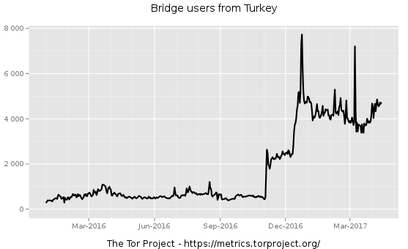
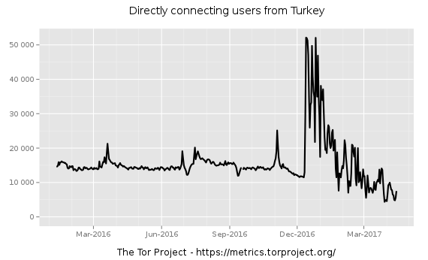

Slide 14
What is the Darknet
How to access the Darknet
What can you find
What can you buy
Why hackers use the Darknet

Slide 15





What can you find on the Darknet?
Almost anything that you can find on the clearnet
Email services
Hosting service
Forums
News sites
E-commerce

Slide 16
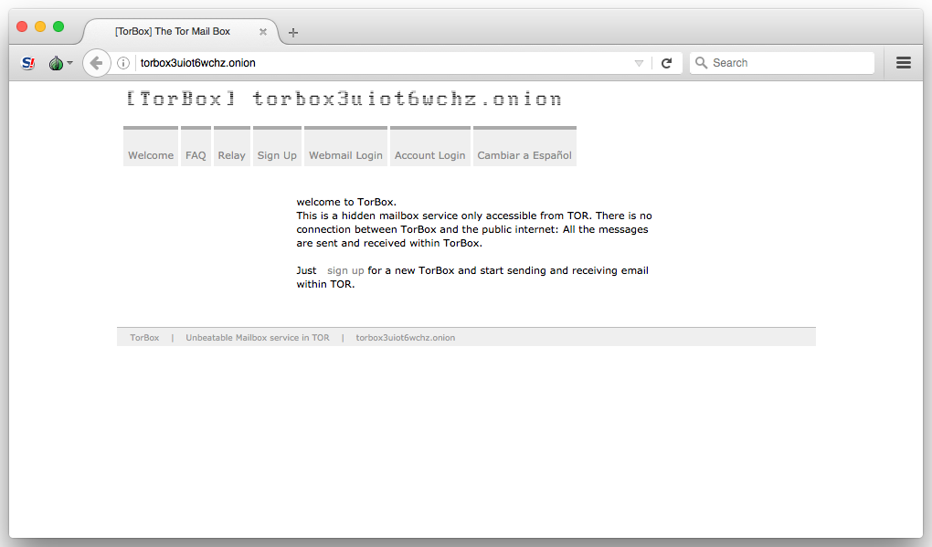
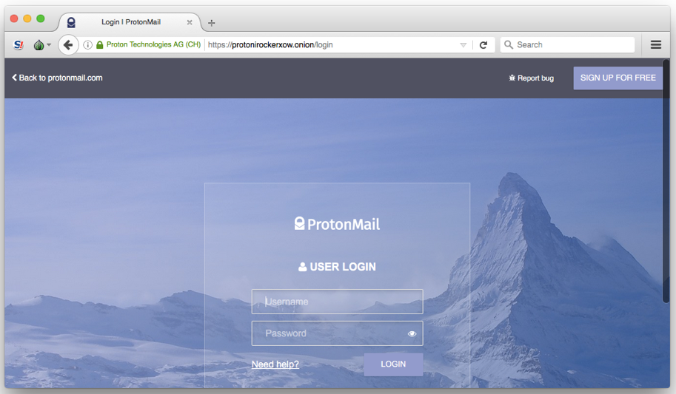
Email Services
Tor adds an additional layer of security
Combats Censorship and Surveillance
Options
  Tor only services
  Clearnet services with hidden service option

Slide 17
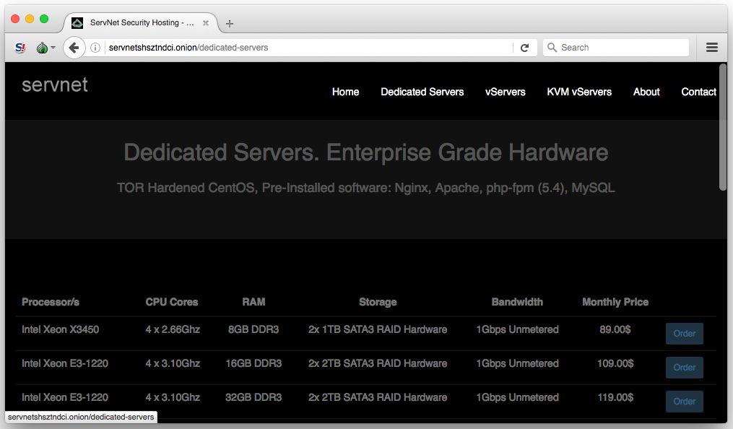
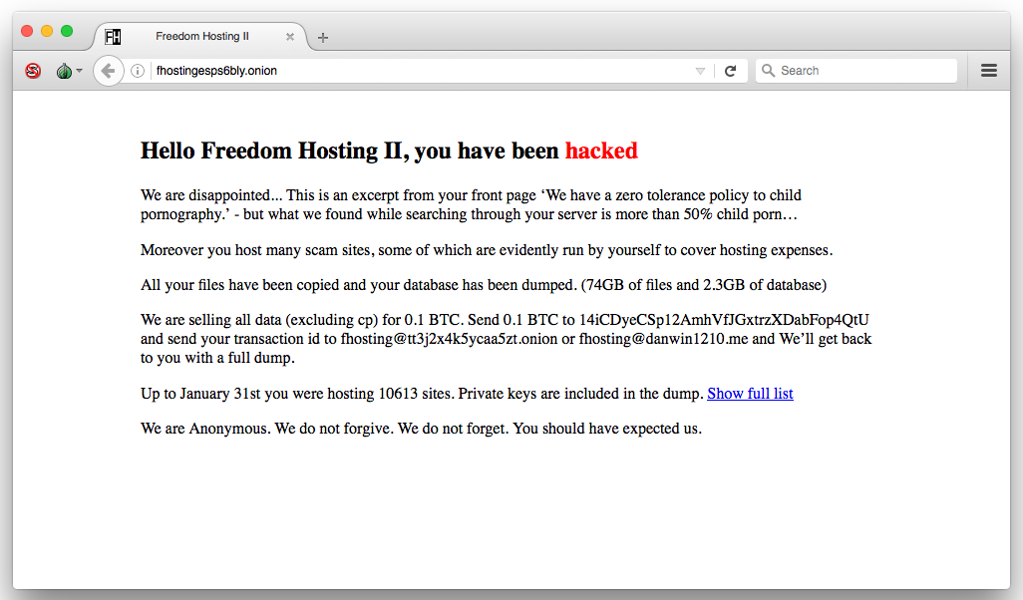
Hosting Services
Risk Analysis / Trust
High-Privacy hosting
  Bulletproof / Offshore
Freedom Hosting II
Option
  Self host on a VPS

Slide 18
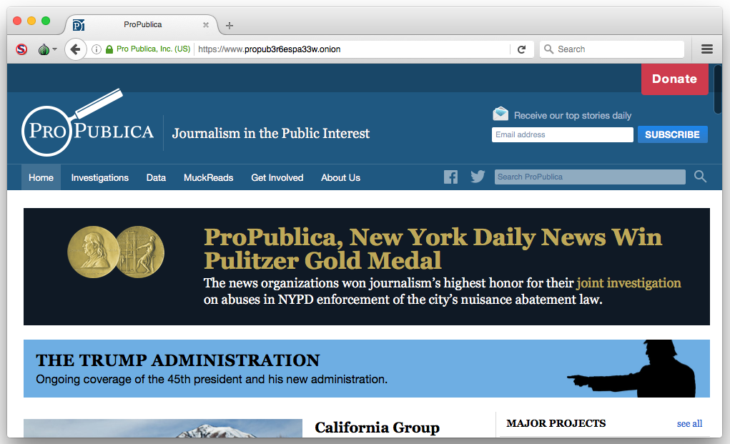
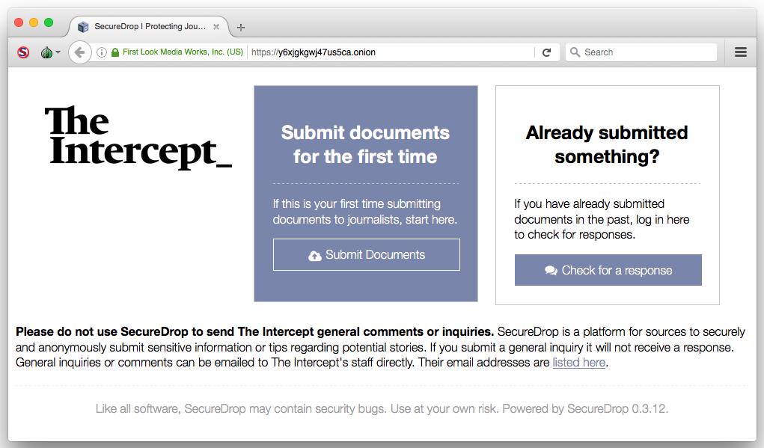
News
Mirrored news services
Combats Censorship and Surveillance
Securely submit information

Slide 19
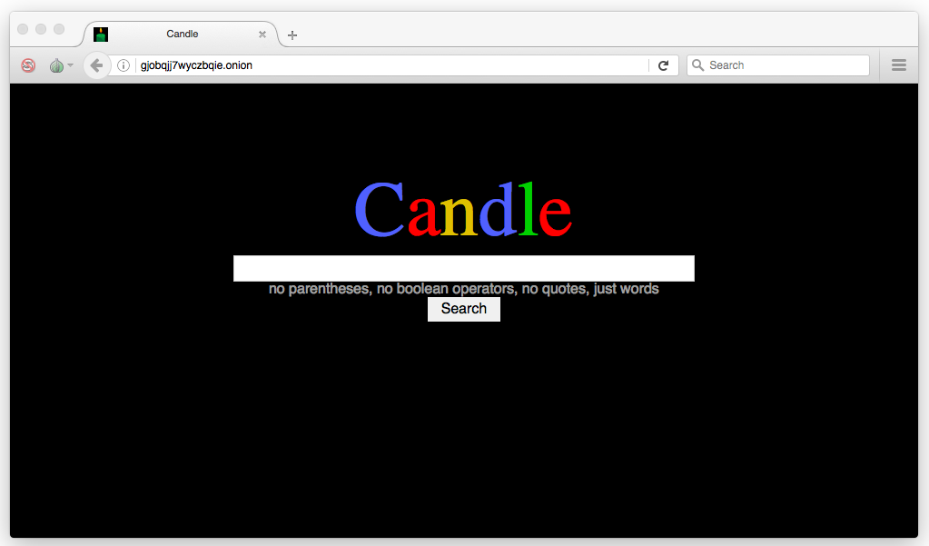
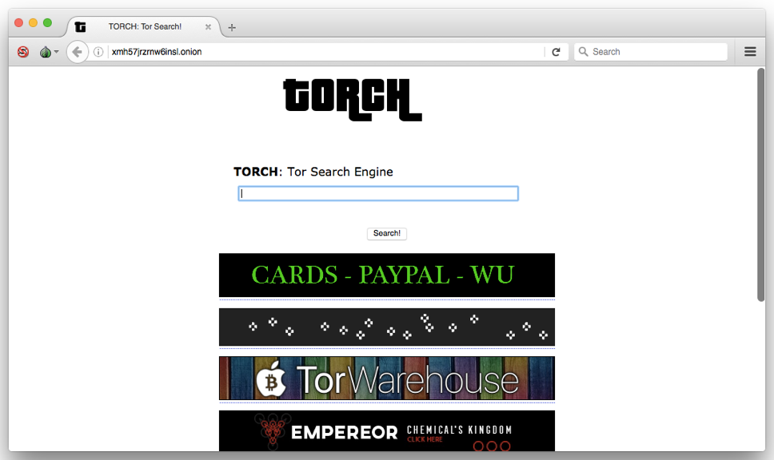
Search Engine
Indexed .onion sites
Easier to search for Hidden Services

Slide 20
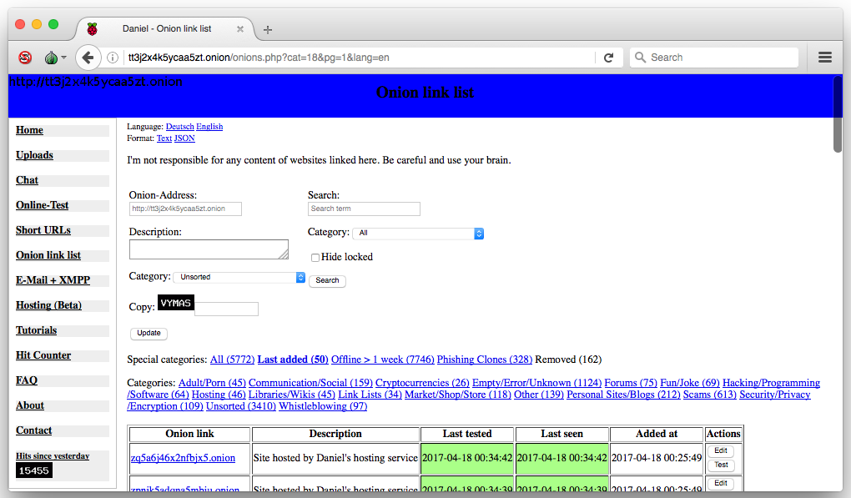
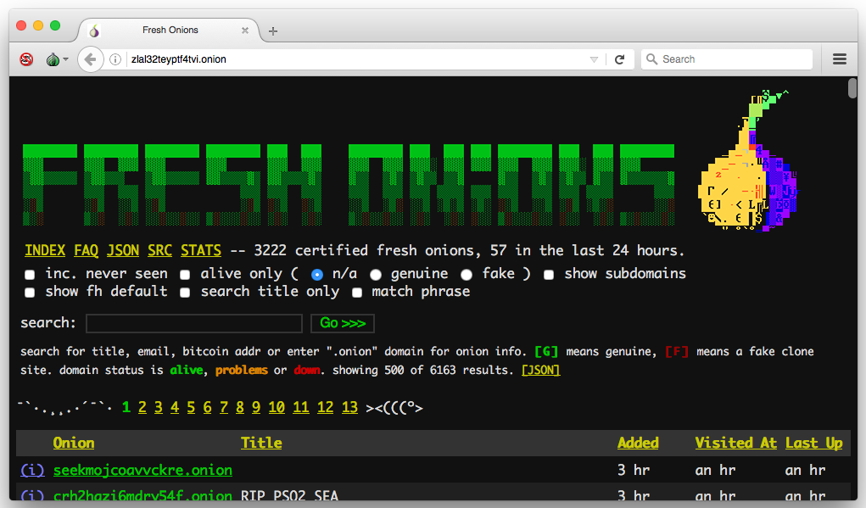
Link List
Hidden Services that list fresh .onion’s

Slide 21
What is the Darknet
How to access the Darknet
What can you find
What can you buy
Why hackers use the Darknet

Slide 22
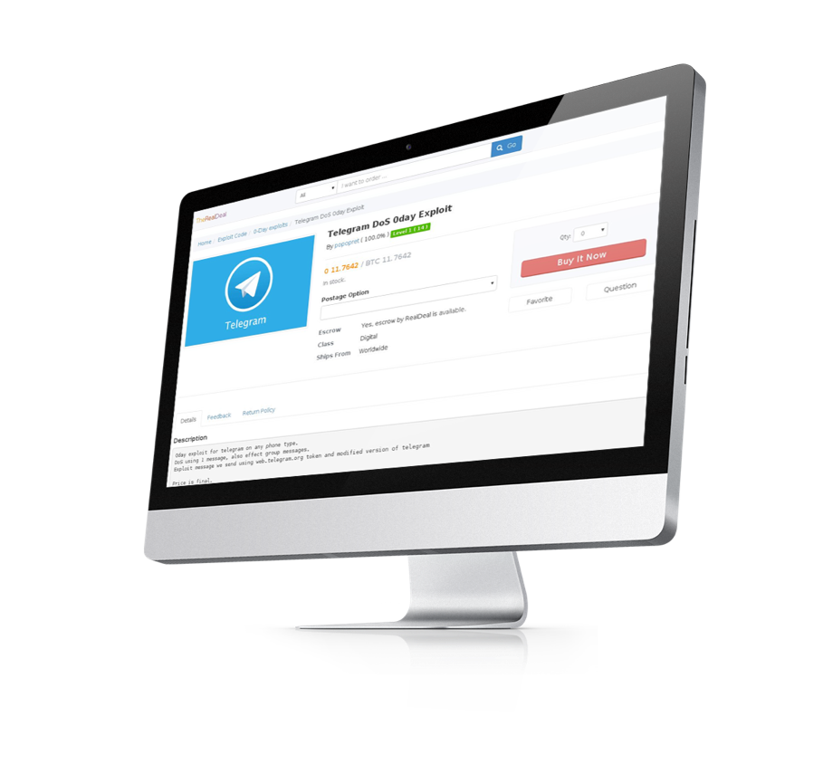
What can you buy on the Darknet?
Items found in the marketplace include:
  DDoS as a Service
  Botnet Rental
  Malware/Ransomware
  Security/Hosting
  Undisclosed Exploits
  Leaked Data / Fraud

Slide 23
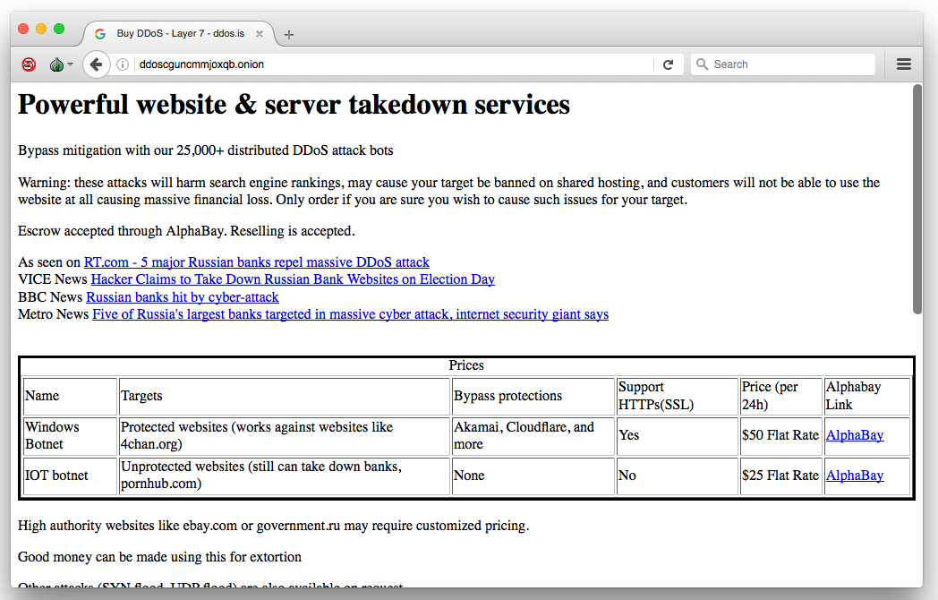
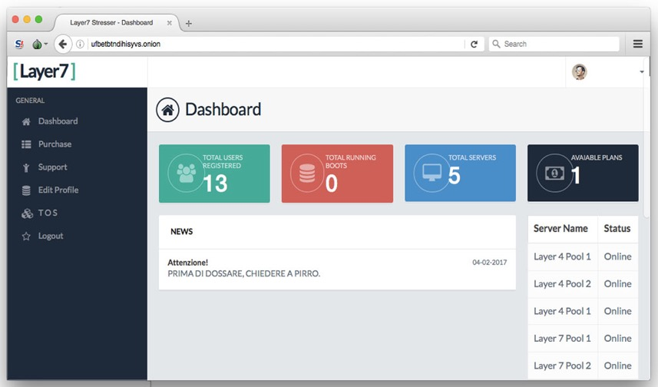
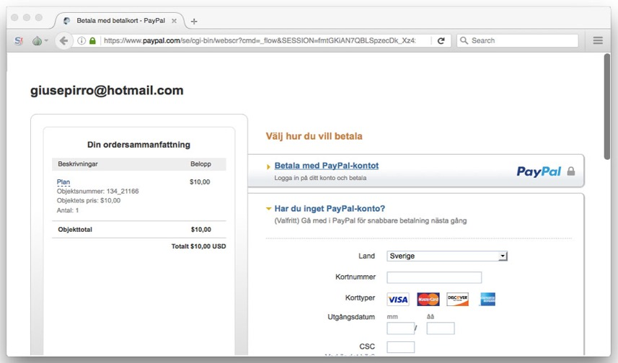
DDoS as a Service
Developing industry
  Lucrative
Services sold in marketplaces or on private hidden services
Recent growth in stresser services on the Darknet
Attackers are using Tor to mask their origin

Slide 24
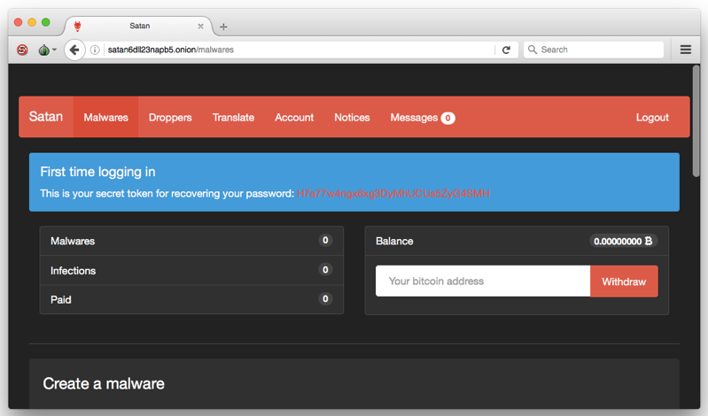
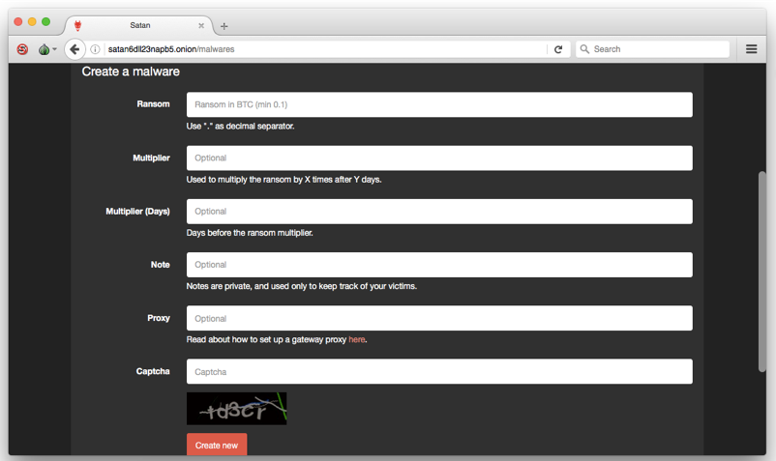
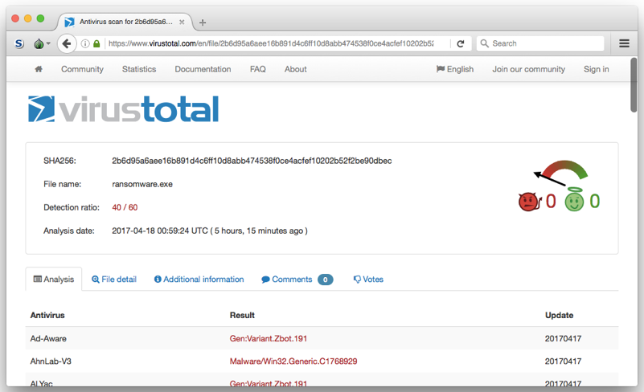
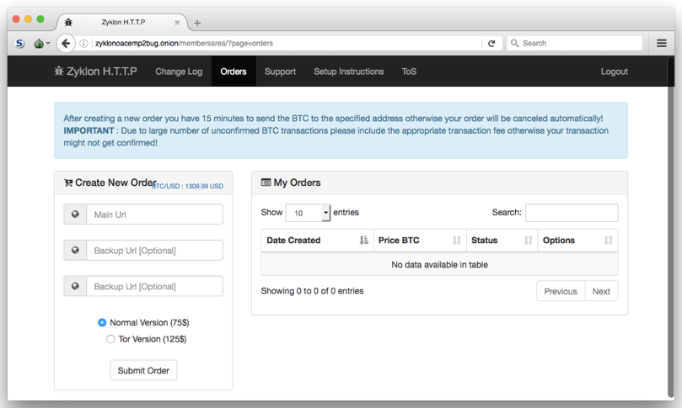
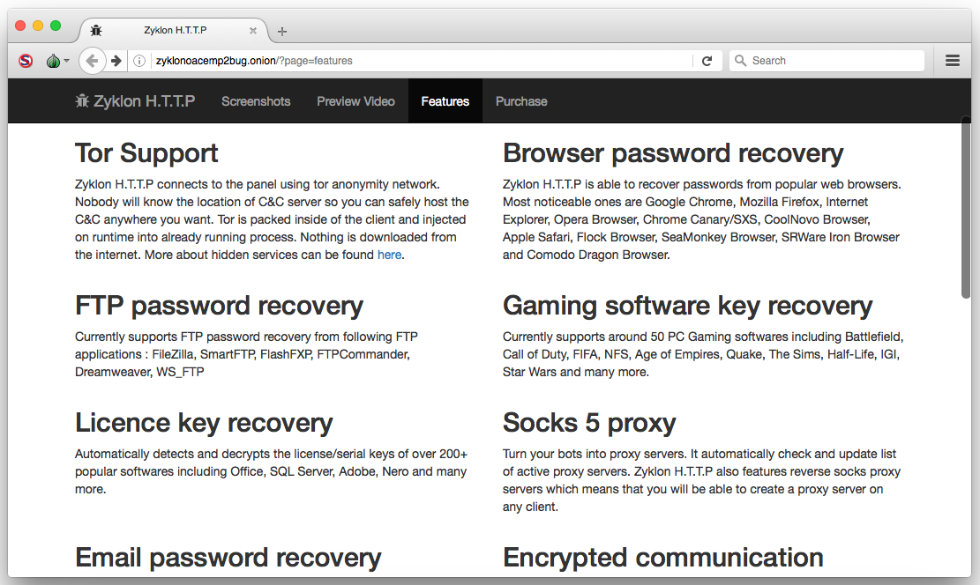
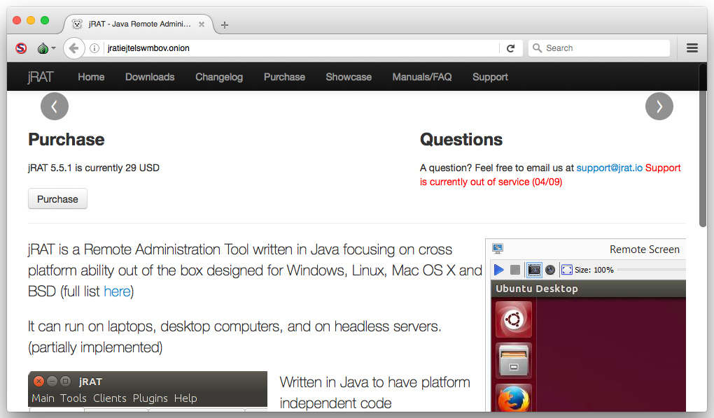
Malware / Ransomware
Ransomware as a Service
Sold in Marketplaces
Other malware is also available
jRAT sells for $29 dollars
  or you can download educational RATs on Github..

Slide 25
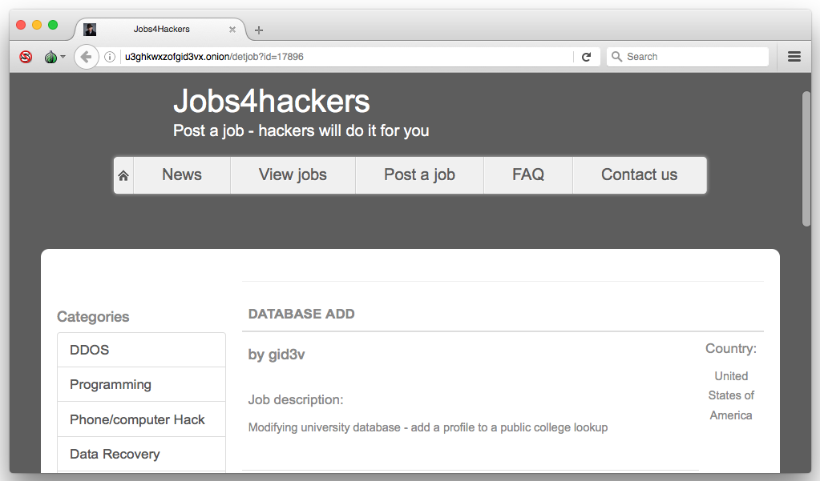
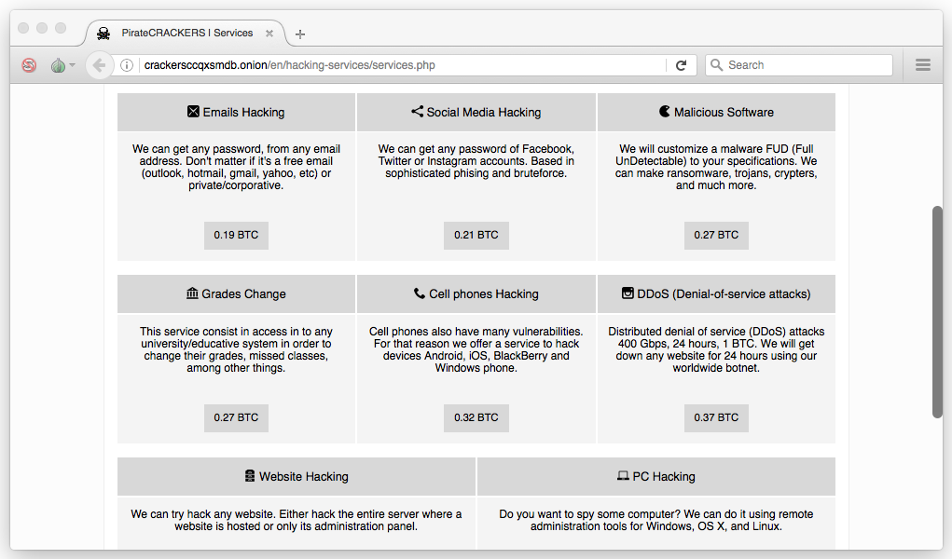
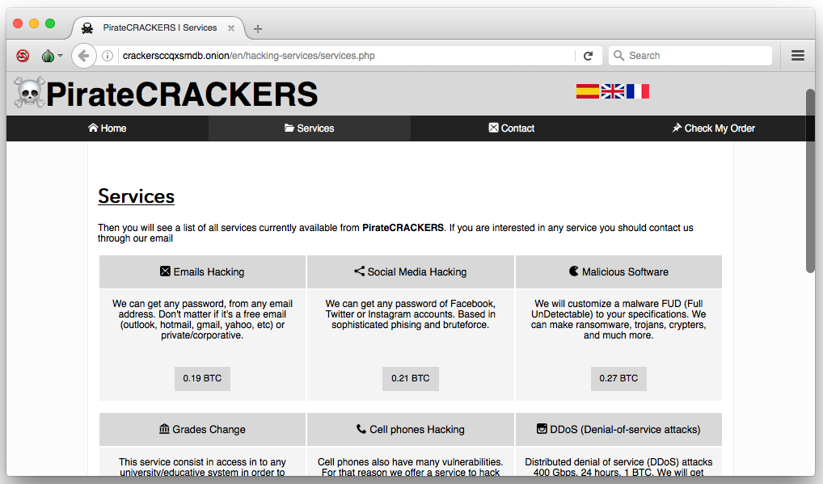
Services
Direct from Vendor
Wide range of services

Slide 26
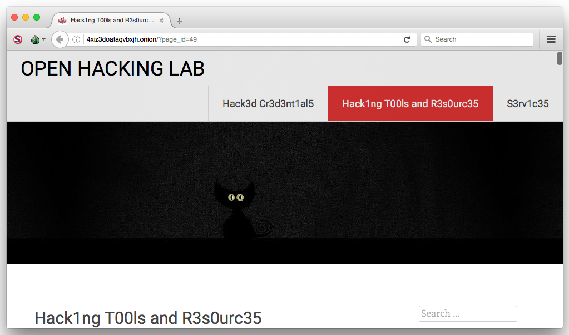
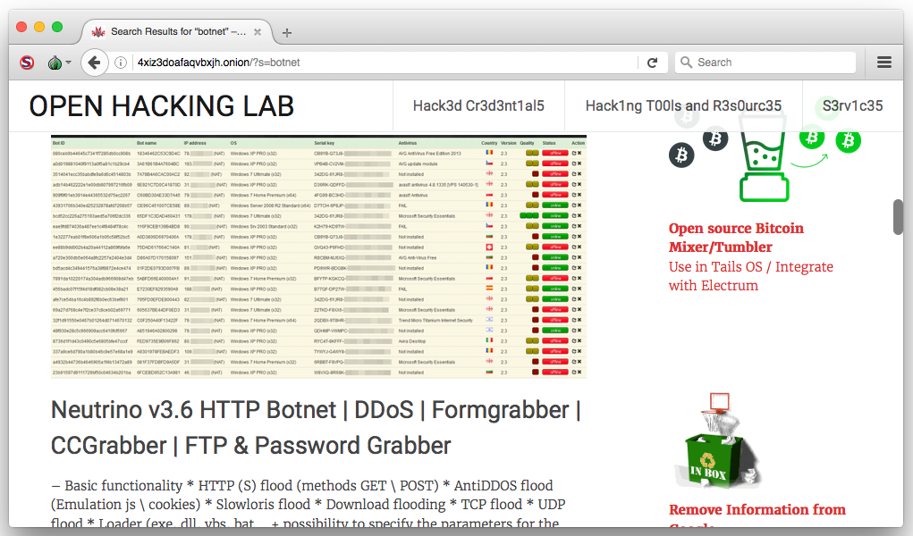
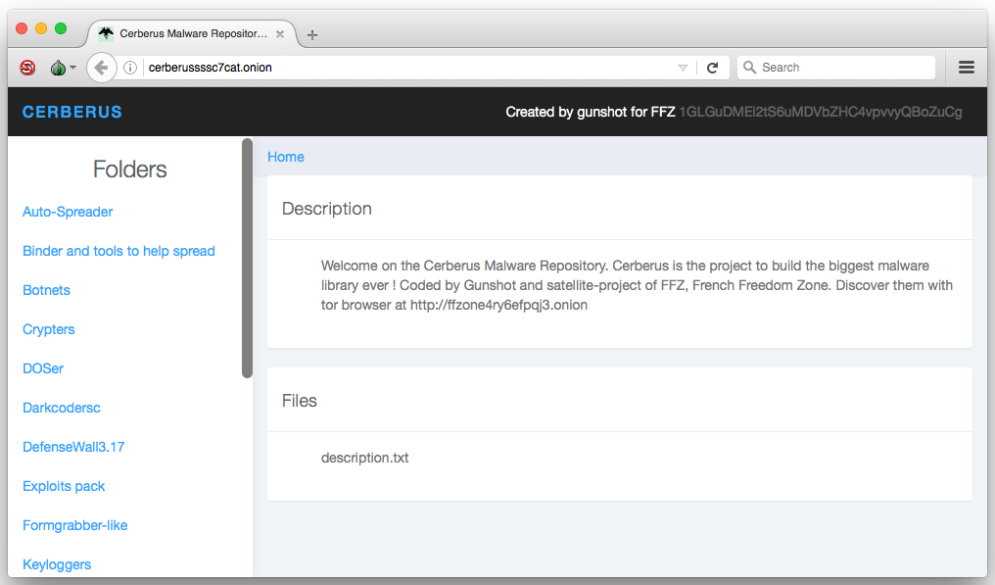
Free
Open Hacking Lab
Cerberus (FFZ)

Slide 27
What is the Darknet
How to access the Darknet
What can you find
What can you buy
Why hackers use the Darknet

Slide 28

Marketplace of Choice
Variety of marketplaces available on the Darknet:
  The Majestic Garden
  Valhalla
  Dream Market
  AlphaBay
  DHL
  Hansa
  More...
One click shopping experience

Slide 29

Why hackers use the Darknet?
Hackers do not only rely on the Darknet.
It is just one of many tools at their disposal.
Benifits of the Darknet to an attacker:
  Privacy
  Obfuscation
  Opportunity

Slide 30
Thank You
www.radware.com
security.radware.com
© Radware 2016

