Slide 1
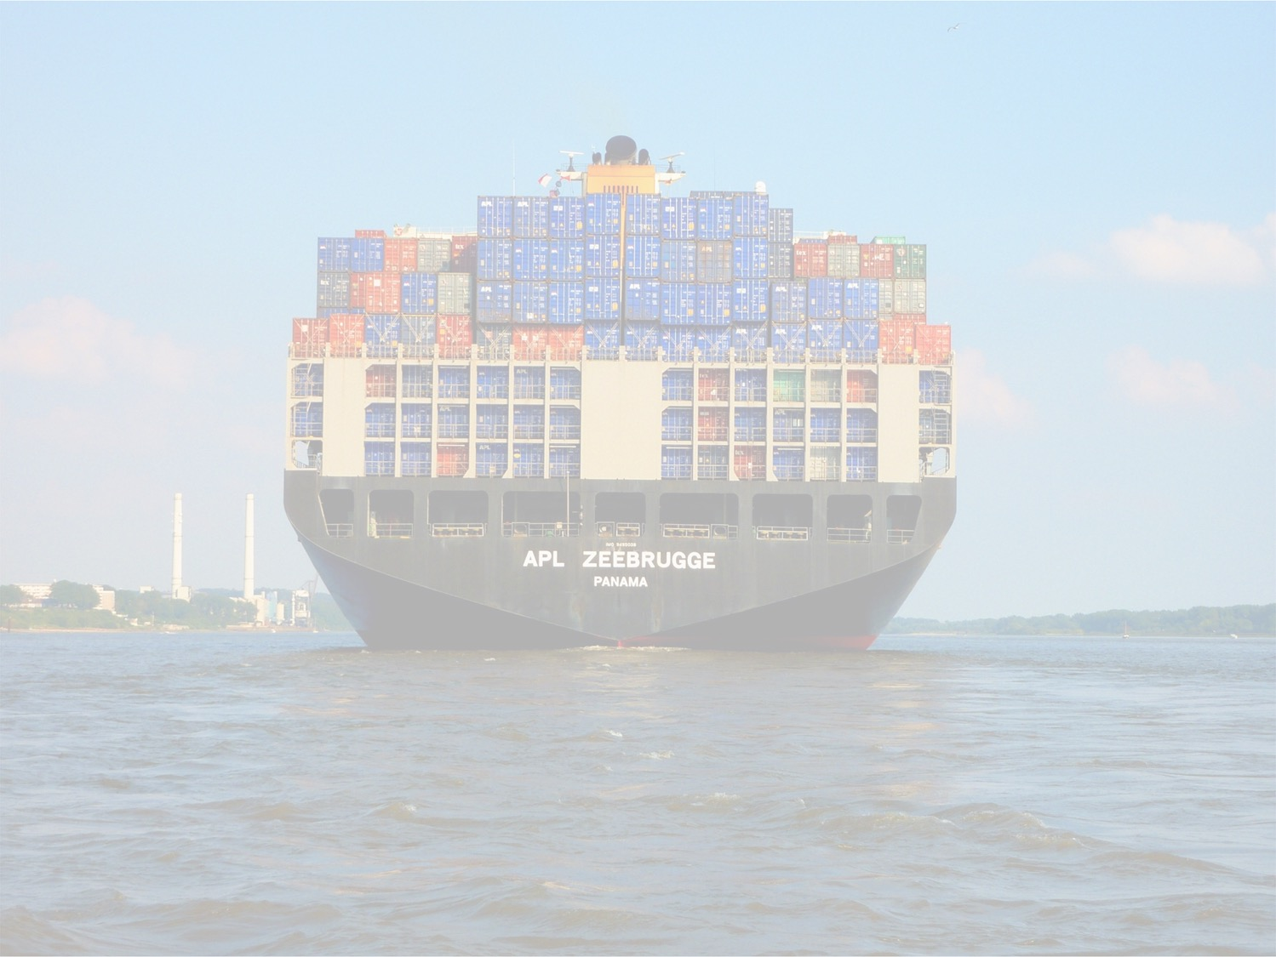
Containers: The new network endpoint

Slide 2
Agenda
Me talking about non-technical things
How we got here
Me talking about technical things
Definitions
Mechanics
Docker built in options
Third Party plugins
Flannel
Weave Net
Me talking about non-technical things
Looking forward
Questions

Slide 3
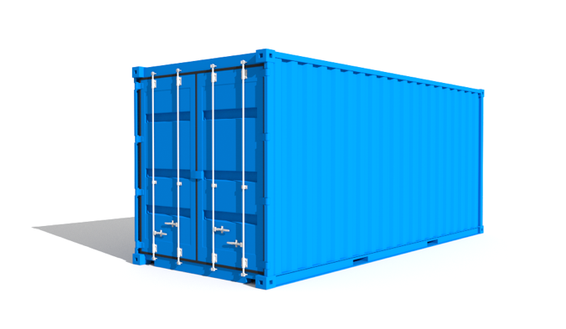
The new endpoint
Networking is a challenge
A new paradigm
Physical -> VM -> Container
Similarities
IP endpoint
Differences (challenges)
Size (scale)
Microservice architecture
Ephemeral (dynamic in nature)
Sound familiar?
Another iteration of problems we’ve already solved (or at least tried to solve…)

Slide 4
How we got here
Layers aren’t autonomous
Building blocks more so than transition
Each block has different network models and attributes…
Physical host
Physical Network
Virtual Machine
Virtualization host
Container
Guest OS
Different space
Closer to the app
Blurring lines of ownership

Slide 5
To summarize…
Fundamentals
Existing infra?
Cross discipline collaboration?
New things rely on old things
Know your options

Slide 6
Disclaimer
Docker is the Kleenex of containers
First to really put it all together
We’ll focus just on the network with Docker
Not the only container runtime software out there
Rocket (rkt) maintained by CoreOS
Networking is largely the same implementation
It might come up, but orchestration is a huge topic on its own

Slide 7
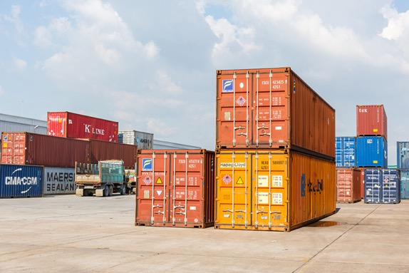
Defining a container
From Docker…
A container image is a lightweight, stand-alone, executable package of a piece of software that includes everything needed to run it: code, runtime, system tools, system libraries, settings.
What is a container from a network perspective?
An IP endpoint
A network namespace

Slide 8
What is a network namespace?
Goal – limit (scope) what you can see
Pretty close to a VRF – but not a VRF
Full isolation of the network stack
Each namespace has it’s own routes, IPs, sockets, conntrack, netfilter rules, etc.
There is a default/root namespace
Each interface can live in only one namespace

Slide 9
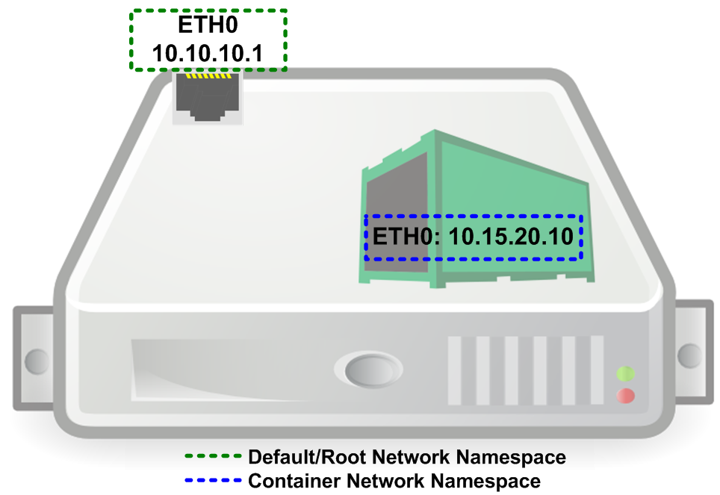
The problem

Slide 10
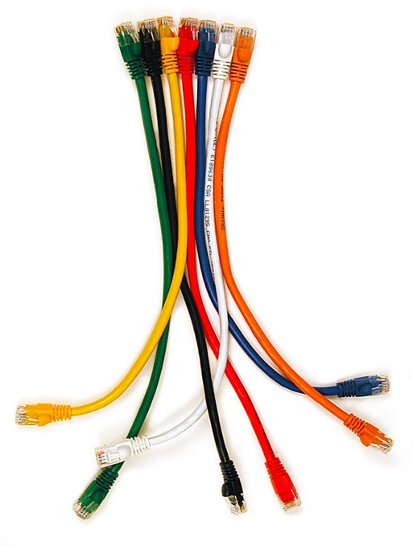
The solution
VETH Pairs
The patch cable of Linux networking
Always come in pairs
Either end can be…
L2 (attached to a bridge)
L3 (assigned an IP address)
Can bridge namespaces

Slide 11
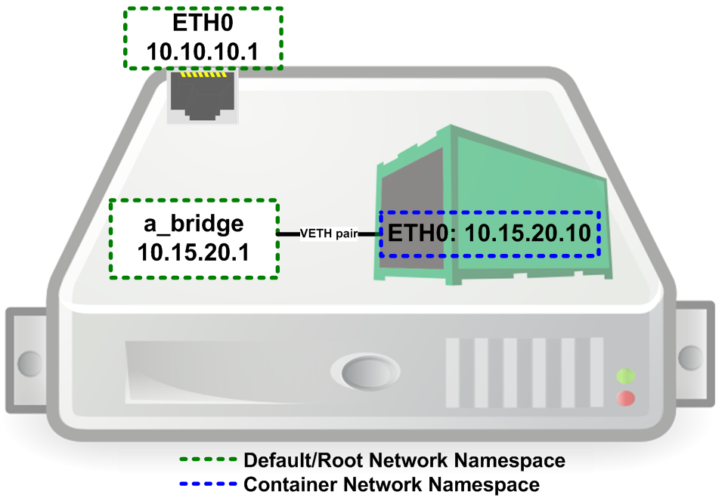
The solution

Slide 12
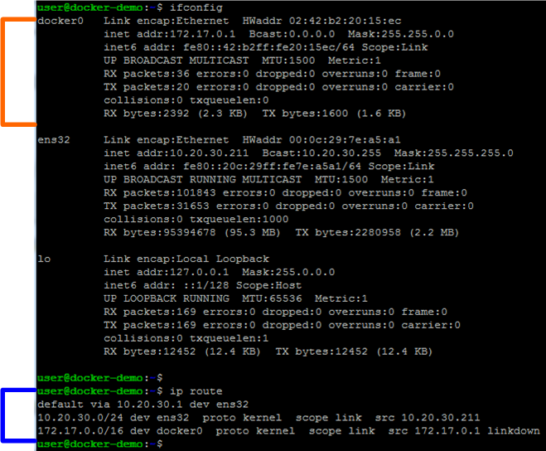
In real life

Slide 13
Running a container

Slide 14
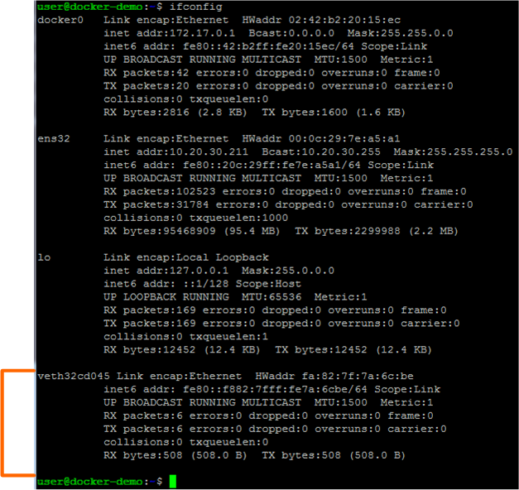
Result on the host

Slide 15
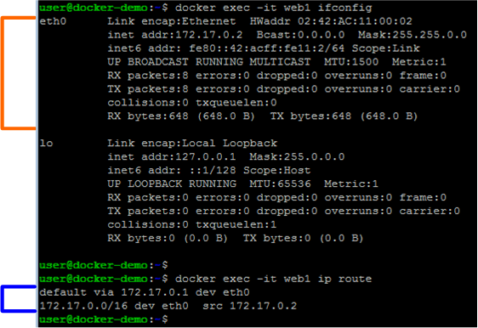
Result on the container

Slide 16
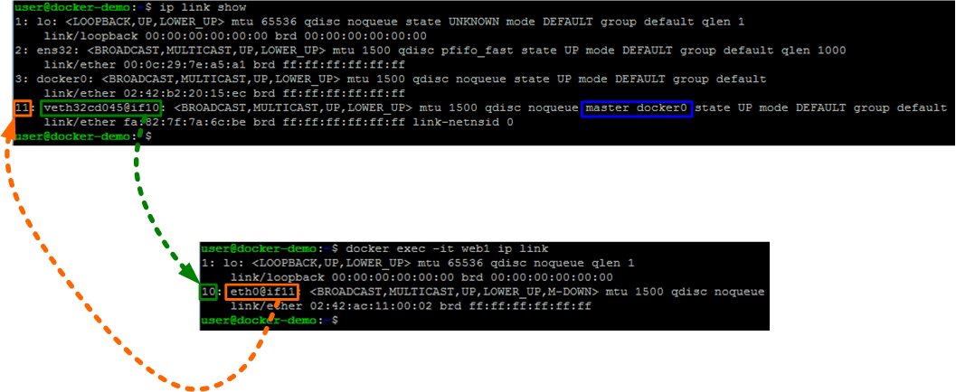
Proving it

Slide 17
Great, now what?
Without routing this doesn’t help us
Problems
Container talking to external network
Accessing service in container from external network

Slide 18
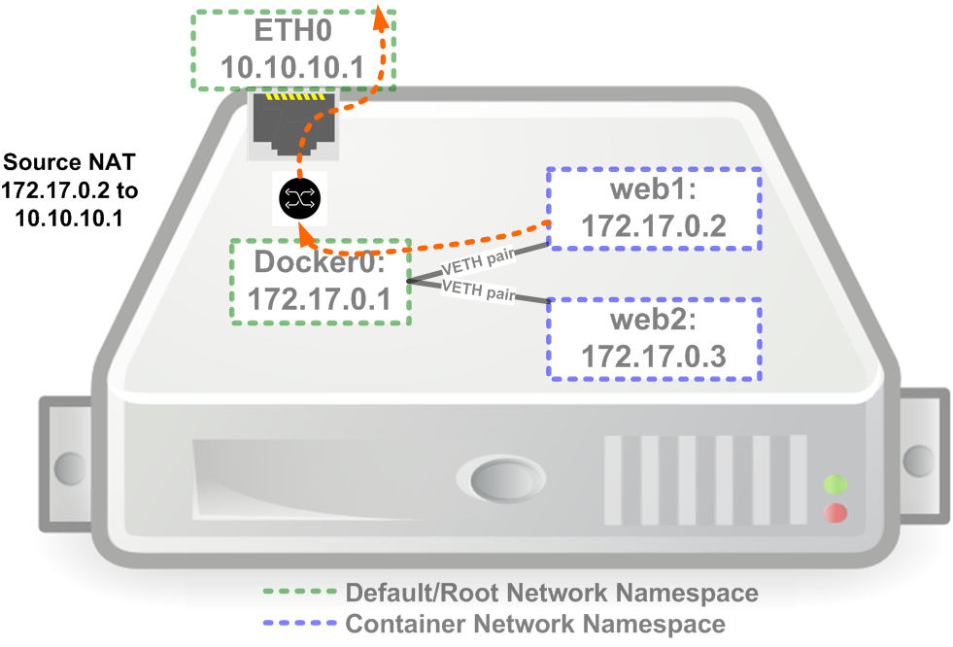
Container -> External
-A POSTROUTING -s 172.17.0.0/16 ! -o docker0 -j MASQUERADE

Slide 19
External -> Container
Non-default
Relies of port mapping at the host
Exposed vs published ports
Publishing Exposed ports
Publish them with ‘-P’ flag
Example:
docker run -d -P --name web1 jonlangemak/web1_80
Manual port mapping
Use the ‘-p’ flag
Example:
docker run -d -p 8080:80 --name web1 jonlangemak/web1_80

Slide 20
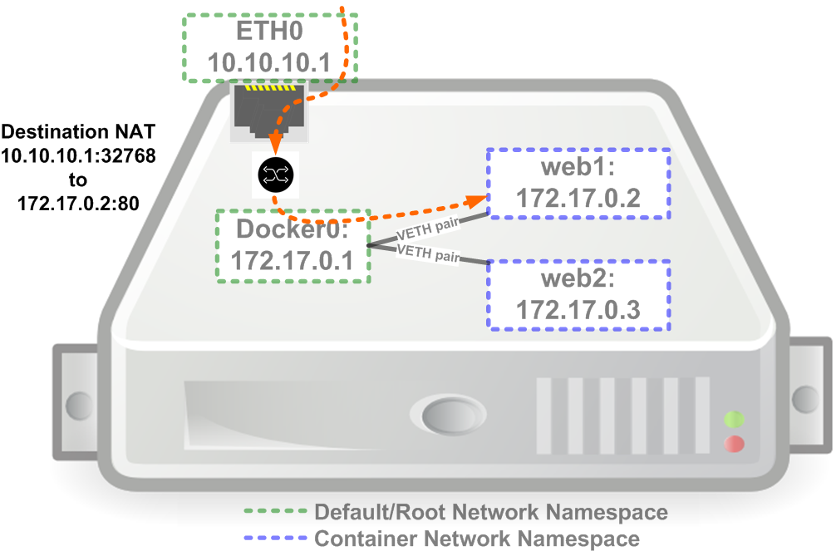
Access service in container
-A PREROUTING -m addrtype --dst-type LOCAL -j DOCKER
-A DOCKER ! -i docker0 -p tcp -m tcp --dport 32768 -j DNAT --to-destination 172.17.0.2:80

Slide 21
Bridge mode
All the functionality we’ve seen so far
The default
All containers attached to same bridge
All use the docker0 bridge as gateway
All containers can talk by default
ICC mode

Slide 22
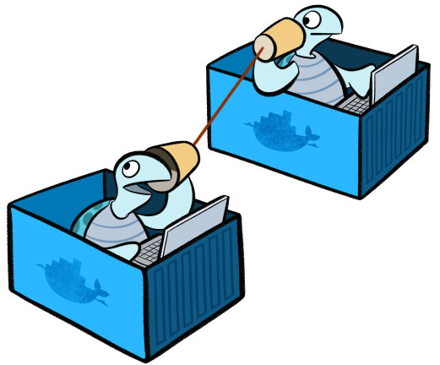
Other default (built-in) options
Host mode
Mapped container mode
None mode
Don’t recreate the wheel
Native routing

Slide 23
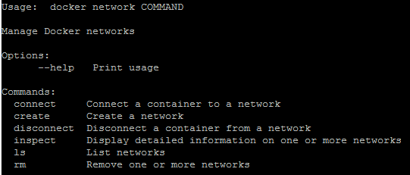
Docker network
Added in version 1.12
Create/Delete
Connect/Disconnect
User defined networks
Bridge
Overlay (multi-host)
Portability
MacVLAN
VLAN tagging
Configuration state replay

Slide 24
Flannel
Widely used overlay solution
Supports multiple different back ends
Overlay
Host-GW
Others
ETCD backed solution
Prerequisites

Slide 25
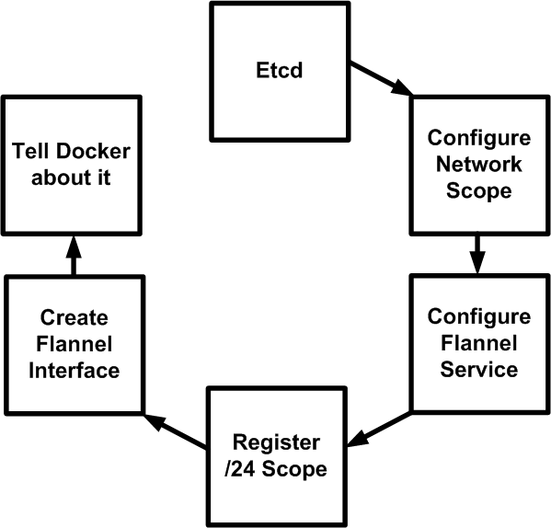
Interaction and setup
Methods for interacting with Docker
Background

Slide 26
Weave Net
Simple install, container based
Acts as a shim layer
Overlay is additive
DNS for containers
No external key store
Subnet based segmentation and encryption

Slide 27
Interaction and setup
Methods for interacting with Docker
CLI shim
Network plugin
API proxy

Slide 28
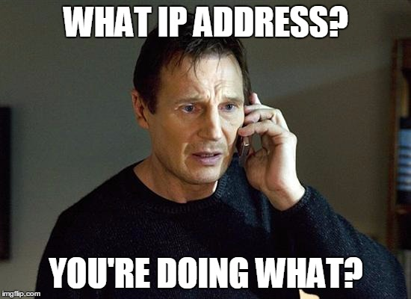
Looking forward
Learn more about Linux (networking)
Get involved
Community
App teams
Don’t worry
New skillset

