Slide 1

Getting to Know Model-Driven Management With the YANG Catalog
CHI-NOG 09
Joe Clarke
Distinguished Services Engineer, Cisco
May 23, 2019

Slide 2
Remember SNMP?
.1.3.6.1.2.1.31.1.1.1.10.1 = 172143605
.1.3.6.1.2.1.31.1.1.1.10.2 = 15958098
.1.3.6.1.2.1.31.1.1.1.10.3 = 0
.1.3.6.1.2.1.31.1.1.1.10.4 = 0
.1.3.6.1.2.1.31.1.1.1.10.5 = 0
.1.3.6.1.2.1.31.1.1.1.10.6 = 0
.1.3.6.1.2.1.31.1.1.1.10.7 = 10148078
IF-MIB::ifHCOutOctets.1 = 172143605
IF-MIB::ifHCOutOctets.2 = 15958098
IF-MIB::ifHCOutOctets.3 = 0
IF-MIB::ifHCOutOctets.4 = 0
IF-MIB::ifHCOutOctets.5 = 0
IF-MIB::ifHCOutOctets.6 = 0
IF-MIB::ifHCOutOctets.7 = 10148078
SNMP
MIB

Slide 3

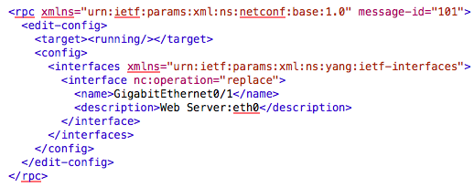
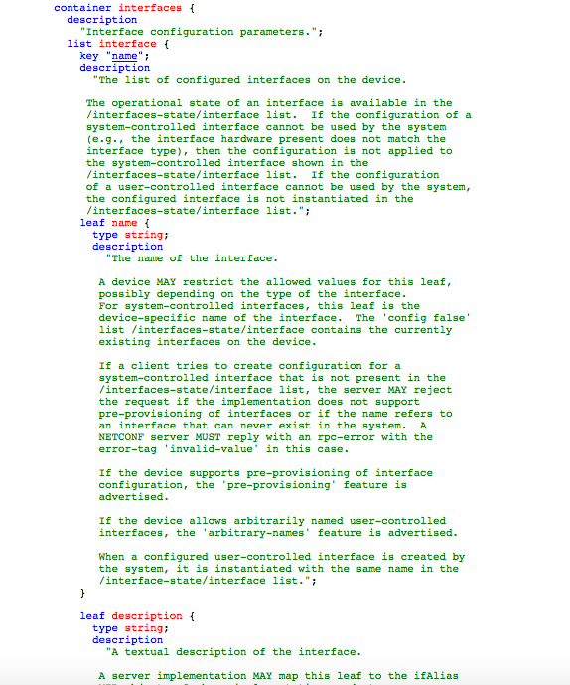
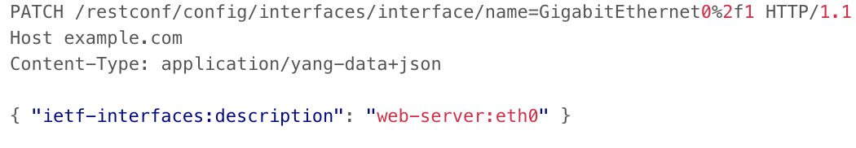

A Model-Driven Approach
NETCONF / RESTCONF

Slide 4
MIB versus YANG Module
ifIndex OBJECT-TYPE
SYNTAX InterfaceIndex
MAX-ACCESS read-only
STATUS current
DESCRIPTION
"A unique value, greater than zero, for each interface. It is recommended that values are assigned contiguously starting from 1. The value for each interface sub-layer must remain constant at least from one re-initialization of the entity's network management system to the next re-initialization."
::= { ifEntry 1 }
leaf name {
type string;
description
"The name of the interface. A device MAY restrict the allowed values for this leaf,
possibly depending on the type of the interface. For system-controlled interfaces, this leaf is the device-specific name of the interface.
…
reference
"RFC 2863: The Interfaces Group MIB - ifName";
}
MIB Module
YANG Module

Slide 5
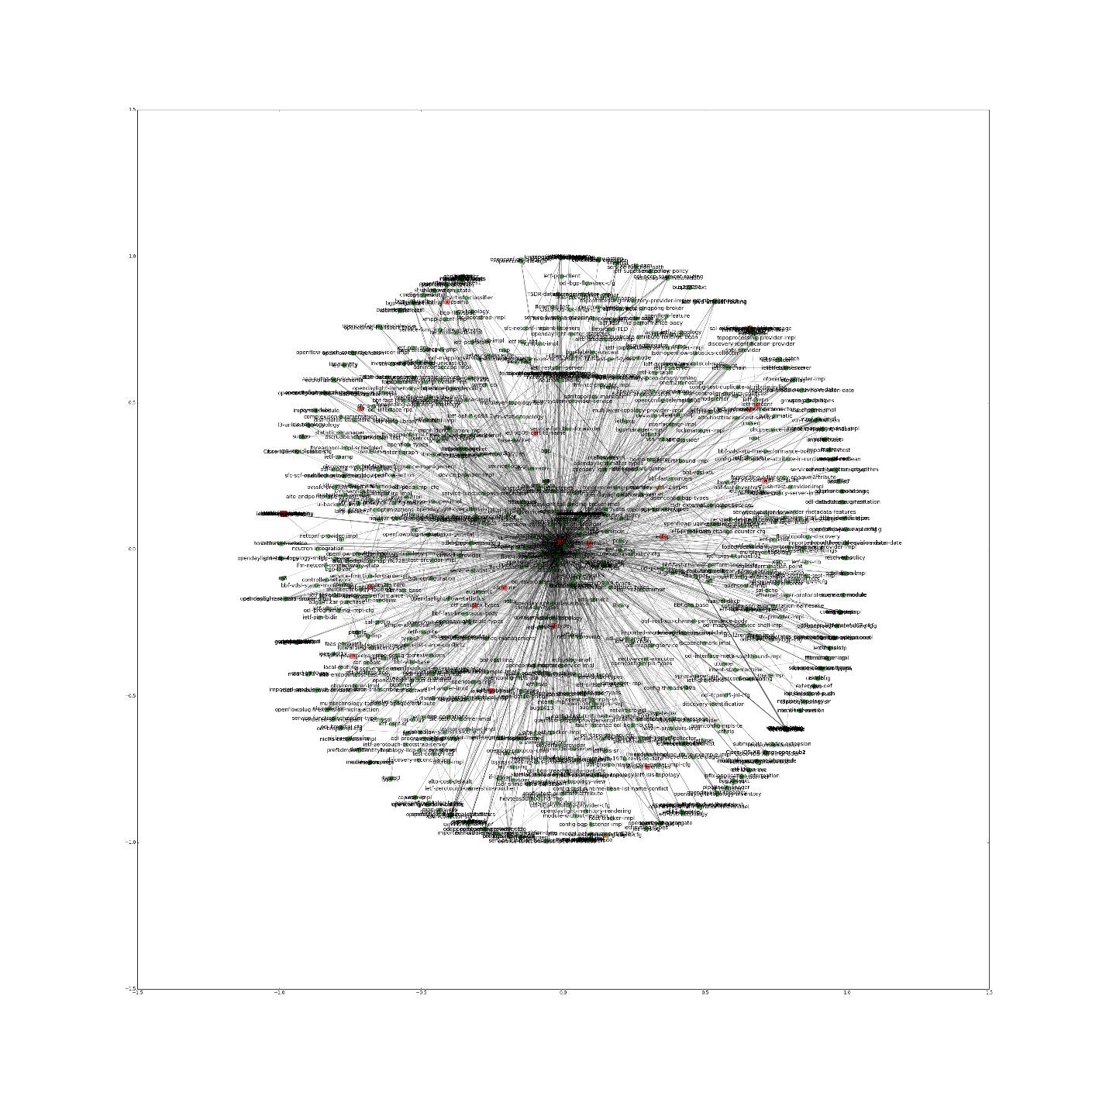












It’s safe to say model-driven
management is taking off
5

Slide 6
“Automation is as good as your data models, their associated metadata, and your tool chain.”

Slide 7
SNMP “Meta” Tooling
SNMP had tooling to do basic operations (get, set, get-next, etc.)
And, of course, countless network management platforms
But what about…
  Finding the right MIB
  Translating OIDs when you didn’t have the MIB (or the right version)
  Finding out what MIBs are supported in my platform or my version of code
  What MIB or object should I be using to manager foo

Slide 8
Building Out YANG Tooling From The Start
While translation tools aren’t really needed, other meta-tooling is required
Tooling will depend on the role of the user
For example:
  Finding the right module and objects
  Learning from others when designing modules
  Knowing what modules are supported in what platforms
  Understanding module changes
  Validate my module’s syntax
  Recognizing the impact and scope of a module

Slide 9
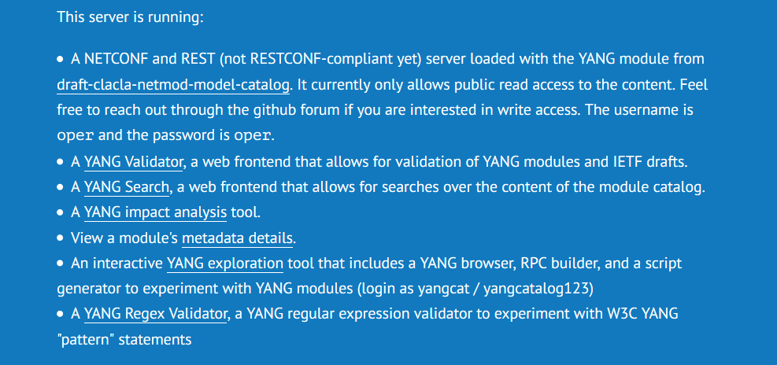
YANG Catalog
https://yangcatalog.org

Slide 10
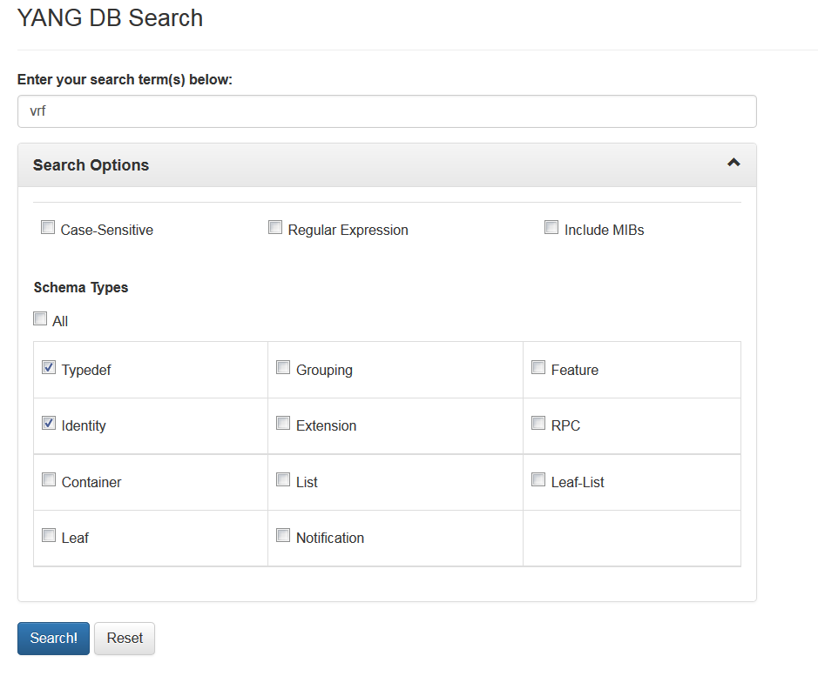
YANG Module And Node Search
What YANG modules and features exist in the industry?
Which are supported by a given platform and OS?
What is a good type definition for a MAC address?

Slide 11
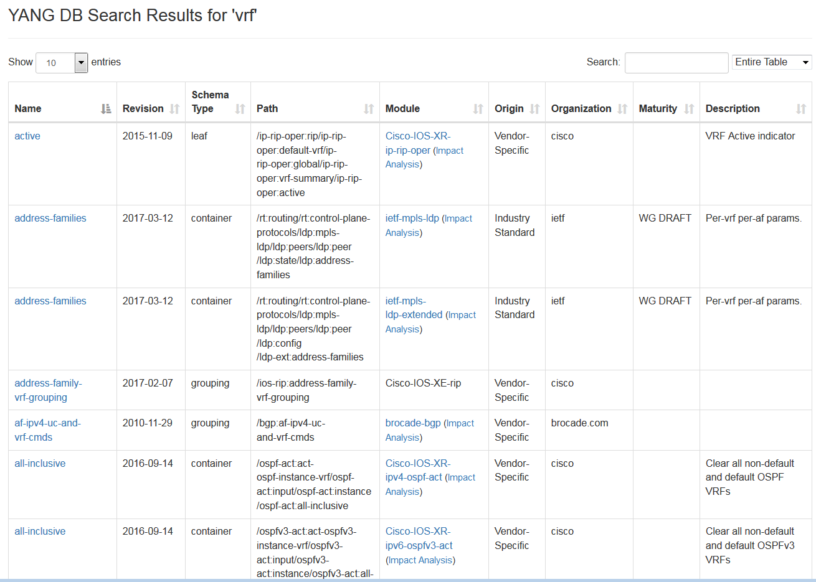
XPath for access
Lifecycle maturity
Creating organization

Slide 12
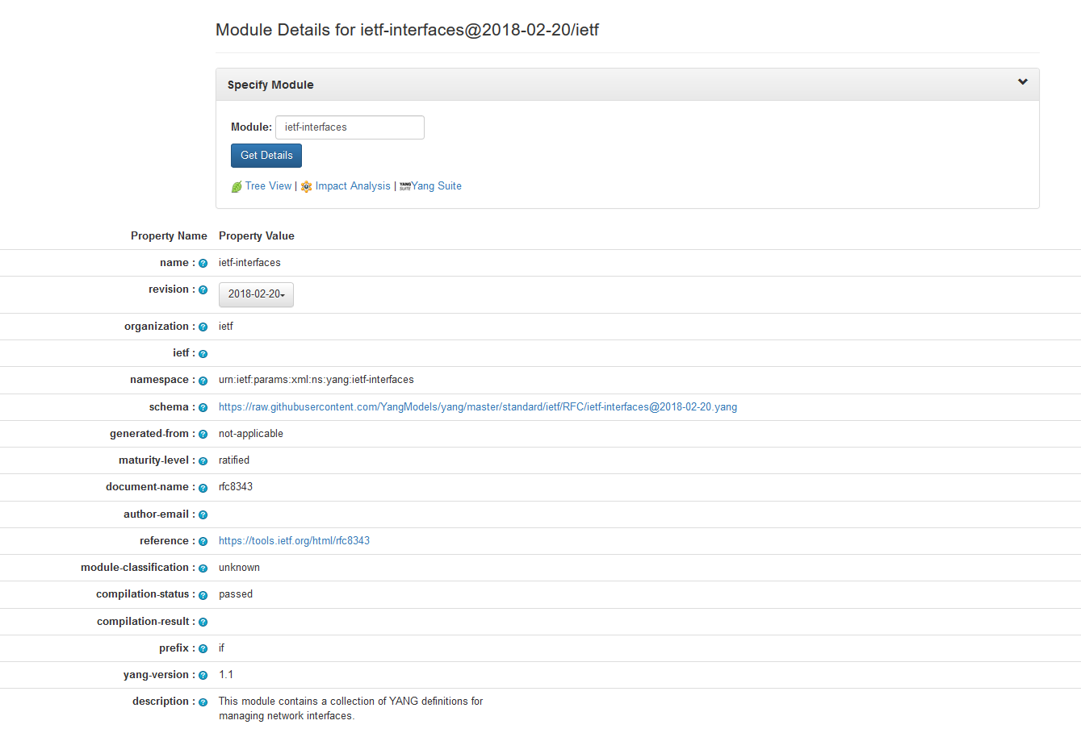
YANG Module Metadata
Obtain compilation status
Get device support data
Find supporting documents
Notes:
It includes the maturity level: IETF:RFC, IETF:WG DRAFT, IETF:INDIVIDUAL, IETF: N/A,
Supporting document
Where it’s implemented

Slide 13
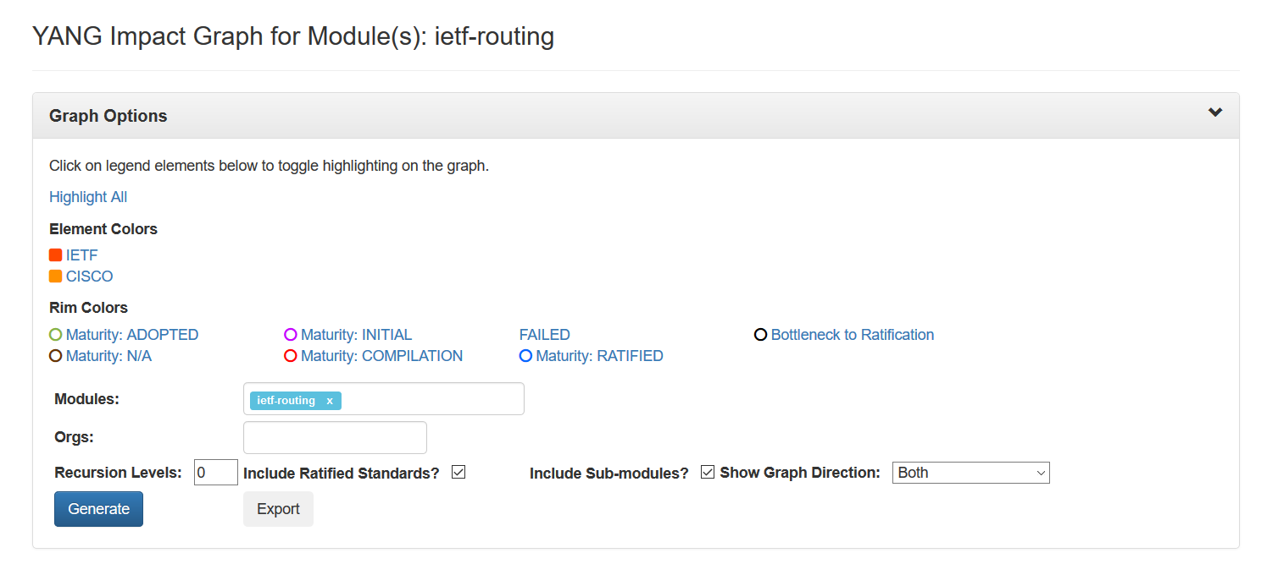
Impact Analysis
Notes:
It includes the maturity level: IETF:RFC, IETF:WG DRAFT, IETF:INDIVIDUAL, IETF: N/A,
And same maturity level for BBF.

Slide 14
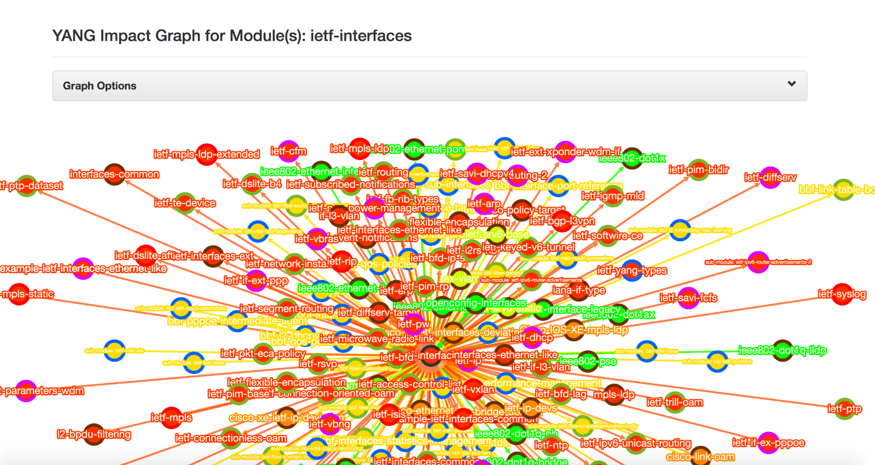
Tracking Dependencies and Dependents
Identify the scope and impact of a module

Slide 15
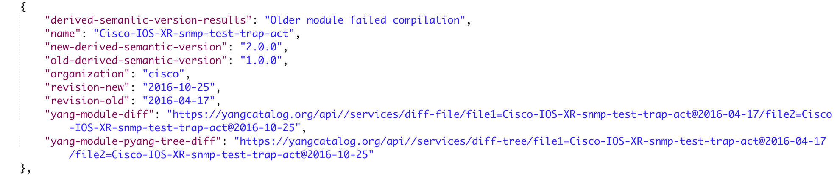
Integrating With YANG Catalog
YANG Catalog comes with a an open REST-based API
All search, metadata, and dependency tracking features included
A Postman collection is offered to demonstrate the API capabilities
Determine how a module has changed semantically within your application

Slide 16
Looking Ahead
The YANG Catalog was born from IETF hackathons as an open source project
Today, the YANG Catalog has been transitioned to the IETF LLC
The intent is to incorporate more vendor and SDO modules
Continue the open source work to build additional tooling and a community

Slide 17
Questions?

