Slide 1
Comparing the Network Performance of AWS, Azure and GCP
Yefim Pipko, ThousandEyes
ypipko@thousandeyes.com

Slide 2
Agenda
Report Genesis & Overview
Research Methodology
Research Findings
Summary & Recommendations
Q&A

Slide 3
HOW DO WE MAKE DECISIONS ABOUT THE CLOUD TODAY?

Slide 4
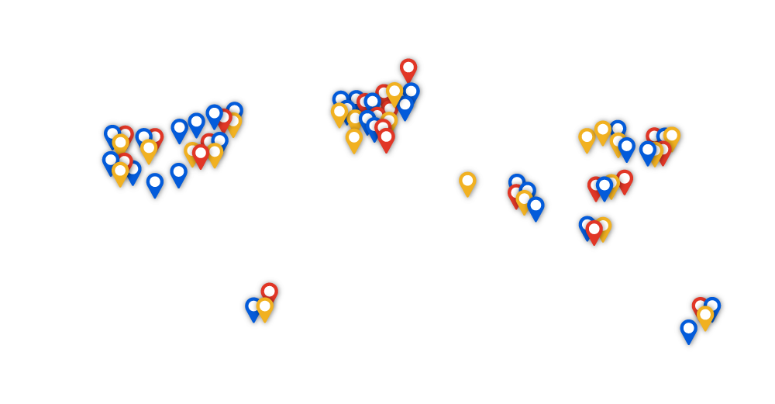
Typical Cloud Decision Factors
Global Presence
Global Presence
Global Presence
Global Presence
Pricing
Pricing
Pricing
Pricing
$
$
$
$
Cloud Decisions
Cloud Decisions
?
Services
Services
Performance
Services
Services
Performance

Slide 5
What’s Been Missing from Cloud Performance Data?
TIME
Snapshots not trends
Single provider
Lack comparisons Limited geos
No multi-cloud
BREADTH
No network architecture
No loss or jitter
No predictability analysis
DEPTH

Slide 6
Data Collection Methodology
MONITORING AGENT
Software probes (monitoring agents) emulate user-data by triggering a “test”
Customized Traceroute
TCP Traces. Resistant to ICMP issues caused by rate-limiting routers.
Bidirectional
Basic traceroute is directed (source-to-destination)
Bidirectional tests to account for variation in forward and return routes
TCP Traces
Bi-directional Tests
Loss
Latency
Jitter
Network Path Data
MONITORING AGENT
Notes:
Why did we pick TCP – to address the shortcomings of ICMP – mention a couple of points in there
We call it customized because it does not only get information on hop ip

Slide 7
Data Collection Methodology
MONITORING AGENT
A single “test” gathers different types of data
Network Path Data:
Geo-located Layer 3 hops from source to destination including AS paths that allows us to determine connectivity architecture to the cloud providers
Per hop loss and latency
DSCP re-marking across the path
MPLS tunnels
End-to-End Network Metrics:
Loss, Latency and Jitter
Helps understand user-experience to cloud providers and within cloud providers
TCP Traces
Bi-directional Tests
Loss
Latency
Jitter
Network Path Data
MONITORING AGENT

Slide 8
Data Processing Methodology
Software probes are well provisioned globally with continuous access. Allows easy detection of connectivity issues or local-faults
Tests are run periodically, at an interval of 10 minutes
Data gathered over a period of 30 days (07.01.2018 – 07.31.2018) to accommodate for extraneous events such as outages
Note: Zero outages occurred during the data collection timeframe
Data generated is continuously exported to a cloud-based platform for analysis and trend-detection
Network metrics generated compared across all three providers
Latency differences across providers prominent
Loss and Jitter were negligible

Slide 9
Test Scope
End User
Measurements
Inter-Availability Zone
Measurements
Inter-Region
Measurements
Multi-Cloud
Measurements

Slide 10
End User Measurements
27 Global Locations
1485 Tests
55 Regions
15
25
15
Notes:
27 global locations for end user piece – cloud agents

Slide 11
Inter-AZ Measurements
Inter-AZ tests are measured within a single cloud provider
Availability zones are mapped independently for each account. Data samples from multiple AZ pairs analyzed to discount for exceptions.
AWS : 4 regions
Azure : 1 region (Concept of AZ relatively new for Microsoft)
GCP : 4 regions
A
B
C
Region X
Notes:
used Cloud Agent to Enterprise Agents
Cloud agents in one AZ, so had to deploy Ent Agents in other AZs
Each AWS region – we tested between three AZs in each region
Used the same account so that when Ops team deployed in AZ A, Ent agent in AZ B would be in a different location.

Slide 12
Inter-Region Measurements
15 REGIONS
25 REGIONS
15 REGIONS
Notes:
Mohit’s:
This is a full mesh of inter-region – Yes
Details are in the report

Slide 13
Full Mesh of Multi-Cloud Measurements
25 REGIONS
15 REGIONS
15 REGIONS
Notes:
Full mesh of inter cloud tests
But only selected regions are presented in the report since the data set is too large.
Actual locations are in the report

Slide 14
Data Points Gathered
30 DAYS
10 MIN-INTERVALS
40M
Unique Measurements
20M
Unique Measurements
Loss
Latency
Jitter
Network Path
80M Unique Measurements
120M Unique Measurements
160M Unique Data Points
40M Unique Measurements
Notes:
160 MMMMM!!!!!!
20M - single direction includes – End User, Inter AZ, Inter region, inter cloud

Slide 15
GOOD
BAD
UGLY

Slide 16
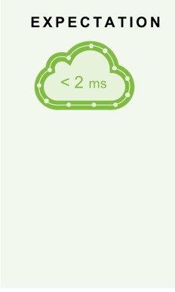
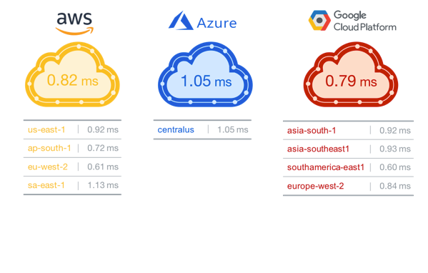
Inter-AZ Performance
Inter-AZ performance is reliable and consistent
Indicates robust regional backbone for redundant multi-AZ architectures
Notes:
Archana to send new slide – Expectation should be the first animation

Slide 17
Inter-Region Performance
INTER-REGION DISTRIBUTION
Inter-region network connectivity stays “within” provider network
Performance baselined with Internet averages to reflect relative performance
Most region pairs perform well but exceptions exist
■ AWS ■ Azure ■ GCP
60
40
20
0
10% faster than the Internet
Same as the Internet
10–30% slower than the Internet
30% slower than the Internet
Notes:
Y-Axis is the number of inter-region pairs
This traffic is all within the cloud backbone, this traffic does not traverse the internet.
But it focused on testing between the various compute services.
(Note the story my be different for compute to DB or other service, etc).
Note Label the Y AXIS .

Slide 18
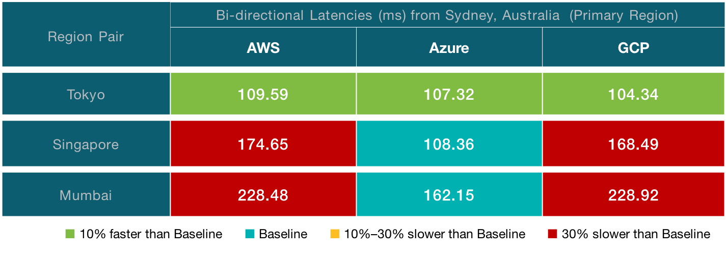
How to Choose Inter-Region Pairs?
Notes:
Baseline - it’s the internet path
We used cloud to cloud agents that are not in AWS/GCP/MSFT (Sydney
The goal is to get relative performance baseline/reference point
Selected this combination of since it show the worst case scenario.
Need to make decisions that makes sense for your business but at least you have some data to provide context that may be relrevant.

Slide 19
Where is End User Performance Strong?
Comparable performance in North America and Western Europe
No significant packet loss or outages in a 4-week period
HOSTING REGION: VIRGINA, VA
BI-DIRECTIONAL LATENCIES
HOSTING REGION: UNITED KINGDOM
BI-DIRECTIONAL LATENCIES
■ AWS ■ Azure ■ GCP
■ AWS ■ Azure ■ GCP
ms
ms
400
400
350
350
300
300
250
250
200
200
150
150
100
100
50
50
0
Asia
Europe
North America
Oceania
South America
0
Asia
Europe
North America
Oceania
South America
USER LOCATION
USER LOCATION
Notes:
End user to cloud regions (from 27x cloud agent locations)
All three providers are, generally they are comparable.

Slide 20
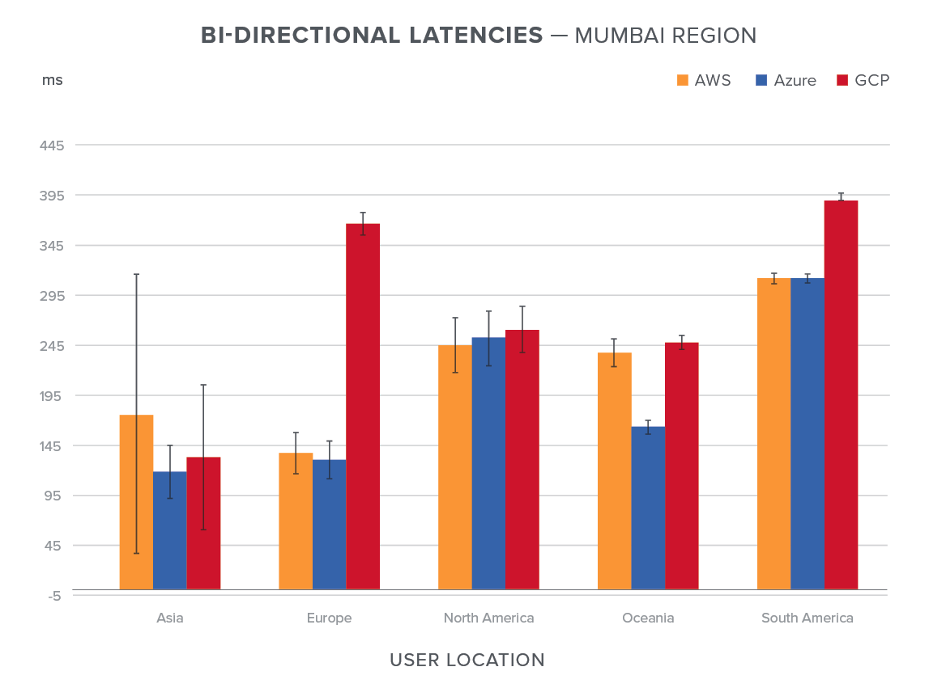
Exception: GCP is 3X Slower from Europe to India
HOSTING REGION: MUMBAI, INDIA
BI-DIRECTIONAL LATENCIES
■ AWS ■ Azure ■ GCP
GCP exhibited 3x the network latency in comparison to AWS and Azure
Circuitous route from Europe via North America to India on the GCP backbone
ms
450
400
GCP has 3x the network latency
350
300
250
200
150
100
50
0
USER LOCATION

Slide 21
Why is GCP Slower to Mumbai?
Users in Europe take a sub-optimal route to India
9
36
Traffic moves through the GCP backbone through the United States
1
1
1
Notes:
Put in backbone connecteor slide
Explain path vis quickly

Slide 22
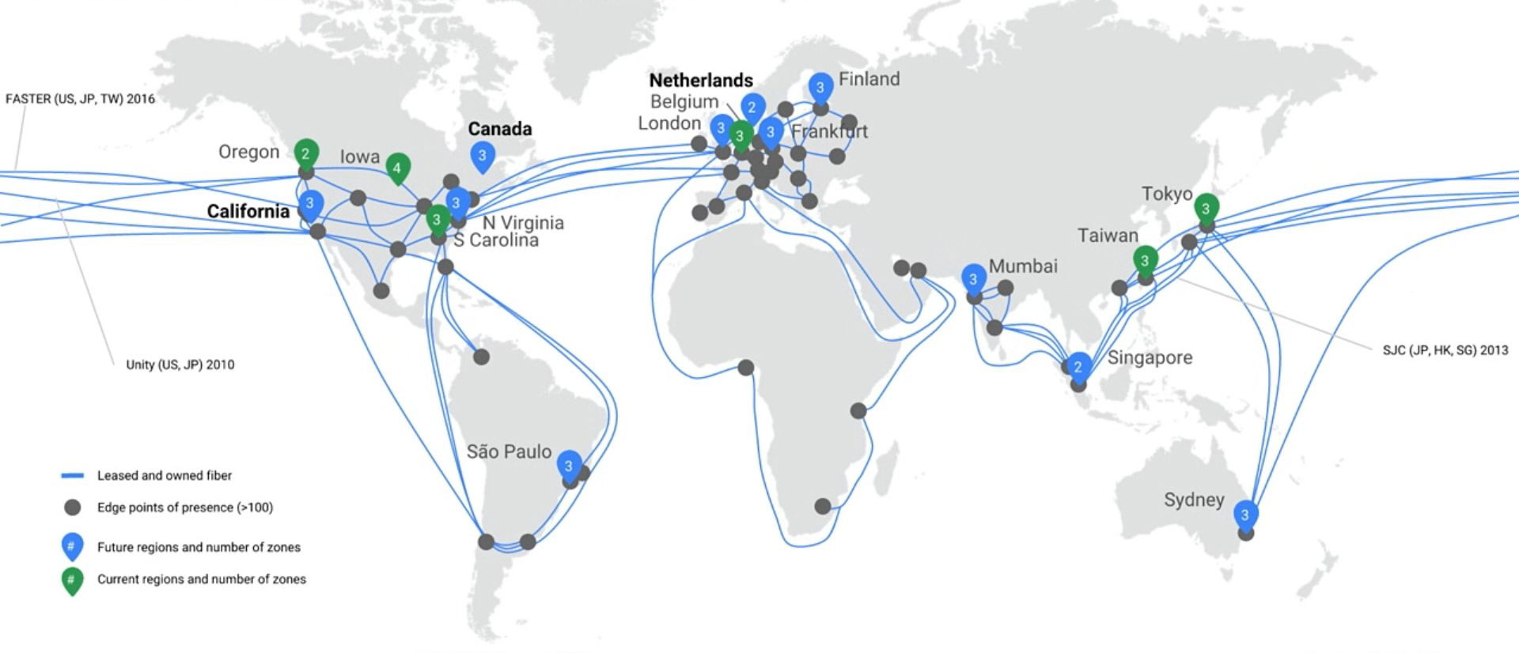
Why is GCP 3x Slower to Mumbai?
No direct route from Europe to India
Notes:
This is the google fiber map – its publically available

Slide 23
Exception: AWS Performance Anomaly in Mumbai
AWS exhibits the largest standard deviation in network latency in Asia
HOSTING REGION: MUMBAI, INDIA
BI-DIRECTIONAL LATENCIES
■ AWS ■ Azure ■ GCP
ms
450
400
350
Considerably higher latency variation with AWS
300
250
200
150
100
50
0
USER LOCATION
Notes:
2 takeawyas
GCP as 3x latency between EMEA and Mumbai
AWS has high variance in latency between Mumbai and the rest of Asia
- Cloud Agents connecting to Mumbai

Slide 24
AWS in Asia is Less Predictable
BI-DIRECTIONAL LATENCY VARIATIONS
■ AWS ■ Azure ■ GCP
Hosting Region: Tokyo
Hosting Region: Singapore
Hosting Region: Mumbai
0
50 ms
100 ms
150 ms
Notes:
Plot of the variance in latency for three specific Cloud provider regions. We selected locations where all three providers had a presence.
This is a snapshot of the reading from the report.
These are based on measurements from cloud agents in Asia (out of the set of 27x).

Slide 25
Why AWS Exhibits Less Predictability
Frankfurt
USER
Singapore
DATA CENTER
Internet
HongKong
Internet
Frankfurt
Internet
Frankfurt
Not all clouds are created equal
Architectural and connectivity differences have an impact on performance
Notes:
We selected a different cloud provider region to show that this behavior is not region specific, it’s a general routing policy across the board.

Slide 26
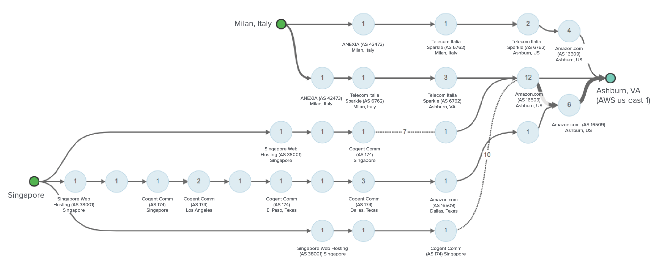
AWS Loves the Internet
4
Traffic from users across the globe traverse the Internet longer on AWS deployments
12
6
1
Traffic from Singapore enters the AWS backbone in Dallas, Texas
1

Slide 27
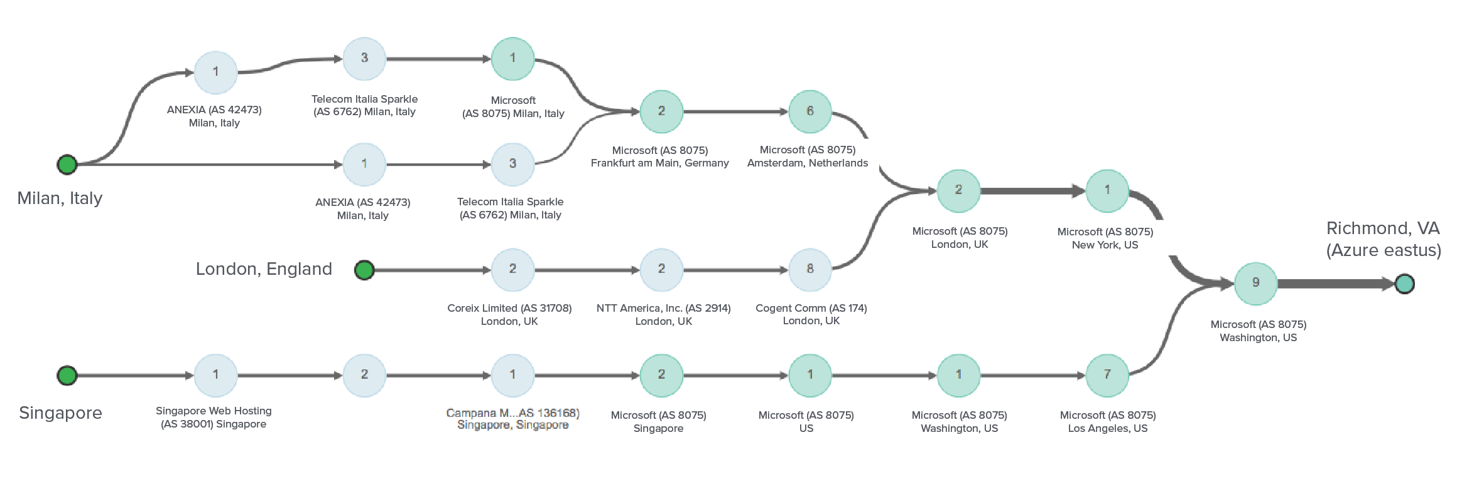
Azure and GCP Network Differently
1
2
6
2
1
9
2
1
1
7
Traffic from Singapore enters the MSFT backbone in Singapore

Slide 28
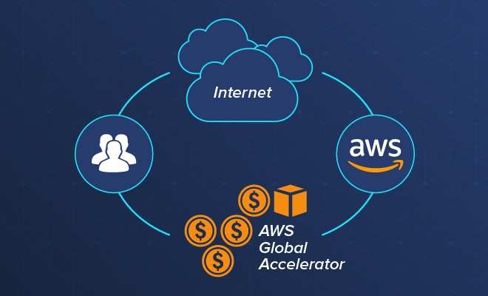
AWS Address Performance Instability With New Service
AWS Global Accelerator for improved performance
Pay AWS more $$ to ride the AWS backbone instead of the Internet
Cloud Trend Alert: Monetization of the backbone
Notes:
Shows the timeliness of the report
And its validation that AWS recognizes that use the internet is not the best path for optimal performance.
Google has a similar service , a premier vs standard
Azure – just routes it through their backbone

Slide 29
Multi-Cloud Performance
AWS, Azure and GCP directly peer with each other
Negligible packet loss and jitter
Traffic between clouds does not leave their backbones
Metric | AWS - Azure | Azure - GCP | GCP – AWS
Jitter | 0.43ms | 0.29ms | 0.50ms
Packet Loss | 0.01% | 0.01% | 0.01%
Notes:
These are averages over 30 days
Across all regional pairs (big average)
-you would have to unpack this further to see if there are performance variances between specific regions pairs (between cloud providers).

Slide 30
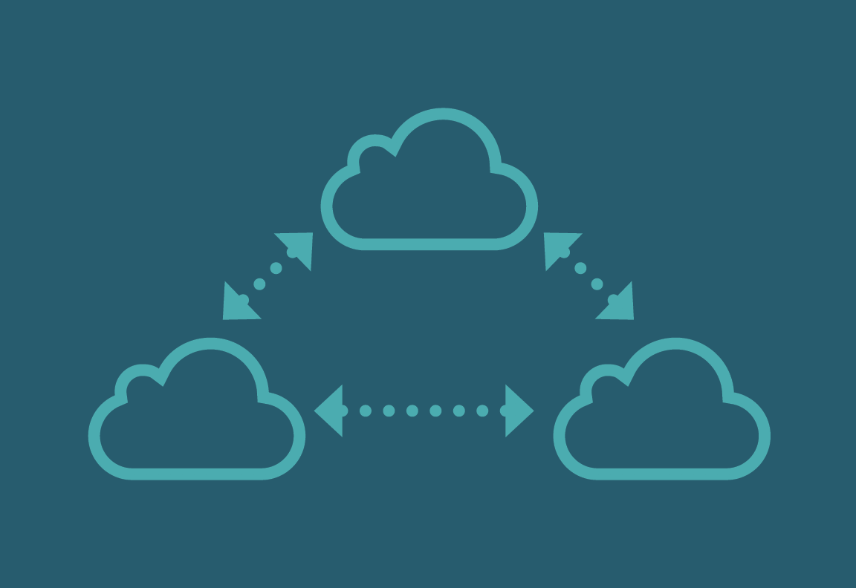
Summary of Learnings
NOT ALL CLOUDS ARE CREATED EQUAL
Architectural and connectivity differences have an impact on performance
AWS has less performance stability in Asia
GEOGRAPHICAL PERFORMANCE VARIES
Do not assume uniform performance across the globe and use data to test, validate and optimize
GCP is 3x slower from Europe to India
INTRA-CLOUD PERFORMANCE IS STELLAR
Robust internal backbone supports redundant and distributed application architectures
Inter-AZ performance between 0.5 ms – 1.5 ms
MULTI-CLOUD IS SAFE
Symbiotic coexistence between the Big 3 and stable multi-cloud performance
AWS, Azure and GCP peer directly with each other

Slide 31
Recommendations
Use data, not your gut to guide your cloud investment decisions
Find your “best” and ”worst” region pairs before deciding on your cloud architecture
Consider your organization’s tolerance to Internet exposure and evaluate risk vs $$
Factor in inter-AZ and inter-region performance. Your app performance and user-experience relies on it
Trust, but verify. Avoid assumptions in the cloud
Notes:
Find your “best” and ”worst” region pairs before deciding on your cloud architecture – could be based on latency from on-premise data centers
Consider your organization’s tolerance to Internet exposure and evaluate risk vs $$ (depends on what matters for you, and the the applications that you run)
There are other considerations for choosing a specifc provider (ie services, applications, etc )

Slide 32
Our Research Vision
2019
Expand to Include Other Public Cloud Providers
Express Route, Direct Connect
2018
160M
Global Hot Spots
Notes:
Ideas that we are exploring
We’ve heard requests to include IPv6 / IPv4 vs IPv6
May include Ali Cloud (most likely not Oracle , IBM cloud – we don’t have agents).
Increase the number locations for the end user piece (from 27 to higher)
Express route / direct connect – on-ramp
AWS global accelerator vs non-global Accelerator (Andrew Vest / Andy Quig) – we see differences.

Slide 33
Thank You
Yefim Pipko, ThousandEyes
ypipko@thousandeyes.com
Download the complete research here:
https://bit.ly/2OKMHkd

