Slide 1
Supercharging your Network Simulations with Jupyter Notebooks
Chinog logo
Taran Deshpande
Technical Marketing Engineer MiG
October 6th, 2022

Slide 2
Jupyter Notebooks as a wrapper for your Network Simulator
Chinog logo
Taran Deshpande
Technical Marketing Engineer MiG
October 6th, 2022

Slide 4
Agenda
1
Network Simulator Overview
Introducing Jupyter Notebooks
2
3
Demo
4
Conclusion

Slide 5
Network Simulator Overview

Slide 6
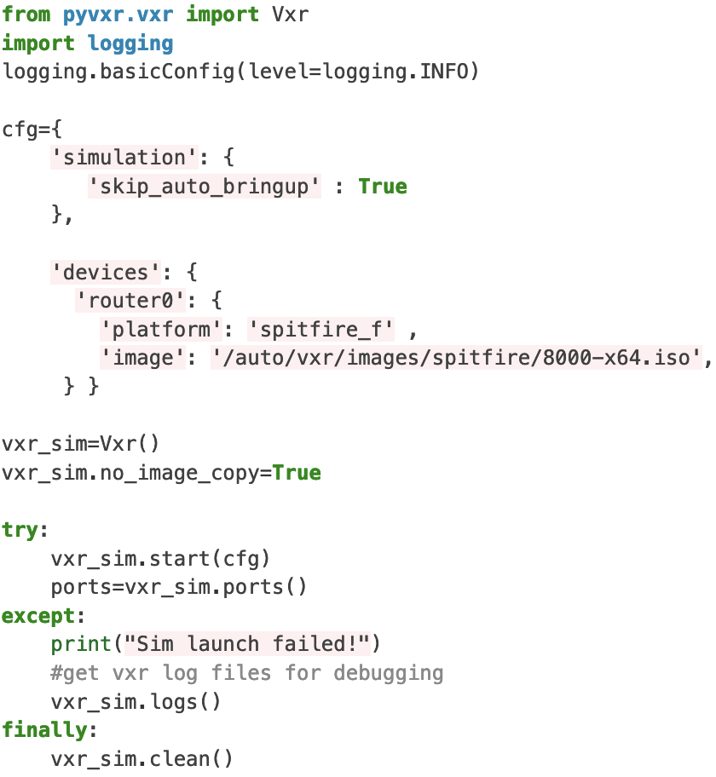
PyVXR
A package containing collection of tools to launch and manage virtual topologies
Topologies can consist of generic and custom Cisco virtual routers
How to invoke
Use PyVXR API within a Python Environment
PyVXR CLI tool
Available to prospective Cisco 8000 customers
Notes:
Original Python interface used for most of the Notebooks that we created

Slide 7
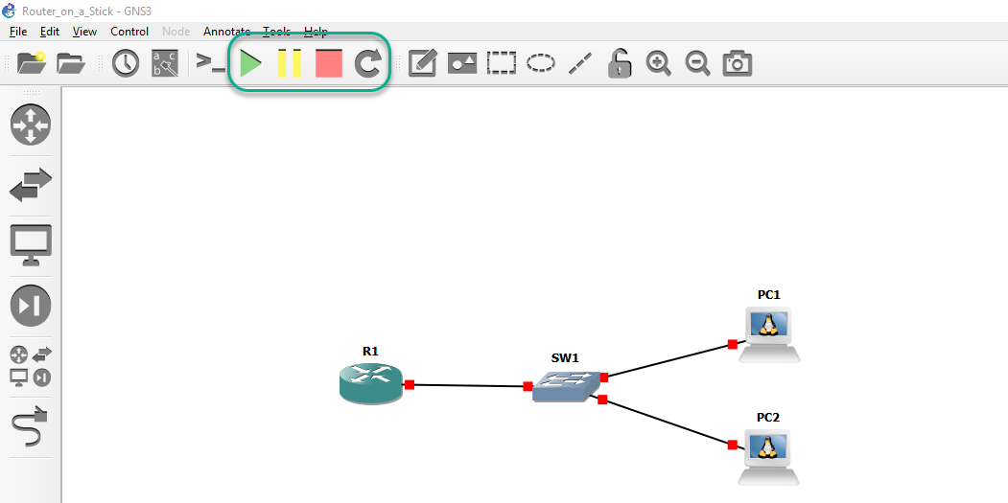
GNS3
GNS3 Marketplace for easy Appliance install
Support for Local Install on Windows, MacOS, and Linux
Can connect Topology to Internet using NAT node
Free and Open Source: https://www.gns3.com/

Slide 8
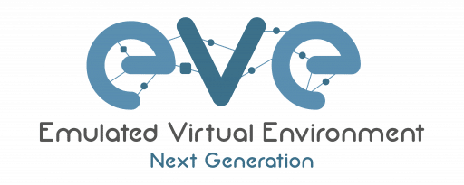
EVE-NG
Cluster Deployment: Multiple servers as one environment
Library of Labs written by EVE-NG
Hot links, interconnection running nodes, ports immediately response (Pro)
Integrated Wireshark capture (Pro)
https://www.eve-ng.net/

Slide 9
Kubernetes Network Emulation (KNE)
Kubernetes is a platform for managing containerized workloads and services
Vendors to provide a standard container implementation
Container launch and management handled by KNE
No GUI
Free and Open Source: https://github.com/openconfig/kne

Slide 10
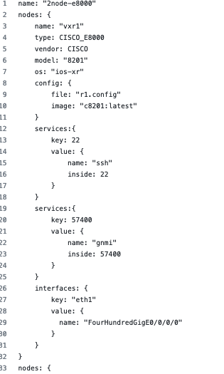
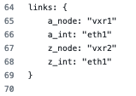
KNE config file
Name, model and OS
Config File
Open Ports
Connections

Slide 11
Network Simulator Options
Simulators | Vendor Support | Images | Topology Configuration
PyVXR | Cisco (IOS-XR or SONiC) | Cisco 8000 provided | Python API and YAML config files
GNS3 | Multivendor | Bring your own | GUI and REST API
EVE-NG | Multivendor | Bring your own | GUI and REST API
CML | Multivendor | Cisco Images provided | GUI and YAML config files
KNE | Multivendor | Bring your own | Textproto config files
Notes:
Community/documentation. Goal of the tool: learning/deployments/etc? installation/resources/platforms

Slide 12
Introducing Jupyter Notebooks

Slide 13
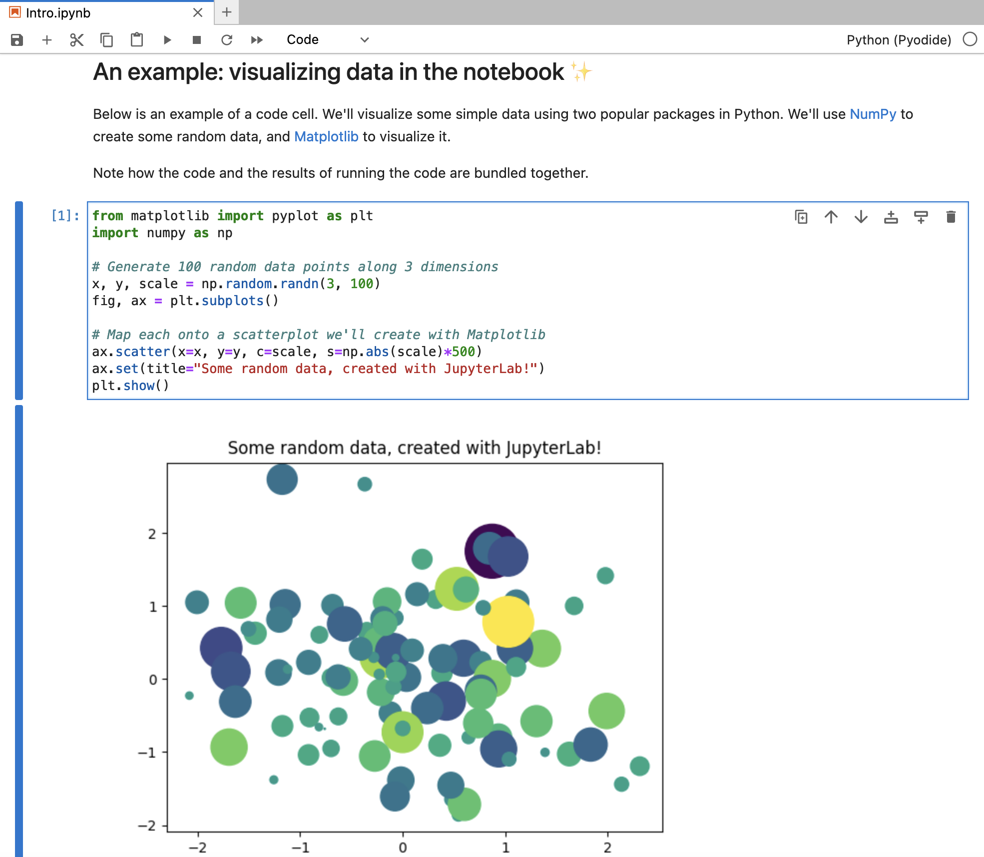
The Jupyter Notebook
Interactive authoring of documents combining text, mathematics, computations and rich media output
Named after 3 core languages- Julia, Python, and R
Components
Notebook Web Application
Kernels
Notebook Documents
https://jupyter.org/

Slide 14
Interaction with Simulator – Networks within Jupyter Notebooks
Why Should You Care?
Automate the creation and bring-up of the topology on the simulator
Design and share proof-of-concepts, use cases, or features
Use as “Live” Documentation
Leverage it as a tutorial for educational purposes
Jupyter Notebooks
Simulator
API
PyVXR
KNE
CML
CML
Network Simulators

Slide 15
Web UI for Notebooks
Not much different from Office document
Create new, execute notebook, run scripts, etc.
Typically available on localhost:8888

Slide 16
Toolbar
Kernel
Images
Code

Slide 17
Demo

Slide 18
Existing Notebooks
https://github.com/ios-xr/network-notebooks/
Setup Network for Transport
Simplify Your Network Using EVPN VPWS
Segment Routing v6 Over An IS-IS Network
Secure Network
Integrity Measurements To Handle Threats (IMA)
Manage Your Router Database Securely (MongoDB)
Type 6 Password Authentication For BGP
Traffic Management
Configure Policies for Quality of Service
Prioritize Delay-Sensitive Traffic Using QOS
Configure QoS Using NSO
Filter Network Traffic Using Access Control List
Filter Network Traffic Using ACL Yang

Slide 19
Existing Notebooks (cont.)
Network Monitoring
Traffic Monitoring With Encapsulated Remote Switched Port Analyzer (ERSPAN)
Stream CPU Utilization Data Using Model-driven Telemetry
Deploy YANG Data Model to Stream CPU Utilization Data Using Model-driven Telemetry
Setup a Pipeline and Stream CPU Utilization Data Using Model-driven Telemetry
APIs
Super-charge Your Router Performance With Service-layer APIs
Utilities
Generate Real-time Network Traffic On Simulated networks
Analyze Bit Level Information of Traffic Flows
Utilize Linux Servers Effectively Within Simulated Networks

Slide 20
Conclusion

Slide 21
Key Takeaways
Use Jupyter Network Notebooks to:
Automate
Document
Educate
Collaborate

Slide 22
Call to action
Contribute to our Network Notebooks Github
For access to PyVXR, contact your Cisco account team or myself

Slide 23
Resources
GNS3
EVE-NG
Cisco Modeling Labs
KNE
Jupyter Network Notebooks

