Slide 1
Modern Tools for Visualizing Network Traffic
Jon M. Dugan
Network Engineer, ESnet
Lawrence Berkeley National Laboratory
CHINOG 06
Chicago, IL
12 May 2016

Slide 2
Introduction
Architecture
Motivating Examples
Our Approach
Time Series Charts
Network Diagrams
Pond: Time Series Operations
Demo
Open Source

Slide 3
Architecture
We are here

Slide 4
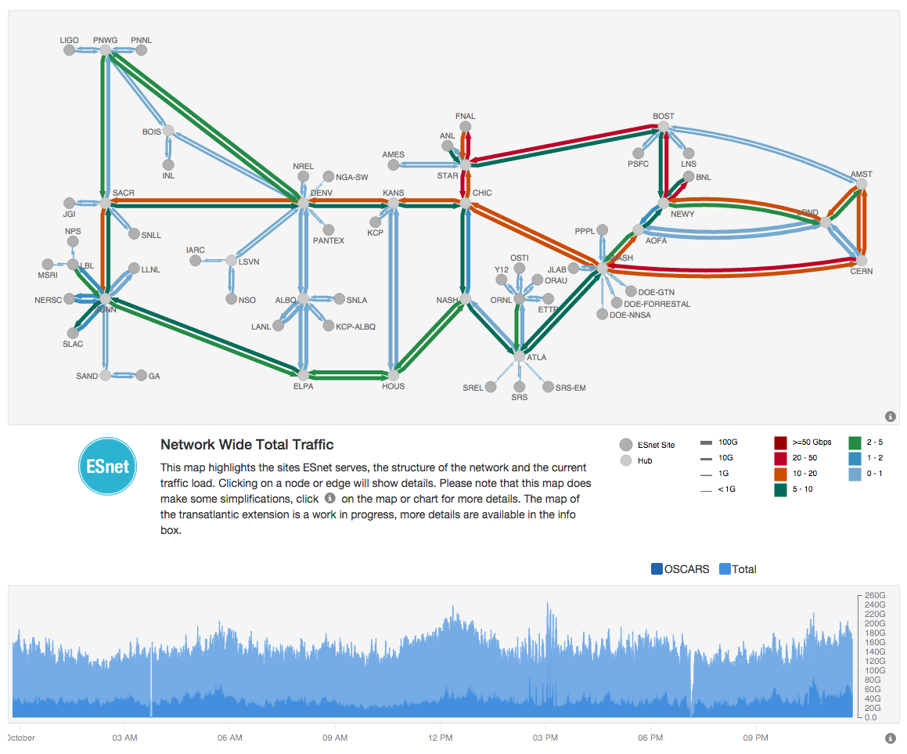
MyESnet Portal
A data-driven website for displaying information and visualizations about ESnet, its sites and community.
https://my.es.net/

Slide 5
The “Mini Portal”

Slide 6
Our Approach
Components
Reusability
Composability
Declarative
Leverage existing tools and libraries
Use existing code whenever possible
Write code only when necessary
Iterative Development
Get feedback often
Do the minimum first, then see what you need to add (or remove)

Slide 7
Components
Reusability
Each component is made to be a general as possible
Surprisingly, general solutions are often simpler than one offs
Composability
Each component has clear boundaries and interfaces
Components can be flexibly arranged as needed
Declarative
Declare what you want, not how to do it; the system “makes it so.”
Allows work to be done at higher level by focusing on domain concepts

Slide 8
Declarative versus Imperative
Imperative: Your friend tells you:
First you go down route 3, until you pass the old farm
Then you turn right at the big rock
After that you’ll see a red brick house on the left
…
Declarative: You enter “1313 Mockingbird Lane” into your GPS

Slide 9
Time Series Charts

Slide 10
Time Series Charts

Slide 11
Network Diagrams

Slide 12
Network Diagrams

Slide 13
Pond: Time Series Operations
We have lots of time series data: SNMP, netflow, log messages, etc
Need a common abstraction and wire format for this data
Provides common operations
Animation showing how Pond generates summary rollups

Slide 14
Demo
Building the mini portal
Step by step

Slide 15
Open Source
Good news everyone, it’s all open source!
http://software.es.net/pond/
http://software.es.net/react-timeseries-charts/
http://software.es.net/react-network-diagrams/
Motivation
Develop a common toolkit for visualizing networks
Lower barrier to entry
Allow people to use what we’ve built so they don’t have to build their own
Encourage others to share their visualizations
Give back to the community

Slide 16
Questions?
Jon M. Dugan <jdugan@es.net>
https://my.es.net/
http://software.es.net/
http://software.es.net/pond/
http://software.es.net/react-timeseries-charts/
http://software.es.net/react-network-diagrams/
http://fasterdata.es.net/
Like code and networks? I’d love to talk to you!
Thanks for listening!

