Slide 1
Bridging The Gap Between Cloud Networking and Traditional Networking
Teren Sapp - Arista Networks

Slide 2
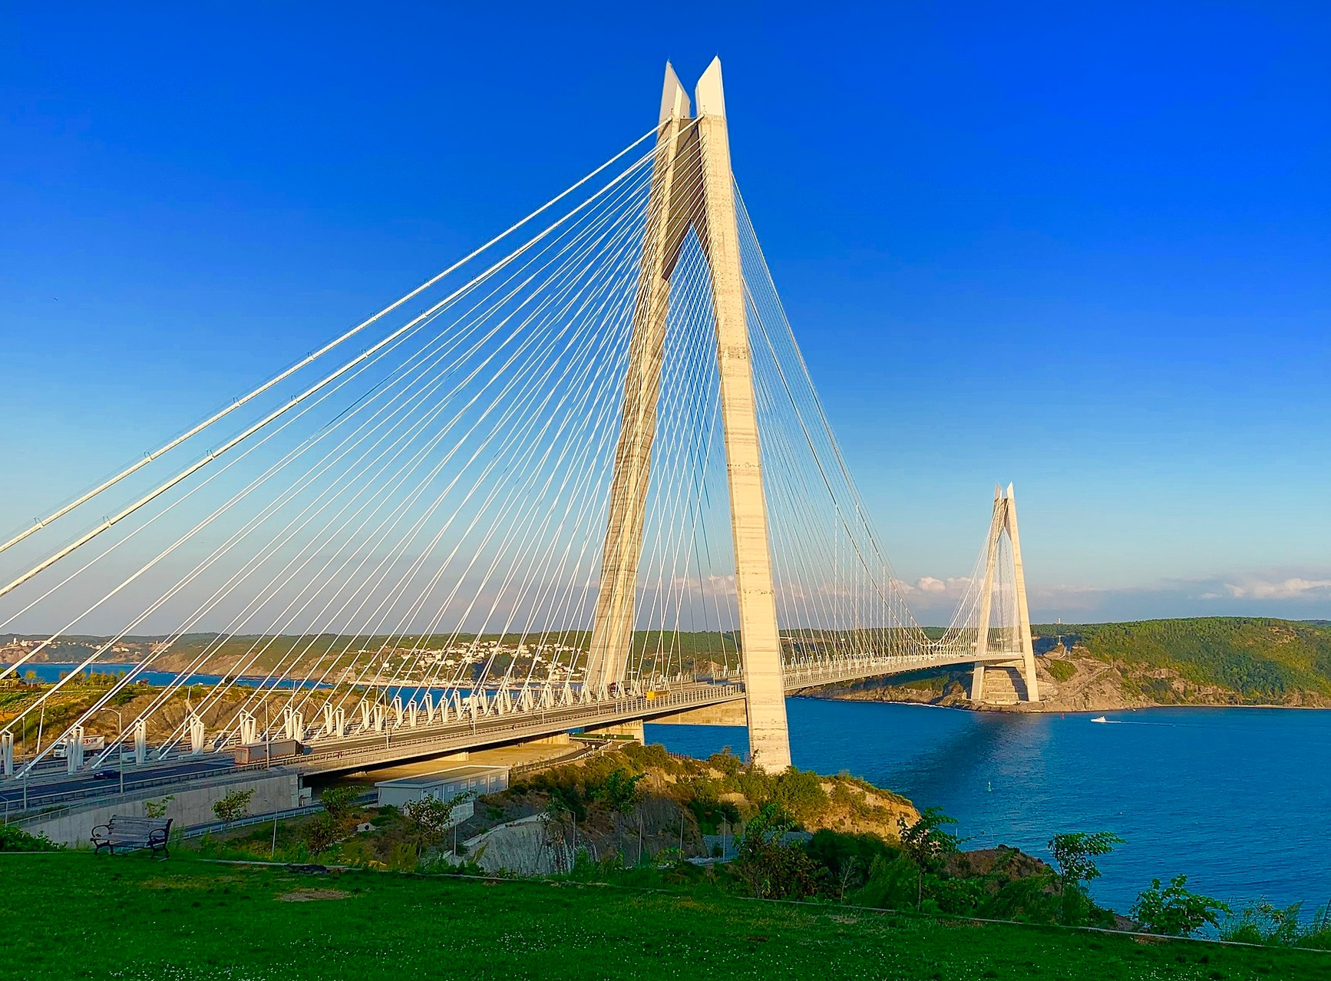
Bridging the Gap
Bridges are built to span distances and provide passage over obstacles
Building a bridge can be an extensive process with precise engineering
Much like bridges, networking has benefited from technological advancements over the years
What do you call half a bridge? A dock

Slide 3
2022 Growth
Workloads Installed
20.4%
500M
Gartner Forecasts Worldwide Public Cloud End-User Spending to Reach Nearly $500 Billion in 2022
Multi Cloud Enterprises
Expected spend in 2023
92%
$600B
Emerging Growth
Top 3 CSP Market Share
AI
61%
Sources
https://www.zippia.com/advice/cloud-adoption-statistics/
https://www.statista.com/statistics/633873/worldwide-cloud-workloads-by-service-type-installed/
https://www.gartner.com/en/newsroom/press-releases/2022-04-19-gartner-forecasts-worldwide-public-cloud-end-user-spending-to-reach-nearly-500-billion-in-2022

Slide 4
Why Go To The Cloud?
Agility & Elasticity
Supply Chain Constraints aka lead times
Collaboration
Business Continuity & Disaster Recovery
Simplicity
Cost Effective
Seemed like the hip thing to do
Source
https://www.forbes.com/sites/forbestechcouncil/2020/10/14/five-reasons-more-businesses-are-choosing-cloud/?sh=67918ad433d9

Slide 5
As network engineers, we must offer a cloud like experience

Slide 6
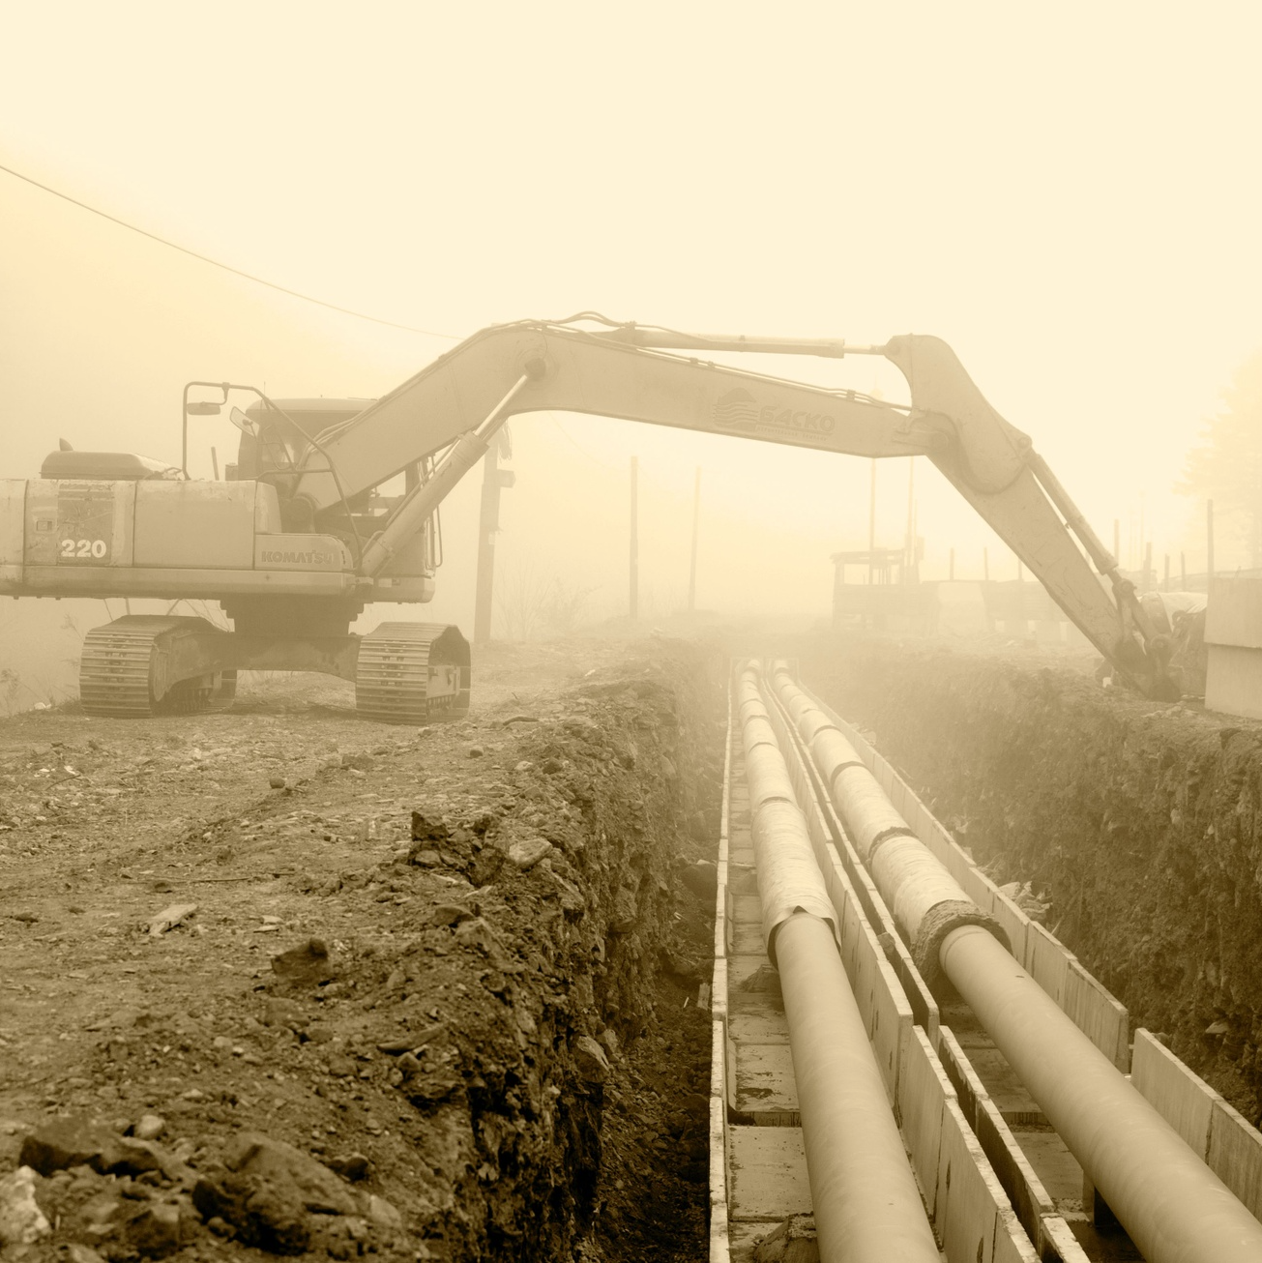
How do we get a seat at the table?
Speak the language
Be part of the pipeline
Build & enable
Fail fast, but still succeed

Slide 7
Now we have a seat. How do we keep it?

Slide 8
Walk the walk & embrace your team
Be part of the pipeline
Be part of the team
Stay Innovative
You are now the CSP, build your network right with the proper protections and then offer an API
Take your guard down
Don't compromise the network but be more willing to say yes because if you say no, the CSPs will say yes
Be a student of the industry and be curious
Don't be a dinosaur!

Slide 9
Dissecting a Cloud Service Provider (CSP)
Virtual Network
Virtual Machines
Storage
CSP
Containers
Databases
Serverless
PaaS

Slide 10
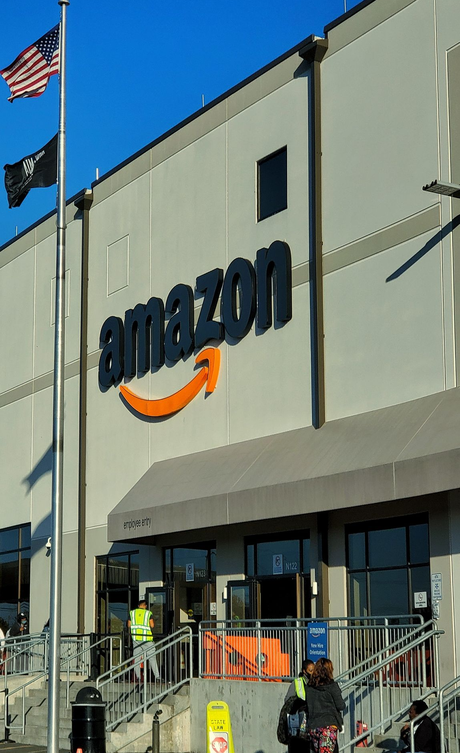
Amazon Web Services (AWS)
VPC
ec2
S3
CSP
eks
RDS
lamda
Beanstalk

Slide 11
Microsoft Azure
Vnet
VM
Blob Storage
CSP
AKS
Azure SQL
Azure Function
App Service

Slide 12
Google Cloud Platform
VPC
Compute Engine
Cloud Storage
CSP
GKE
Cloud SQL
Cloud Functions
App Engine

Slide 13
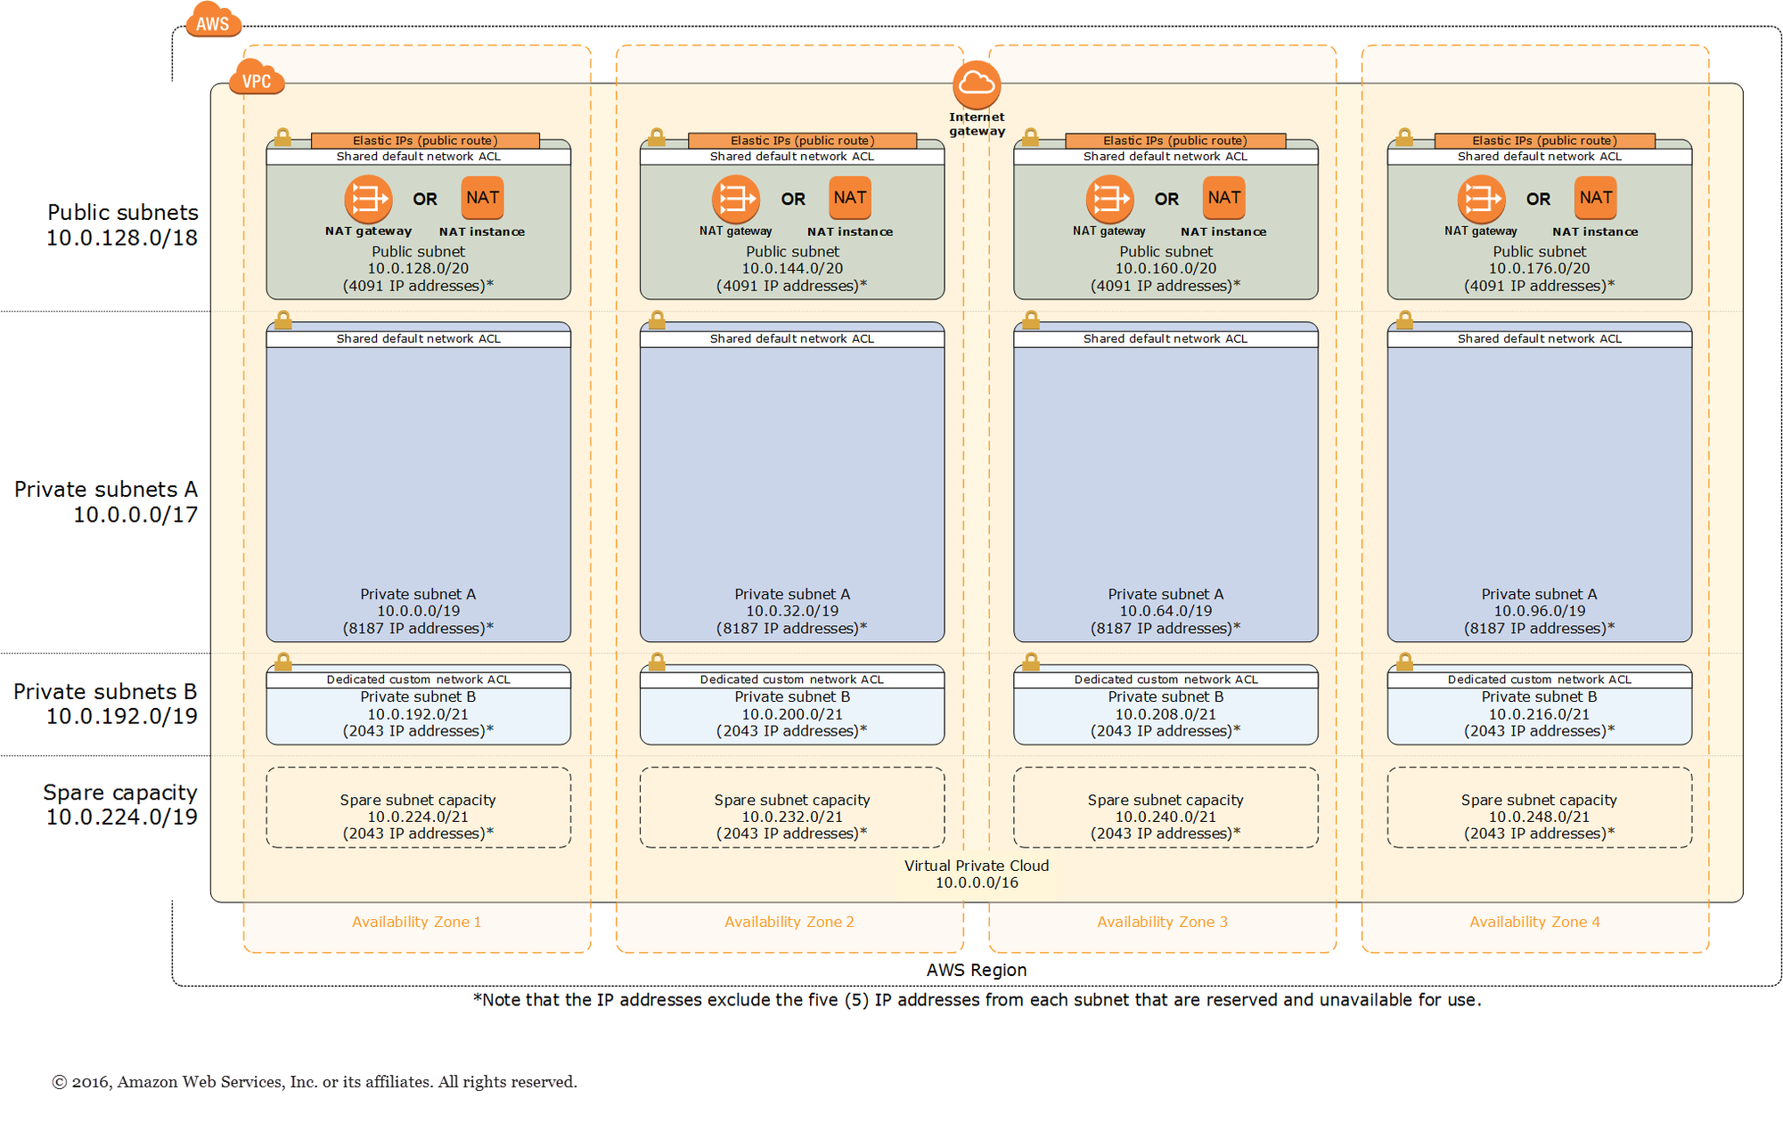
AWS Networking Overview
Key Components
Accounts
Regions
Availability Zones
Virtual Private Clouds (VPC)
Subnets
Internet Gateways (IGW)
NAT Gateways
Network ACLs
Security Groups
CloudWAN
DirectConnect
https://docs.aws.amazon.com/quickstart/latest/vpc/images/quickstart-vpc-design-fullscreen.png

Slide 14
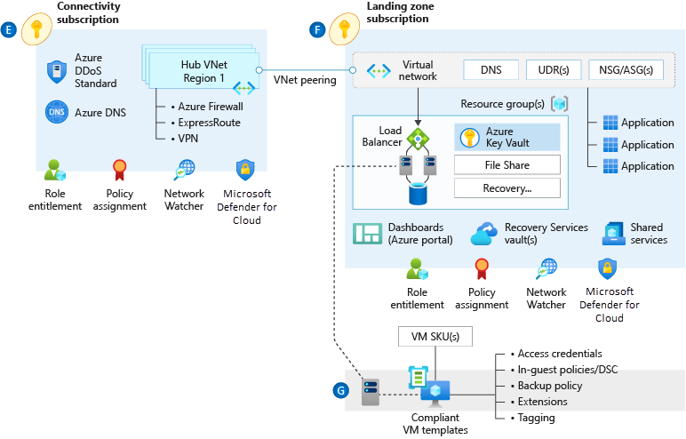
Azure Networking Overview
Key Components
Subscriptions
Resource Groups
Virtual Networks (VNet)
Network Virtual Appliances (NVA)
Load Balancers
User Defined Routes (UDR)
Network Security Groups
Virtual WAN (VWan)
Azure Route Server
ExpressRoute
https://learn.microsoft.com/en-us/azure/cloud-adoption-framework/ready/azure-best-practices/traditional-azure-networking-topology

Slide 15
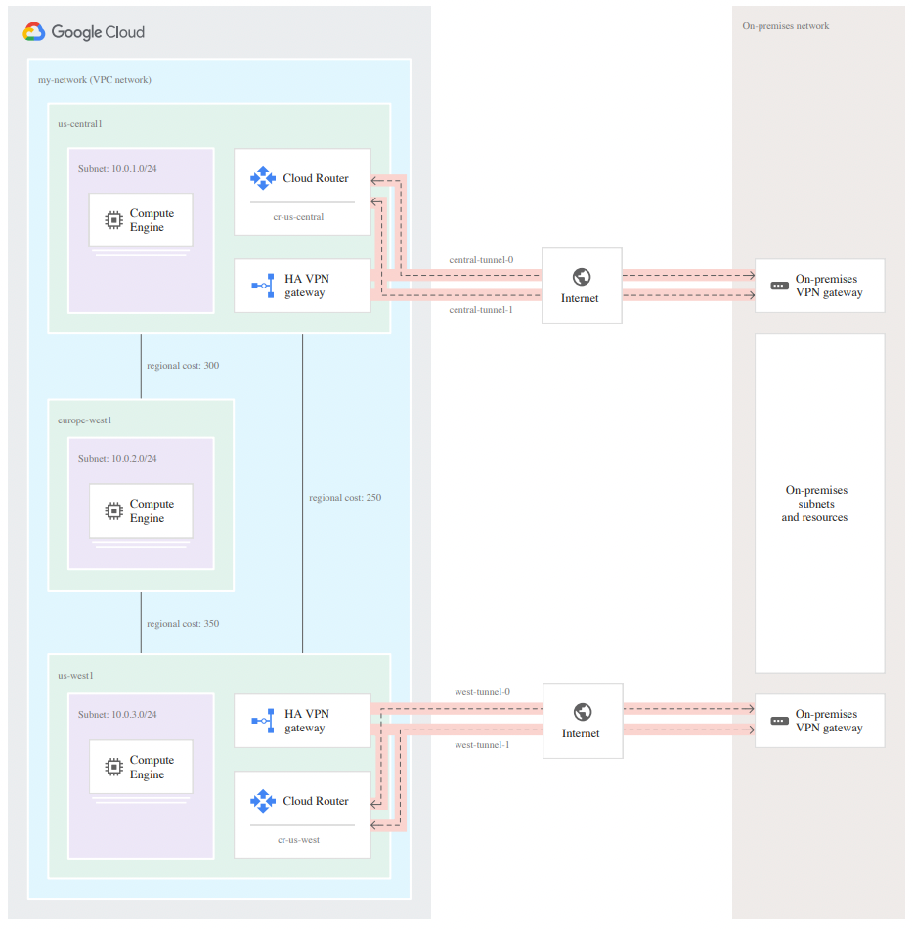
Google Cloud Networking Overview
Key Components
Projects
Virtual Private Clouds (VPC) - Global
Region
Subnets
Cloud Routers
Network Connectivity Center (NCC)
Cloud InterConnect
https://cloud.google.com/network-connectivity/docs/router/concepts/overview

Slide 16
Connecting To The Cloud
Consider your options, do your research
Type text
VPN
CSP Connectivity
Bandwidth Providers
VPN provides fast & encrypted connectivity
CSPs offer connectivity at various locations and speeds
Providers like Equinix & Megaport offer cloud connectivity similar to direct offerings from the CSP

Slide 17
VPN Connectivity
Connectivity over commodity Internet
Fast (both in speed and deployment)
Encrypted (IPSec)
Redundant
Where does the VPN land/terminate?
Connectivity could land in a shared services area or other central location, but it does not have to

Slide 18
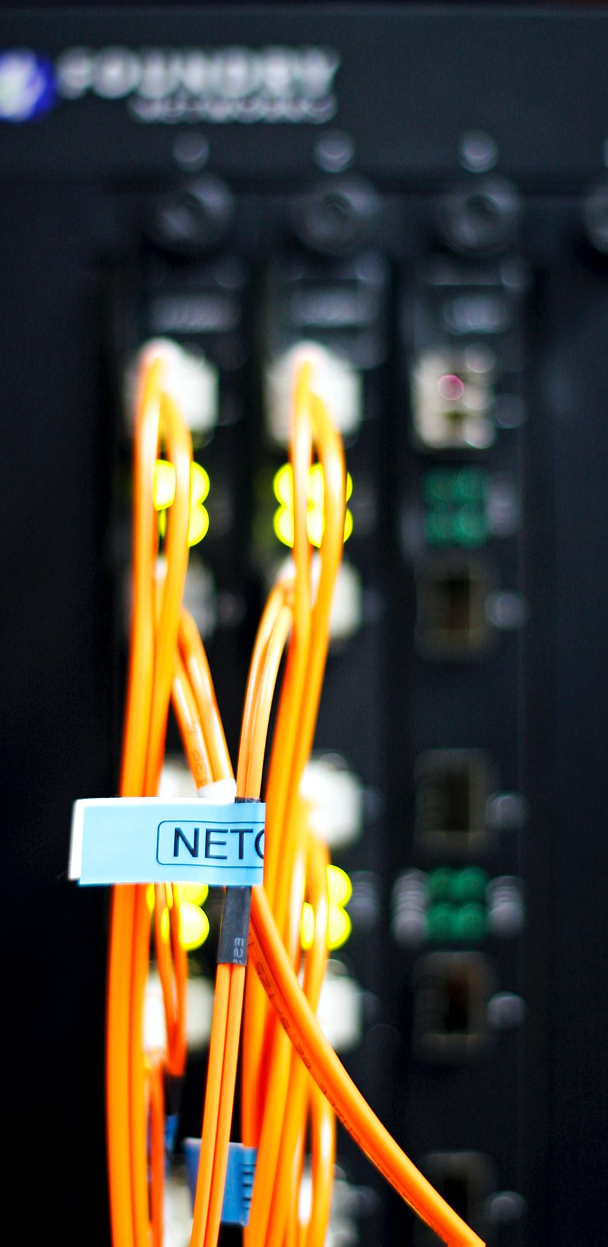
CSP Connectivity
Connectivity from the CSP
Lowest Latency
High bandwidth & dedicated capacity
Region specific
What are some other concerns with CSP connectivity
MACSec may be available for encrypted connectivity but VPNs can also be provisioned on top of CSP connectivity.
Availability must be taken into account both in terms of geographic and how soon the circuit is needed.

Slide 19
Bandwidth Provider Connectivity
Connectivity from a Bandwidth Provider
Cost effective
Quick turnaround
Great geographic availability
Why go with a third party rather than the CSP itself?
A lot of this depends on how much bandwidth you need, how many regions you require connectivity and how many CSPs you're connecting to.
This will utilize the bandwidth providers global fabric so some form of encryption should be discussed if required (IPSec or MACSec).

Slide 20
Networking doesn't stop at the edge
Edge connectivity is just the beginning, understanding where and how data egresses and ingresses the cloud can be critical for application performance
Do your research
Much like traditional networking, cloud networking requires complex engineering and multiple design iterations
Work with your cloud team and CSP account team
CSP features are tough to keep track of, don't rely on yourself to stay up to date with what new network innovations have been released with CSPs
Don't build a dock
Building connectivity to the cloud doesn't just stop at the edge, take the time to learn how cloud works and make yourself part of the pipeline

Slide 21
Thank You
Teren Sapp - @terensapp

