Slide 1
WISP Networks
And tidbits

Slide 2
Topics Covered
Brief History of what a WISP is
Modern WISPS
WISP whys & challenges
Network Topologies
Q & A

Slide 3
About Me
J2sw.com
Packetsdownrange.com
Been in the ISP industry since 1993
Avid GI Joe Collector
Notes:
Subscibe to my newsletter at PDR

Slide 4
Brief History of WISPs every network type has the dark days
Notes:
All IT has the Dark days. Imagine it’s the year 2008 and you are having to buy cases from oen manufacturer, and motherboards from another to make your switches.

Slide 5
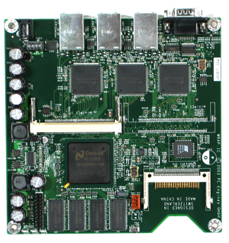
History
802.11 protocols used outdoor with home brew type equipment
Companies like Motorola, Mikrotik, and Ubiquiti started making equipment
Unlicensed frequency up until a few years ago (5GHZ, 2.4GHZ, 900MHZ)
Many were selling >1 meg plans until streaming came along
Lots of natting
Notes:
Imaging having to assemble your switch

Slide 6
Old School Cisco
Notes:
Actually had this equip,ent on towers in boxes providing internet 10 miles away

Slide 7
What Changed?
Customers need for more bandwidth
Government oversight
Government compliance
Internet is essential. Need to become a carrier
Notes:
BEAd reporting, form 477, CALEA,

Slide 8
The Modern WISP
Rapidly becoming a hybrid of wireless and fiber
Carrier class or you aren’t going to make it
Still environmental and space design concerns
Money is improving for better stuff
CBRS, 6GHZ, and licensed links more in reach
Operator needs to step up to meet reporting regulations
Bandwidth
5G & Cellular?
Notes:
Many folks were HAM radio operators used to shoestring budget

Slide 9
The Whys of WISPs
Notes:
Wanting the audience to understand why WISPs make the decisions they make.

Slide 10
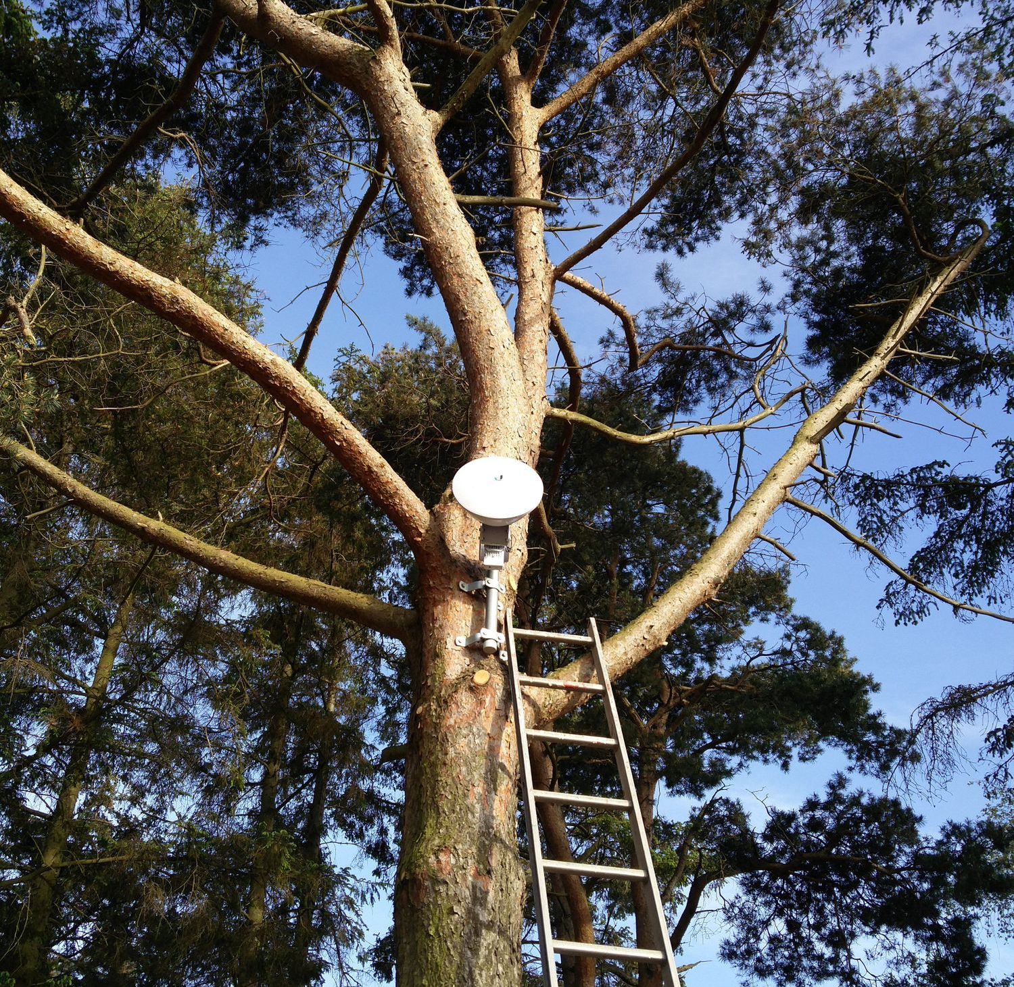
WHYs
In areas with little to no broadband
Typically, rural or underserved
Dependent on whomever can provide transit pipes
Little data center presence starting out.
Notes:
The picture here speaks volumes about WISPs and their ingenuity.

Slide 11
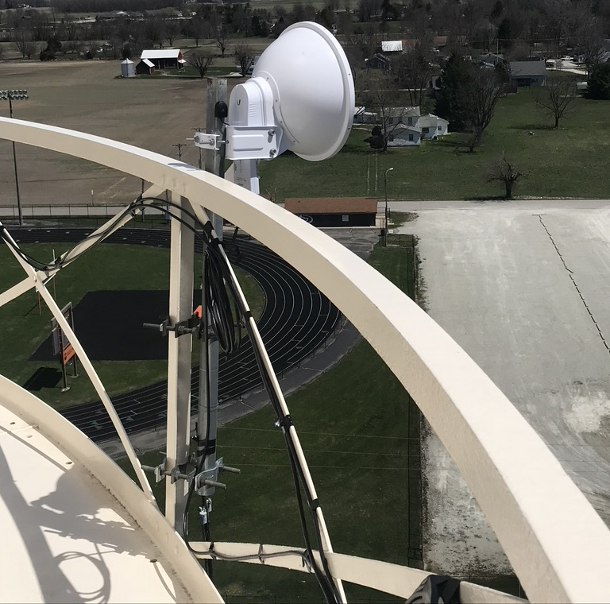
Whys
Historically no USF or government funding
According to broadbandnow the average WISP is 1200 customers. I think it’s less than that.
Mount stuff wherever they can

Slide 12
Hardware used
Environmental and space challenges are a big factor in equipment selection
Mikrotik is a dominant choice in WISP transport networks
Hardened equipment is always a concern
Lightning and surge suppression
Budget vs ROI
Equipment can influence topology greatly

Slide 13
Some WISP photos

Slide 14
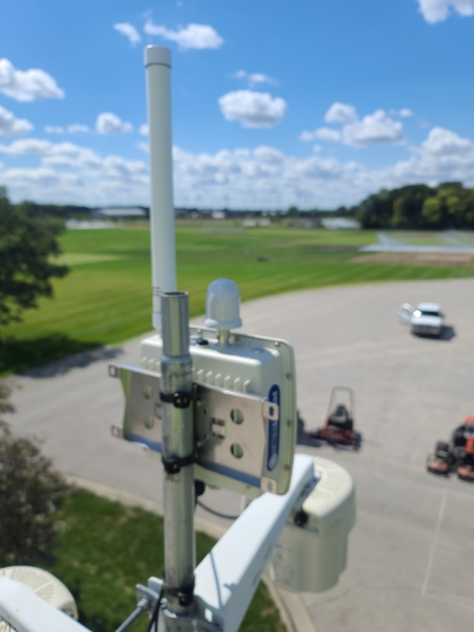
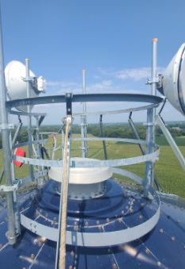

Slide 15
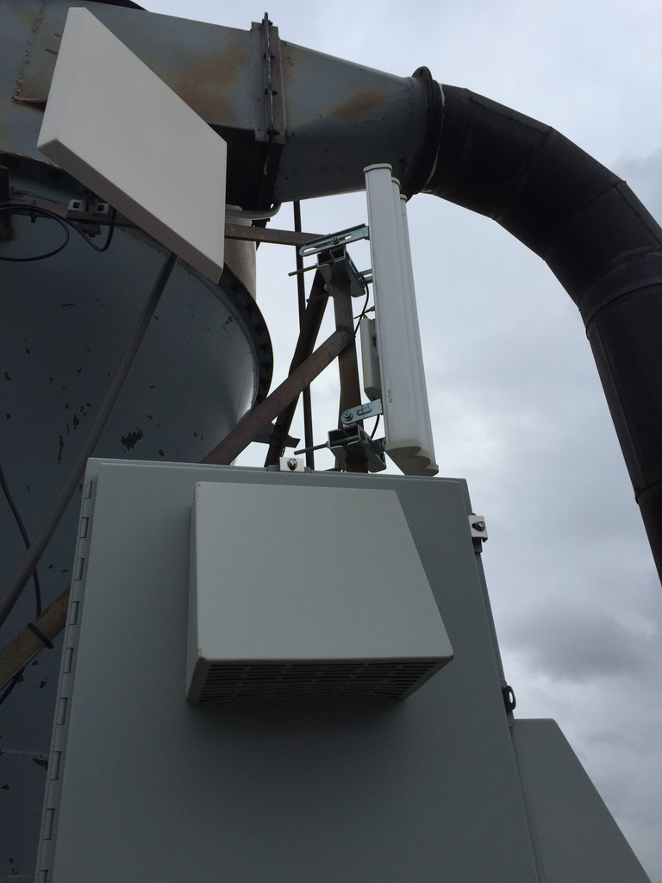
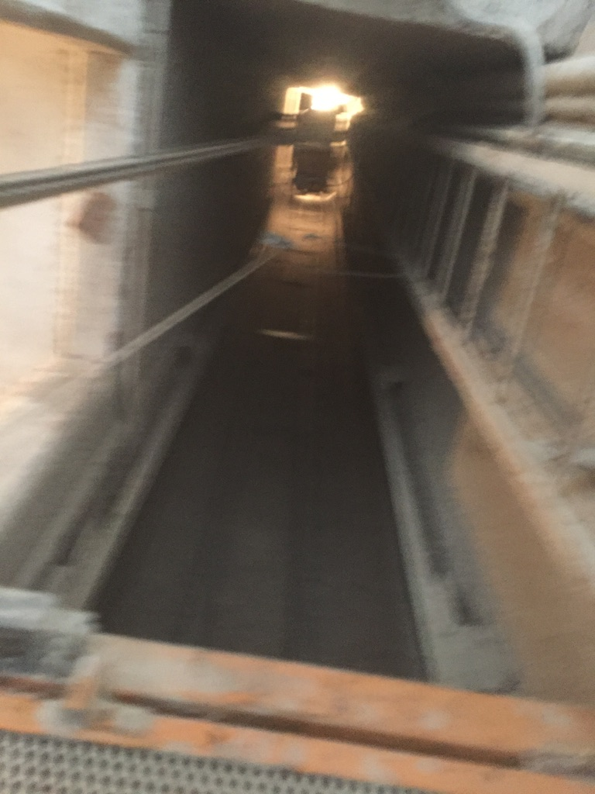

Slide 17
WISP 100g

Slide 19
Topologies
Bridged
Static Routed
OSPF routed
MPLS/VPLS
iBGP
Typically lots of natting
Little to no ipv6
Little IPv4 publics space available

Slide 20
Bridged
Friends don’t let friends bridge networks
Simple and may not need to scale

Slide 21
Static Routed
Why overcomplicate a network of 50 customers?
Not scalable but does it need to be?

Slide 22
OSPF
Now we are getting geeky
Useful for redundant backhauls an exit points
Requires gear that can do OSPF

Slide 23
MPLS/VPLS
Many do it because they read a book
Can be overcomplex on a wisp network

Slide 24
iBGP and other technologies
Very few WISPs have the network to support iBgp
Many don’t even do eBGP *
Data Centers are just now becoming important
Middle mile projects are helping

Slide 25
What is coming?
5G
Still lots of data caps and restrictions
IPV6
Peering
More spectrum use
QOE
Notes:
How to get more out o backhauls and pipes. For many in the data center and hard core networking world the typical WISP is a few years, if not more behind. They have been focusing on getting any type of connection they can to the customer.

Slide 26
Q&A
j2sw@j2sw.com

