Slide 1
Stand up for your Routes!
Using the Resource Public Key Infrastructure (RPKI)
Brad Gorman, Product Owner Routing Security
American Registry for Internet Numbers (ARIN)
May 2023

Slide 2
What’s Being Covered Today
Security of the Early Internet
The Goal of the RPKI
Current RPKI Deployment
Using ARIN’s RPKI Services

Slide 3
Security of the Early Internet

Slide 4
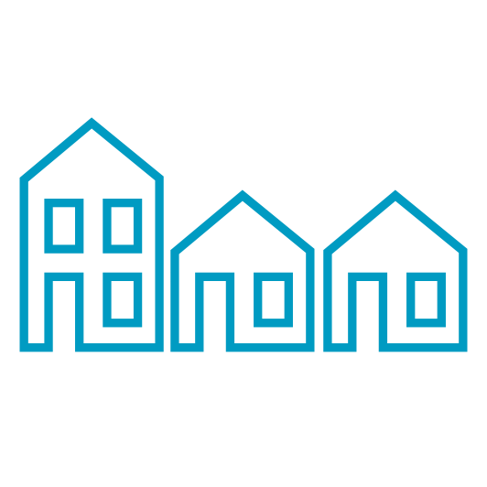
BGP Enabled the Internet We Know Today
Made it easy to establish peering sessions with neighboring networks
Transitioned from information sharing to a commercial platform
Scaled beyond where best effort sharing of routing policy was reliable

Slide 5
Routing Policy Specification Language (RPSL)
RPSL is a standard language used by Internet Service Providers to build security policy on network devices
Internet Routing Registry (IRR) is an ecosystem where operators share information about their policies
ARIN authenticates entries in our database, confirming the resource holder created the objects
We don’t discourage using a 3rd party IRR for redundancy, however, information cannot be verified

Slide 6
The Goal of the RPKI

Slide 7
The Goal of the RPKI
RPKI gives operators another data set to make more informed routing decisions (RPKI Validity State)
Protect resource holders from impact resulting from human error or nefarious activity
Reduce the overall attack vector for attempted hijacks on the greater Internet
Provide a cryptographically signed method for an Internet number resource holder, allowing them to make an authoritative statement about the origin of a prefix(s) announced on to the Internet (Route Origin Authorization, ROA)

Slide 8
Internet is More Complex Today
B
E
H
AS 200
198.51.100.0
AS 100: 192.0.2.0/24
C
F
AS 100
192.0.2.0
D
G
AS 200: 198.51.100.0/24

Slide 9
Bad Actors Will Find a Way
B
E
H
AS 200
198.51.100.0
C
F
AS 100
192.0.2.0
D
G
AS 999
198.51.100.0
AS 200: 198.51.100.0/24
AS 200: 198.51.100.0/24
AS 999: 198.51.100.0/24

Slide 10
RPKI in Action
ROA
B
E
H
AS 200
198.51.100.0
C
F
X
AS 100
192.0.2.0
D
G
AS 999
198.51.100.0
AS 200: 198.51.100.0/24
AS 999: 198.51.100.0/24

Slide 11
RPKI in Action
B
E
H
AS 200
198.51.100.0
ROA
C
F
X
AS 100
192.0.2.0
D
G
AS 999
198.51.100.0
X

Slide 12
RPKI in Action
AS 200
198.51.100.0
ROA
B
E
H
C
F
X
AS 100
192.0.2.0
D
G
AS 999
198.51.100.0
X

Slide 13
Current RPKI Deployment

Slide 14
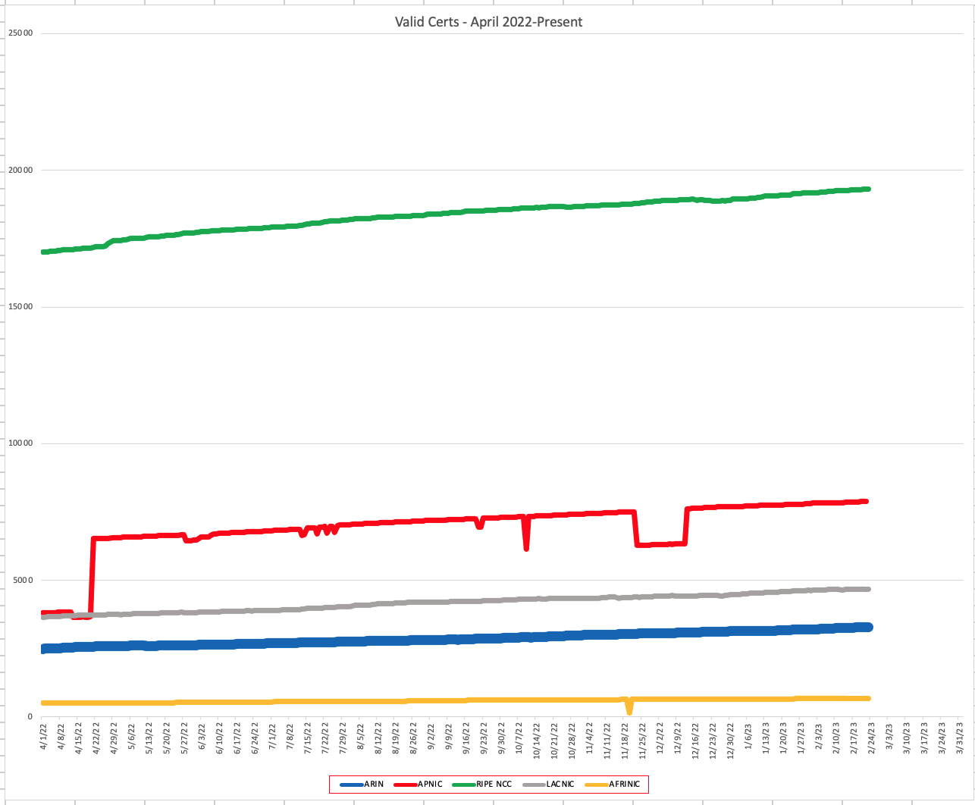
RPKI Adoption – Org Participation
Only 19.5% of Orgs registered to use ARIN’s RPKI services
Hosted – 3,201
Delegated – 80
Repository Service (RPS) – 31

Slide 15
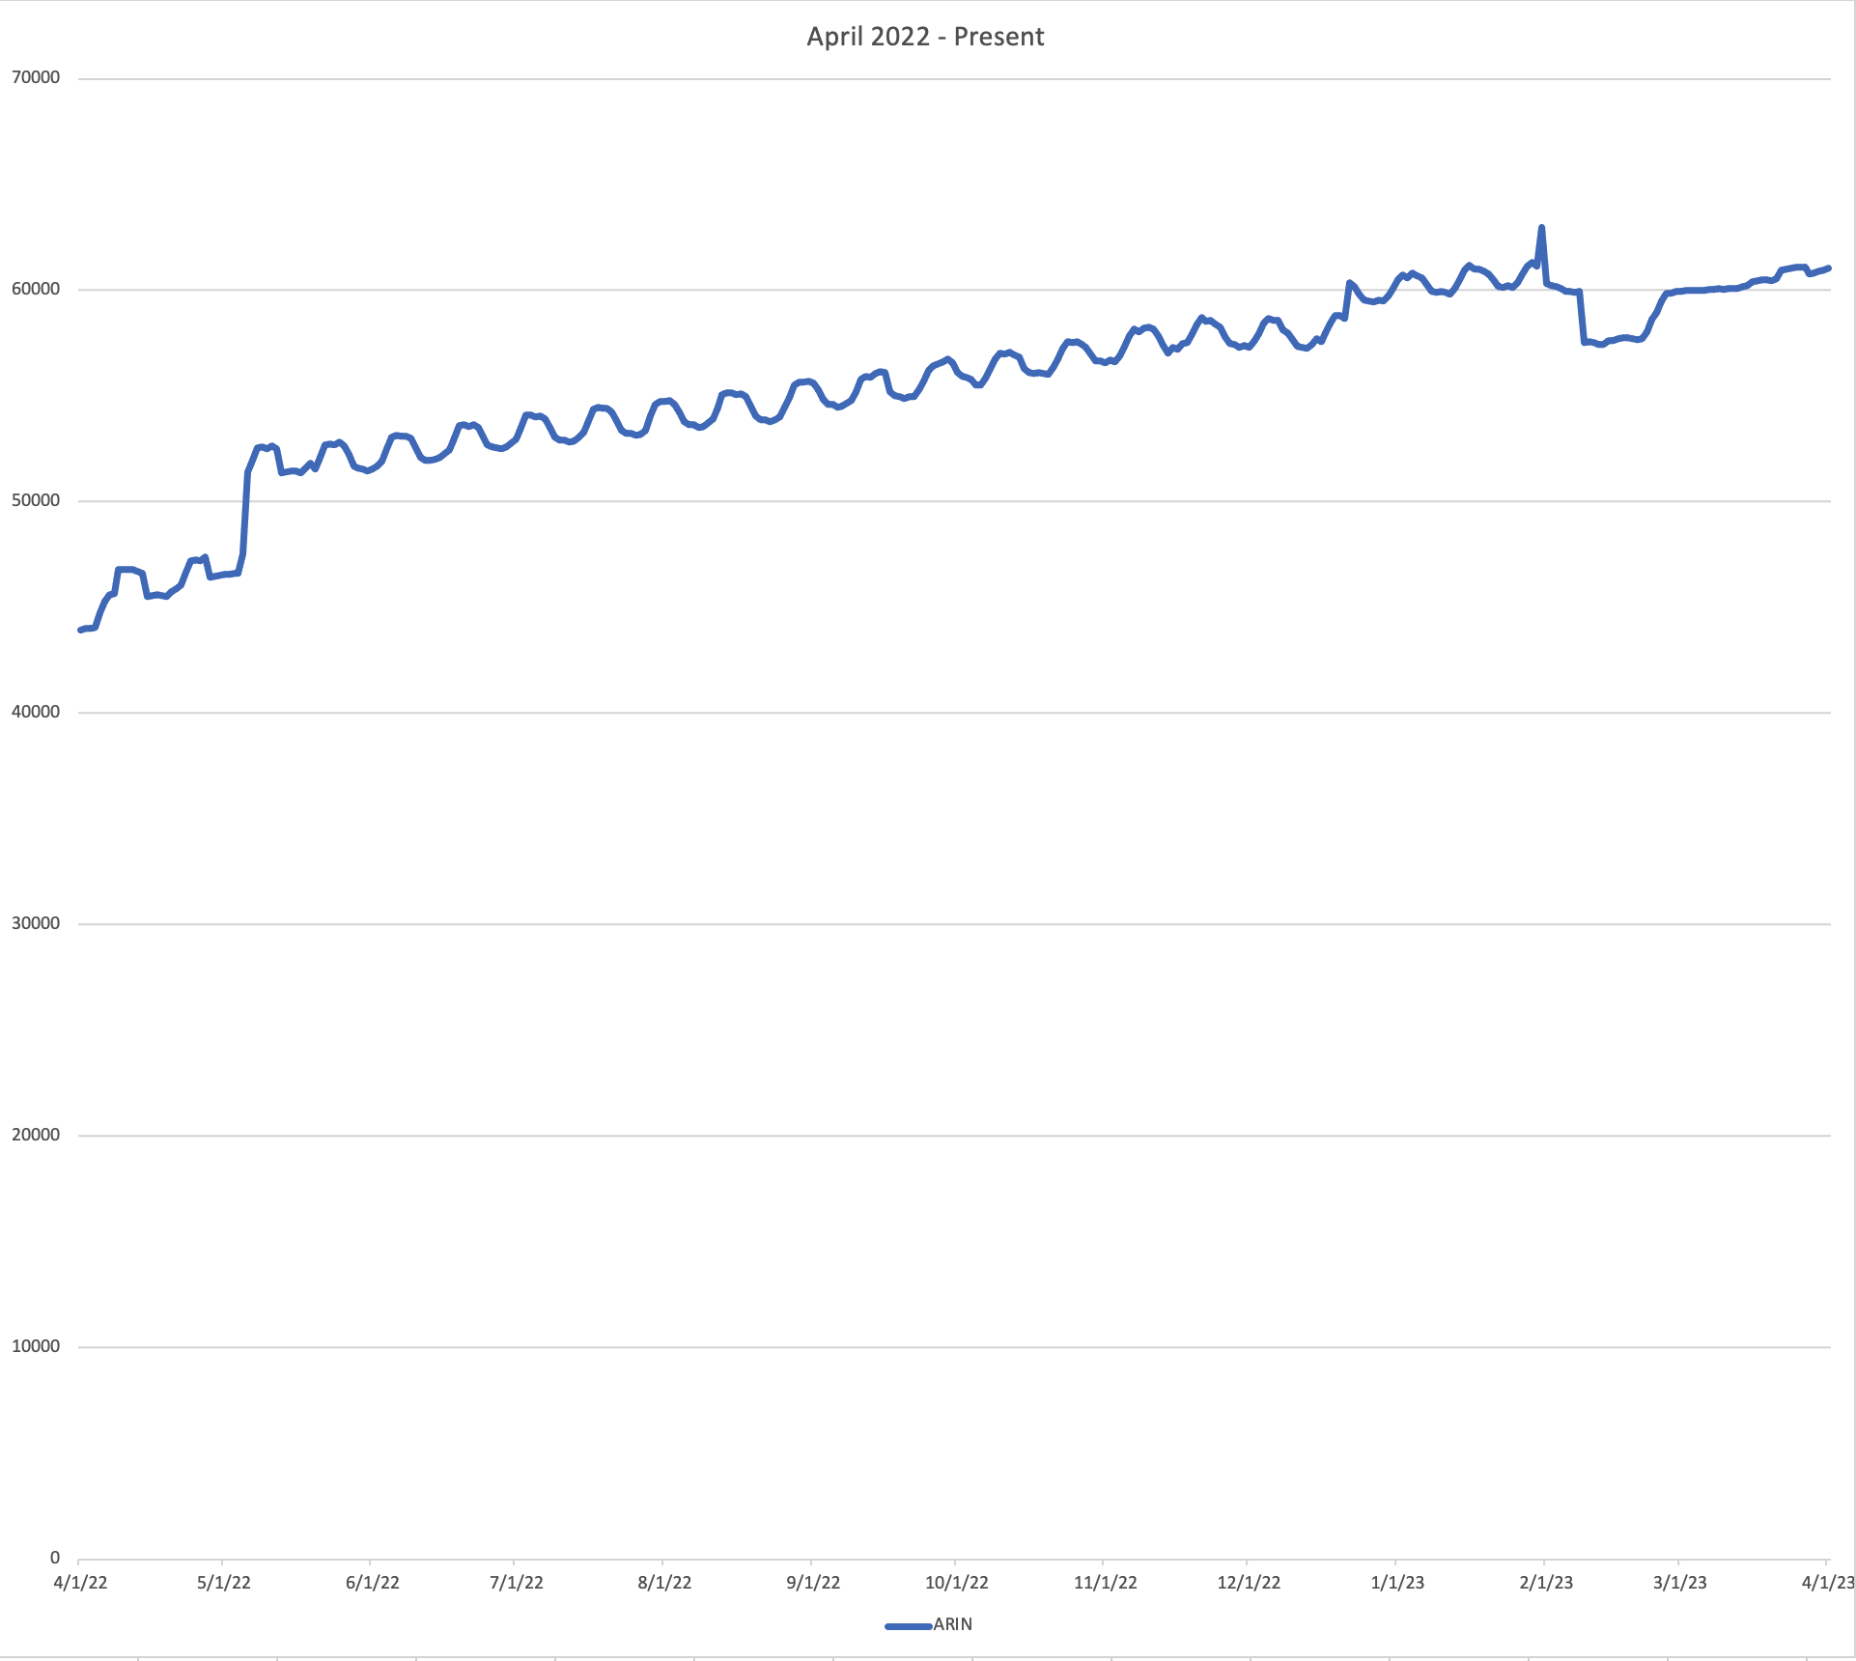
RPKI ROAs – Covered Prefixes
ARIN's Hosted Repository
Route Origin Authorizations (ROAs): 54,892
Validated ROA Payloads (VRPs*): 66,774
ARIN's RPS Repository
ROAs: 1,150
VRPs*: (prefixes): 2,979
* VRPs contain an IP prefix, a maximum length, and an origin AS number derived from a validated ROA, (validated by ARIN to contain authoritative data).

Slide 16
RPKI Valid Route Announcements
28.91% of Internet routes with ARIN IPv4 resources marked as RPKI Valid*
Up 6.5% year over year
47.88% of Internet routes with ARIN IPv6 resources marked as RPKI Valid*
Up 4.2% year over year
* To be considered RPKI valid there must be a VRP that exactly matches an existing route announcement in the global BGP table

Slide 17
RPKI Valid Resources
45.3% of eligible* ARIN IP resources announced are marked as RPKI valid**
508M (eligible) / 1.12B (allocated to ARIN)
5.0% increase year-over-year
* Resources must be covered by a valid (L)RSA agreement to be eligible for RPKI services at ARIN
** To be considered RPKI valid there must be a VRP that exactly matches an existing route announcement in the global BGP table

Slide 18
We can do better!

Slide 19
Using ARIN’s RPKI Services

Slide 20
Hosted RPKI Service
Trust Anchor
Certificate Authority (CA) managed by ARIN
Repository and Publication services run by ARIN
Org creates and maintains their ROAs
Accessed via ARIN Online portal or the RESTful API
* Easiest to use; Recommended for most organizations just getting started with RPKI. Nearly 98% of ARIN participants use Hosted RPKI.
ARIN Hosted Repository
Hosted
ARIN CA
ARIN Repo
Relying Party
Data Collection
Crypto Validation
BGP Router
BGP Router

Slide 21
Delegated RPKI Service
Trust Anchor
The organization has more control and independence
Runs their own CA to manage object signing
Separation of the publication of cryptographic functions
* Highest responsibility and uptime requirement; only organizations with in-depth knowledge of RPKI and resources to run a Certificate Authority (CA) and a publication server, should select Delegate RPKI.
Operator’s
CA and Repository
Delegated
Operator CA
Operator Repo
Relying Party
Data Collection
Crypto Validation
BGP Router
BGP Router

Slide 22
Repository Publication Service (Hybrid RPKI)
Trust Anchor
Maintain control and independence of Delegated RPKI
Runs their own CA to manage object signing
Off-load Repository and Publication services to ARIN
* Suggested for organizations that wish to retain cryptographic control, and do not want to maintain the high availability repository and publication functions
Operator’s
CA
ARIN RPS Repository
Hybrid
Operator CA
ARIN Repo
Relying Party
Data Collection
Crypto Validation
BGP Router
BGP Router

Slide 23
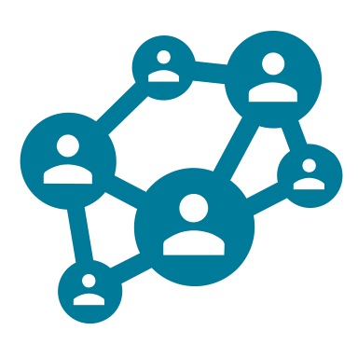
Before Getting Started
IPv4 or IPv6 number resources allocated to your organization by ARIN
Autonomous System Number
Your user account needs to be associated with the org as the Admin, Tech, or Routing Point of Contact (POC)
A signed RSA or LRSA (RPKI Terms of Service if needed)

Slide 24
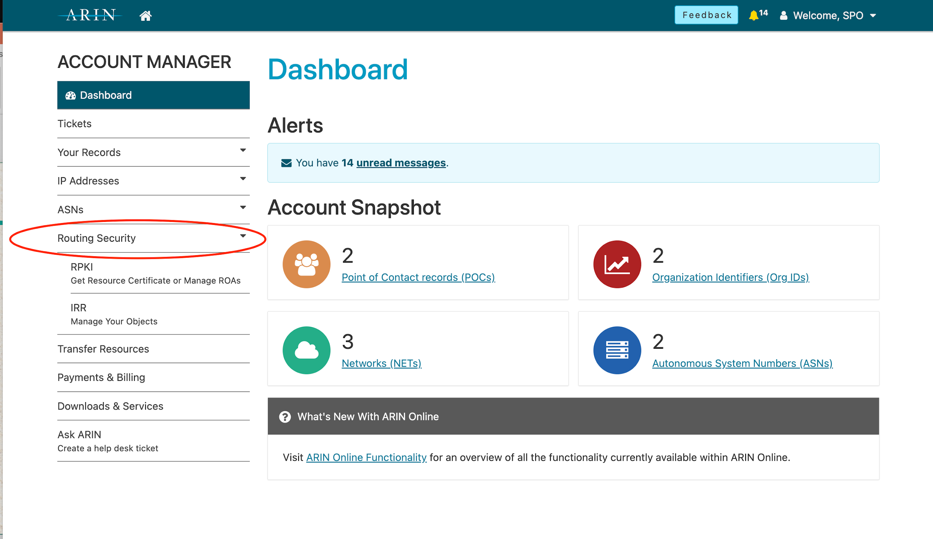
Simplified Navigation
Routing Security dropdown
Fewer clicks to RPKI

Slide 25
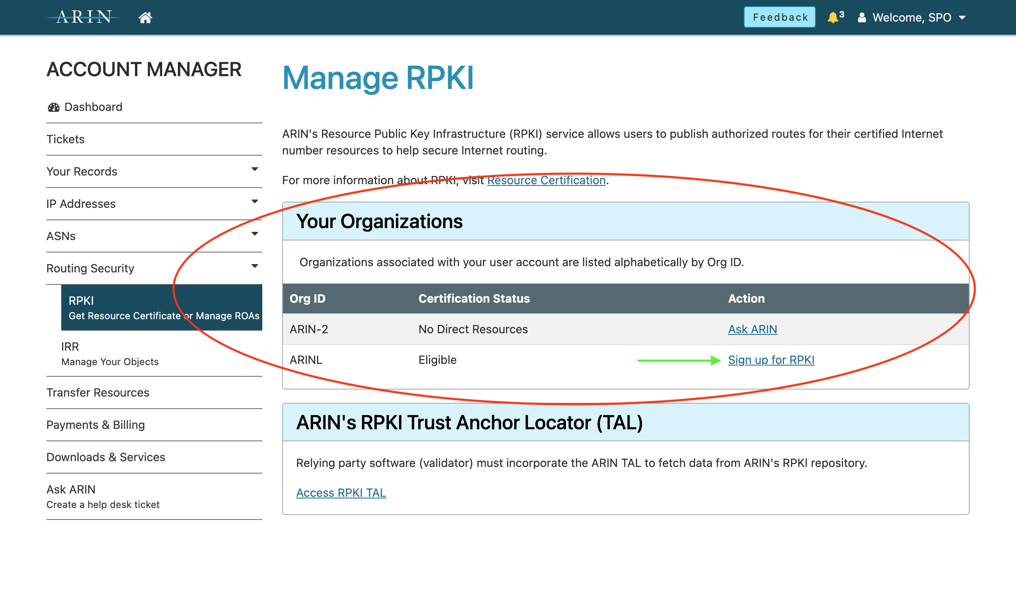
Simplified Navigation
List of all Linked Orgs
Certification Status

Slide 26
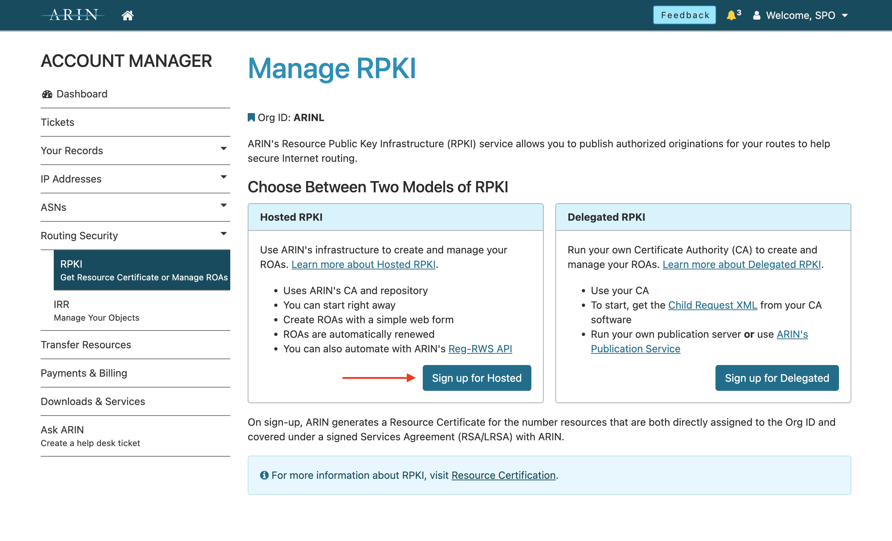
Hosted or Delegated RPKI
Formerly a ticketed process
Required RSD action to complete

Slide 27
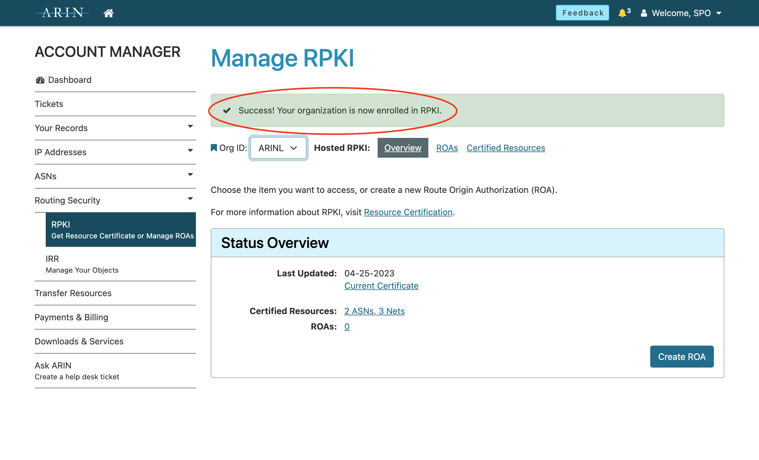
One-Step Signup
Resource certificate is automatically created (covered by RSA/LRSA)
Ready to create ROAs

Slide 28
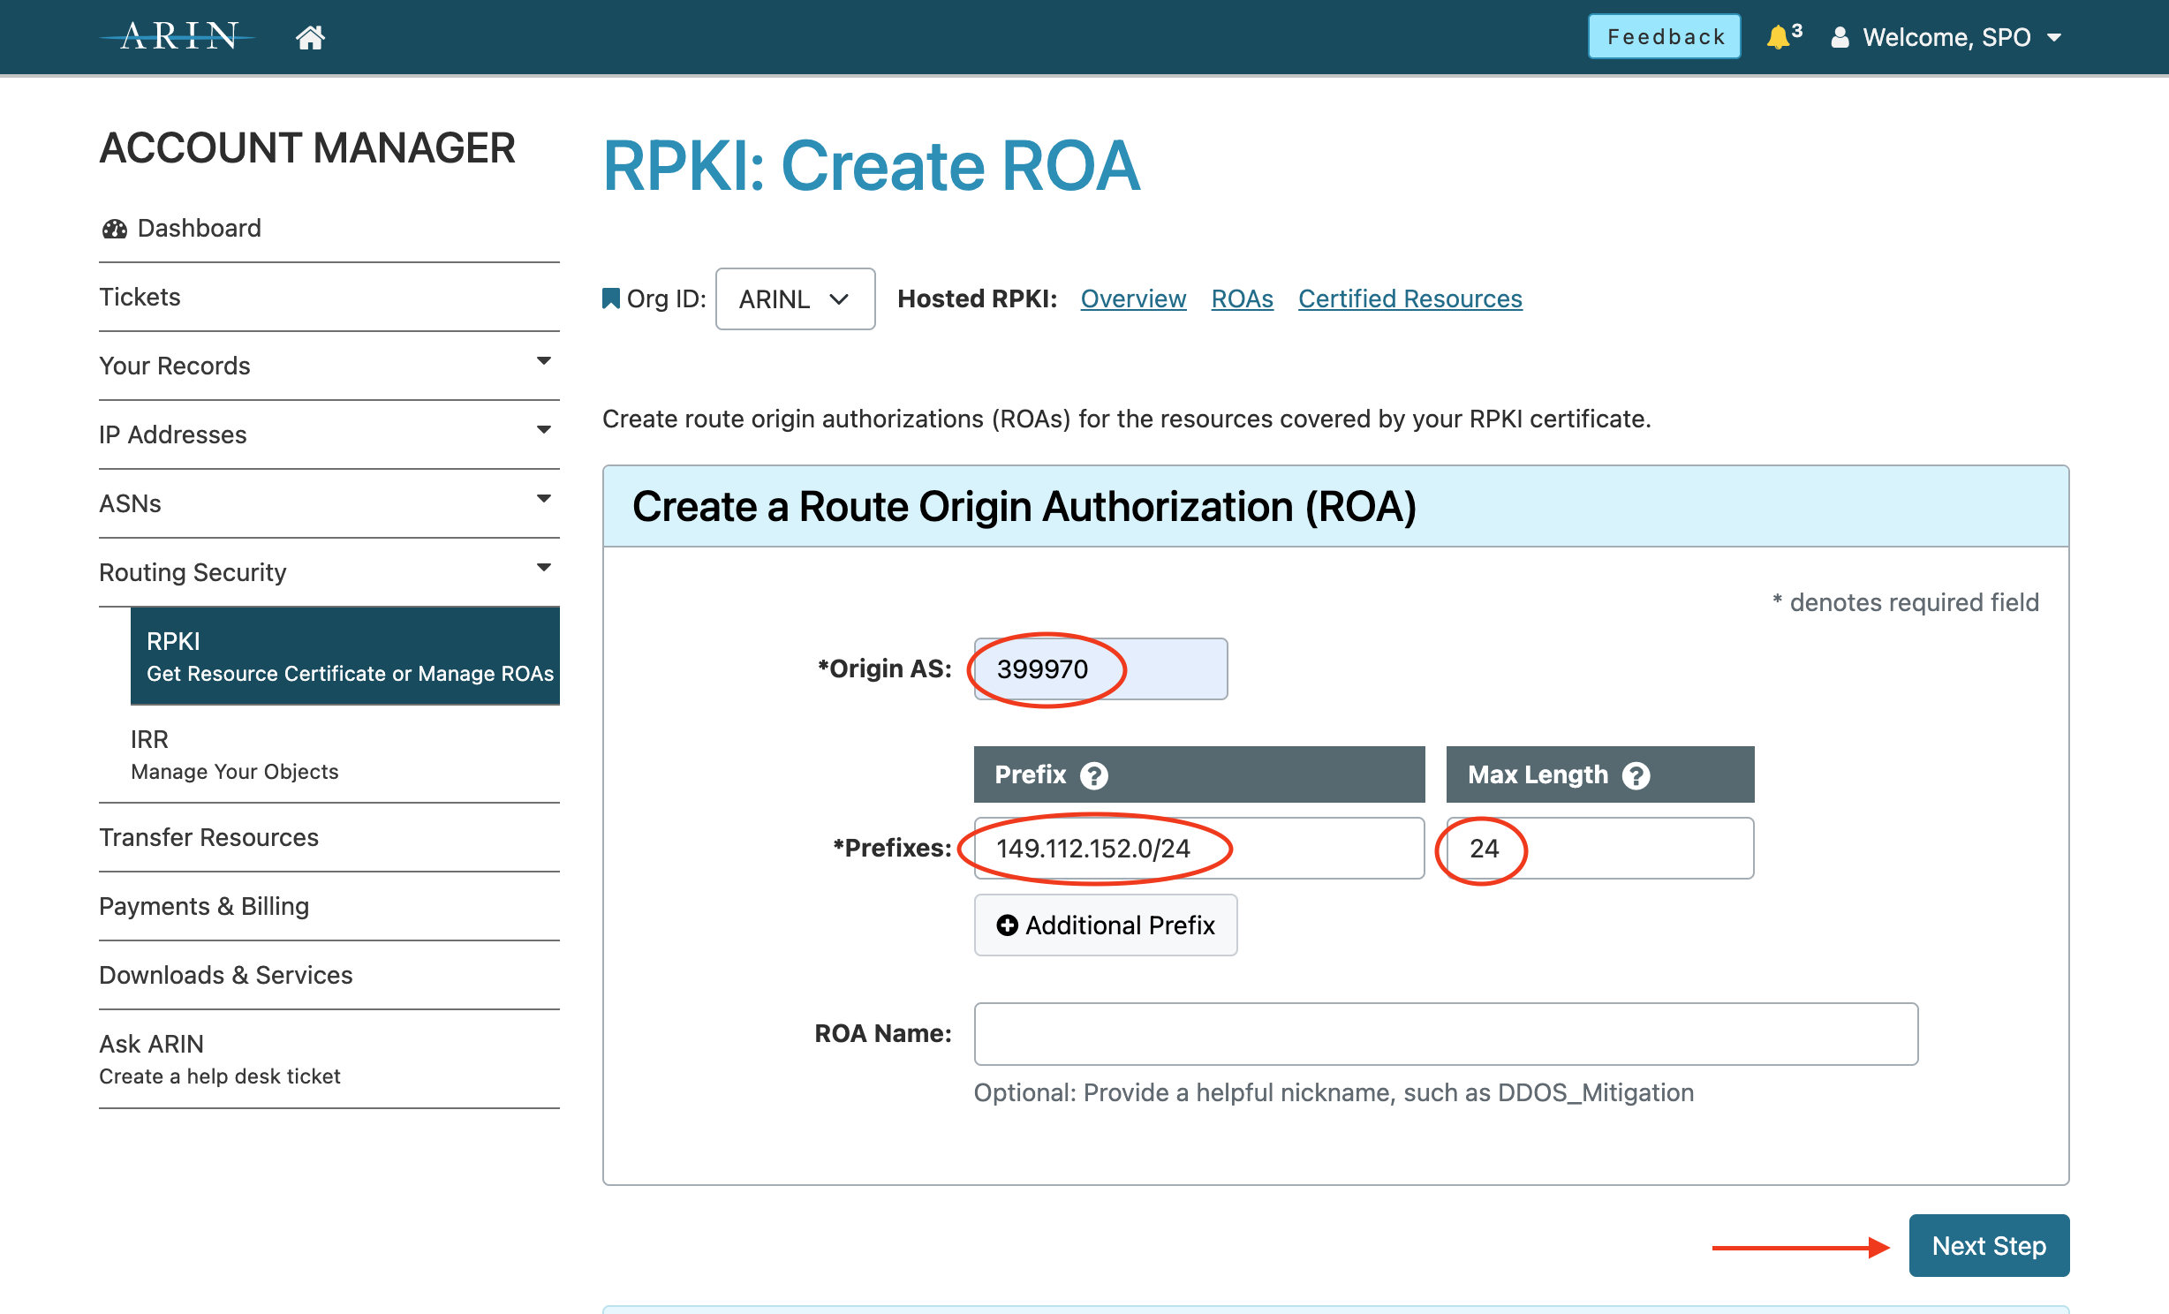
Create Your ROA By Fill In The Blank
No Validity Dates
No ROA signing keys

Slide 29
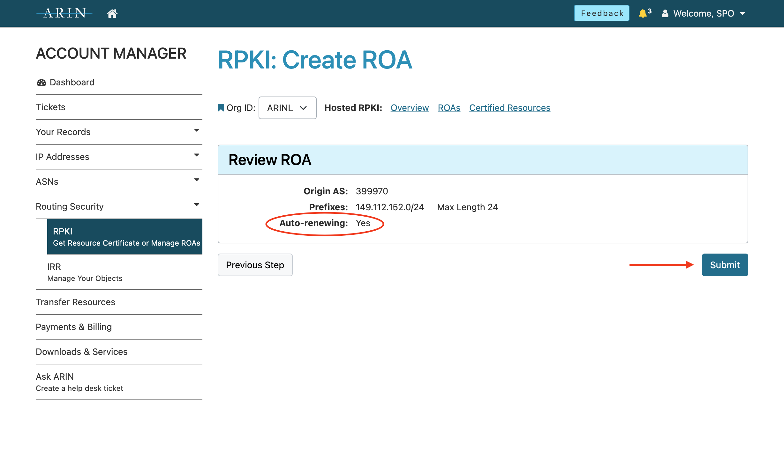
ROAs are Evergreen
Auto Renewing ROAs!
All ROAs created in UI switch to auto-renew

Slide 30
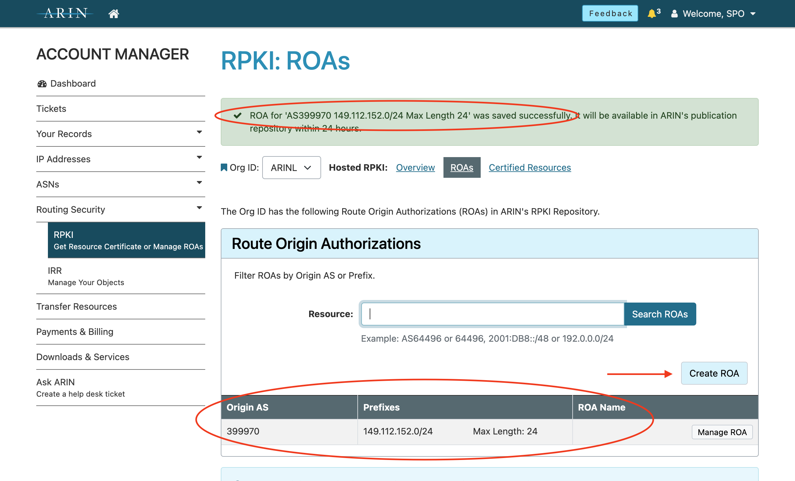
Create More ROAs
Confirm ROA creation
Direct return to ROA list
One click to create more ROAs

Slide 31
Stand Up For Your Routes!

Slide 32
Stand Up for Your Routes!
Creating ROAs for your resources benefits more than just you but also operators who make decisions based on RPKI validity state
There are documented cases where RPKI has been proven to interrupt hijack attempts before they become impactful
Growing number service providers require you to create ROAs for your resources before a business relationship is established
Ongoing standards work in the IETF is defining new features and use cases for the RPKI

Slide 33
RPKI Questions For ARIN?
From the User Dashboard
Select Ask ARIN
“Chat with us!”
Call the ARIN Helpdesk
+1.703.227.0660
Routing Security Team
routing.security@arin.net

Slide 34
Thank You

