Slide 1
Blockchain in Networking
Mike McBride

Slide 2
Blockchain Standards - Networking

Slide 3
Blockchain in the Supply Chain
Every day, there are $140 billion tied up in disputes for payments in the transportation industry.
4°
4°
10°
4°
10% of sensitive biopharmaceutical shipments experience temperature deviations. Problems when exceeding acceptable temperature.
Swiss Tech Firm SkyCell created blockchain enabled refrigerated containers that brought their temperature-deviated rate down to <0.1%.

Slide 4
Blockchains store transactions over a distributed state and help
to determine who owns what,
to provide asset tracing, and
to secure digital content and data.

Slide 5
Consensus protocols are the backbone of blockchains, validating transactions, adding blocks, and working on inconsistent state (PoW, PoS, etc).

Slide 6
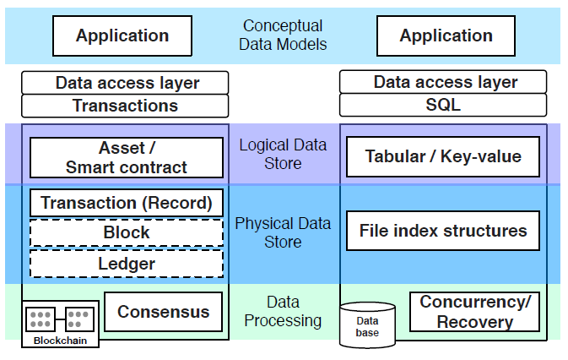
Could you use a traditional DB?
Databases are controlled by an admin
Client/server in nature
Malicious actors can alter data
Administrator decides which data is accessible and visible
They are easy to implement and maintain
They are fast and scalable
Blockchains are decentralized and allow permissionless participation.
Nearly impossible to alter data
No central administrator authority
But not particularly fast

Slide 7
Blockchain P2P Network
Consists of nodes that verify
transactions, execute smart contracts,
boot/seed nodes to bootstrap clients/new
nodes, process new blocks, full nodes,
lightweight nodes...
DLTs don’t much care about the underlying network.
They have a P2P network with a pool of transport layer (TCP, UDP) connections.
They secure their application.
TCP/IP Network

Slide 8
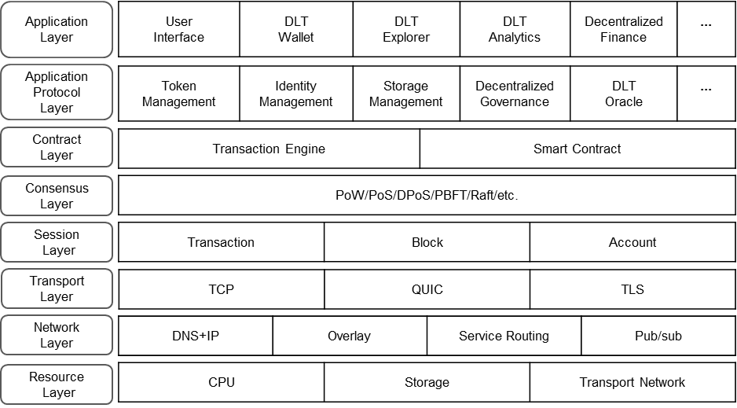
IEEE DLT Layering Architecture

Slide 9
IETF Opportunities
Consensus algorithms
Proof of Work (PoW), Proof of Stake (PoS), Proof of Capability, Proof of Space, Leased PoS, Stellar consensus protocol, Delegated Proof of Stake (DPoS), Transaction as Proof of Stake (TaPoS), Delegated Byzantine Fault Tolerance (dBFT), Casper PoS, Proof of Importance (PoI), Proof of Elapsed Time (PoET)...IETF DCS?
Interoperability
Cross-Chain Bridges, SATP WG
Integration with network functions
Improve on scalability and costs
Metaverse, BaaS…

Slide 10
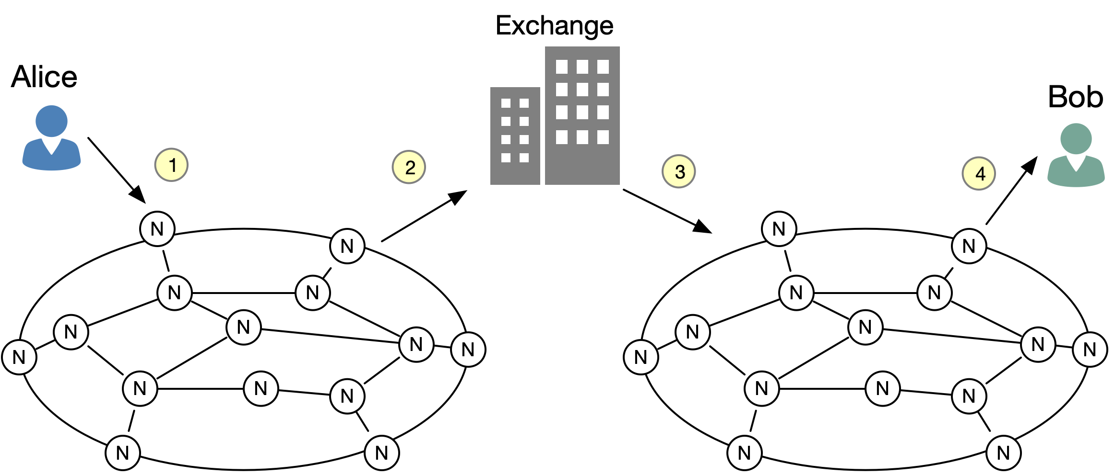
Blockchain Interoperability
Cross-Chain
Bridge

Slide 11
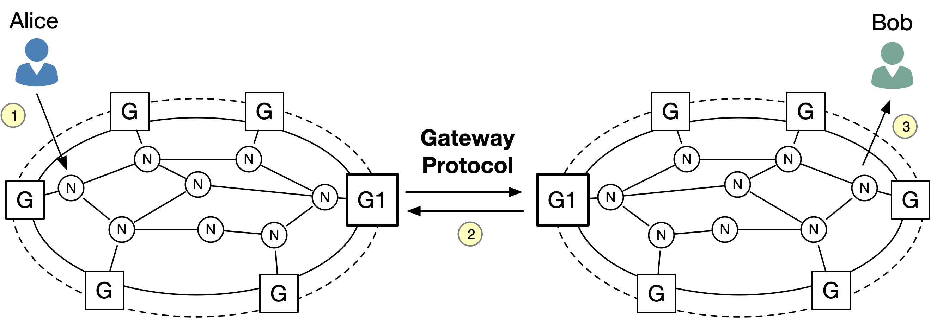
IETF – SATP (Secure Asset Transfer Protocol)
G2

Slide 12
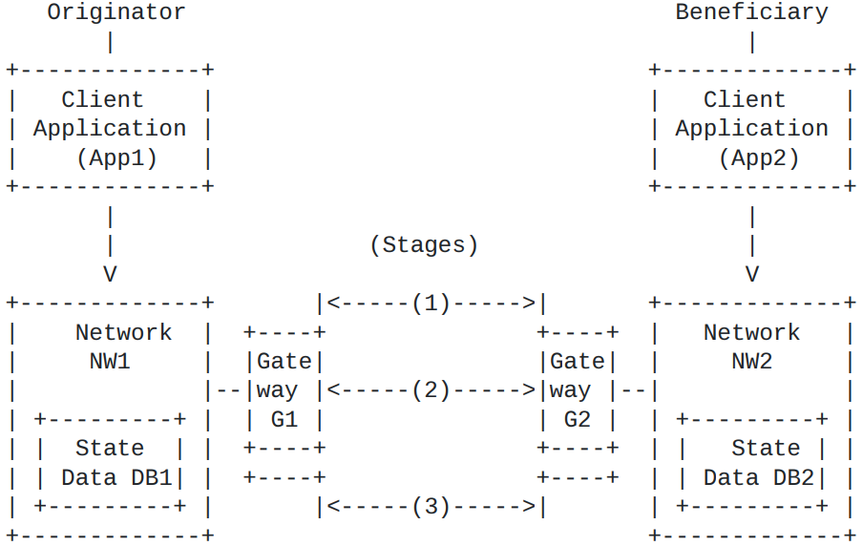
IETF – SATP WG

Slide 13
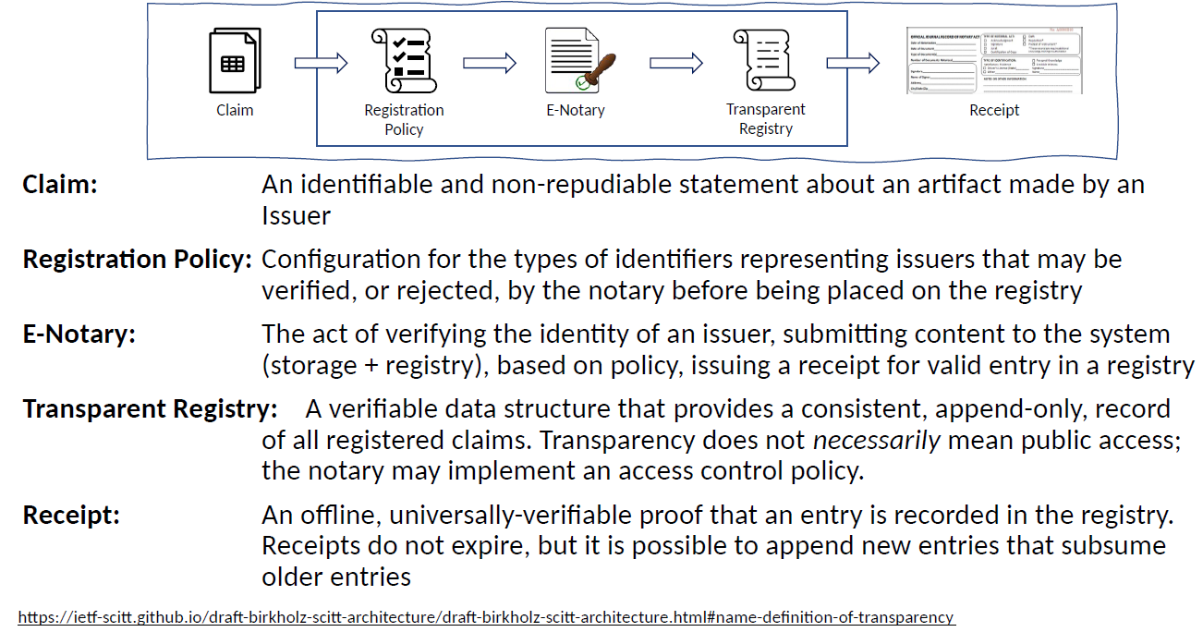
IETF – SCITT (Supply Chain Integrity Transparency & Trust)

Slide 14
Blockchain Routing Opportunities
Trust packet capture data
Network mgmt moves to a decentralized, smart contract-based system
Signing routing advertisements, proof of transit.
BGP/RPKI. ROA’s in a blockchain
Overlays, such as LISP, to find best DLT peer

Slide 15
draft-mcbride-rtgwg-bgp-blockchain
Review possible opportunities of using Distributed Consensus Systems (DCSs) to secure BGP policies within a domain and across the global Internet
Propose that BGP data could be placed in a DCS and smart contracts can control how the data is managed
Create a single source of truth, something for which DCSs are particularly well suited, as a complement to existing IRR and RPKI mechanisms

Slide 16
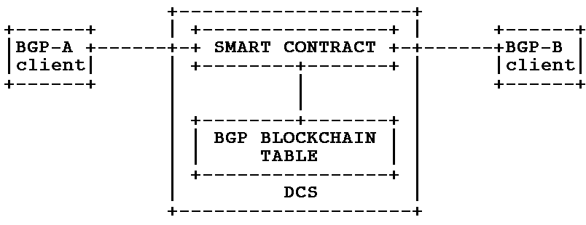
BGP-Blockchain Background
Smart contracts are programs realizing BGP-related operations and store their (distributed) state in a DCS
-> A DCS could be used to supplement existing BGP management
A BGP related smart contract could be executed when some condition such as receiving an update with too many prepends or hijacking detection
DCS realized through a P2P Network where participating nodes verify transactions, execute smart contracts, boot/seed nodes to bootstrap clients/new nodes, process new blocks, full nodes,lightweight nodes...
TCP/IP Network

Slide 17
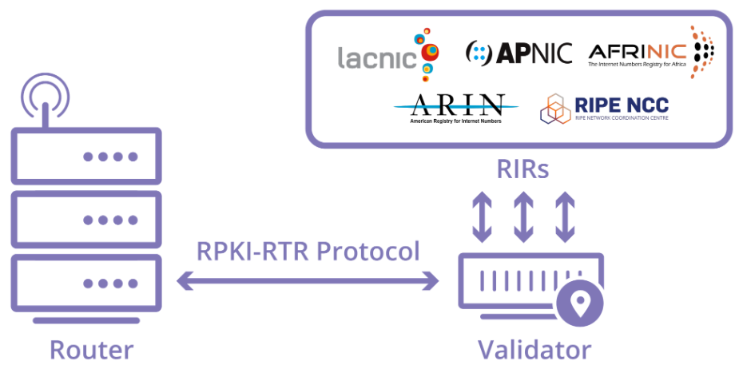
RIR – RPKI Blockchain Options
BLOCKCHAIN?
BLOCKCHAIN?
BLOCKCHAIN?
Image: Cloudfare

Slide 18
draft-trossen-rtgwg-impact-of-dlts
Perspective of the DLT Application:
DLTs do not typically care about the underlying TCP/IP network
They have a P2P overlay network (TCP, UDP based) and that is their focus
They focus on securing their application and do not worry about the network
Perspective of the Network: What is the impact of choices made by the application design on the network, e.g., in terms of costs, traffic generated etc.?
Our work aims to understand the impact of DLTs on provider networks and the possible opportunities to improve on those impacts

Slide 19
DLT Interactions
A client commits a transaction (request) to the DLT
A miner commits a found block to the DLT
Any client or miner can read the blockchain in the DLT
All of those interactions are between originator and N peers, i.e. inherently multipoint in nature

Slide 20
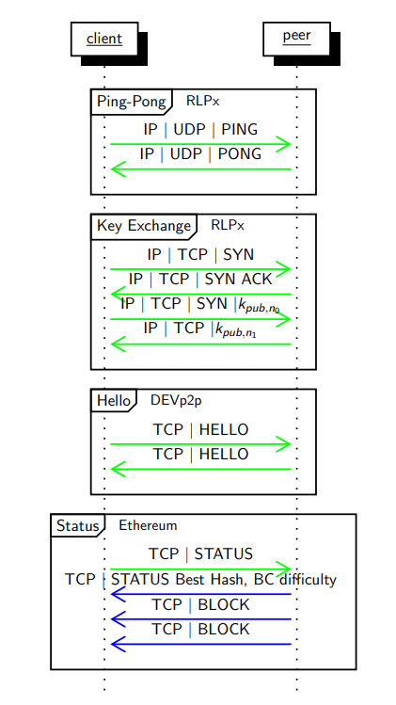
Communication Patterns
miner or client
miner
Node discovery
Transport security
Keep alive, used to maintain a given sized (about 1500) pool of peers to communicate with for the transactions
TCP | COMMAND
Transactions to be executed at miners with RESPONSE specific to transaction type with miners selected from pool of peers
TCP, COMMAND, constraints
TCP, RESPONSE, payload
This may lead to disconnects with reachable miners if constraints do not match

Slide 21
Challenges of DLT in Networking
Problem 1: Information is required to reach other peers
Bootstrap nodes maintain IP addresses of all peers (plus port information)
New DLT members need to download routing information upon joining and for regular update
Problem 2: Clients know nothing about peers’ capability to serve requests
Approach is to (1) contact potential peer, (2) wait for connection, (3) inquire capabilities, (4) disconnect if not matching
Peers may never reply to connection establishment (step 2)
Problem 3: Peers map sending of transactions onto unicast communication
Negatively impacts efficiency (bandwidth usage) and completion time
Problem 4: Need to expose IP address to Bootstrapping Node
Sending IP address during DLT sign-up may lead to privacy and/or security issues

Slide 22
On Using Multicast for DLTs…
Highly individualized operations
Seeding from bootstrap nodes, discovery of other peers, constantly changing pool of transport connections
-> frequently changing multicast trees if multicast were to be used.
Highly distributed DLT network
Discovered nodes, i.e. potential members of DLT pool, may reside ANYWHERE within the geo spread of the DLT -> inter-domain support for multicast poses a problem, possibly requiring hybrid approaches (e.g., replay nodes)
Highly dynamic pools per peer
Pools are constantly refreshed to randomize membership -> meaning the pool of peers undergoes constant changes, possibly incurring high membership signaling
Highly diverse peers in overall DLT network
May range from individual at home over hosted VM in cloud to entire private clouds -> multicast may or may not be supported in local domain or enabled for peer

Slide 23
Summary
Blockchain is the backbone for crypto assets
Non-cryptocurrency (supply chains) gaining momentum
There are potential opportunities for Blockchain in networking
Networking DCS
Private Blockchain to secure data
Replace RIR Database
New PKI application (Blocks)
Supplement (or replace) RPKI
DLTs have a clear impact on provider networks
Understanding traffic impact is important for network innovations
Presented in IETF, side meetings and IEEE papers.
Please join us: dlt-networking@ietf.org
Interoperability
Scalability
Multicast
Supply Chain Integrity

