Slide 1
Documentation, Automation, and validation Oh My!
Dan Kelcher
Solution Architect @

Slide 2
Audience Participation!
Have you ever heard a network engineer say: “I don’t want to be a developer?
Are you currently automating network tasks?
Notes:
Q1: Is anyone willing to admit they’ve said it?
Q2: Are you only doing ad hoc scripting?

Slide 3
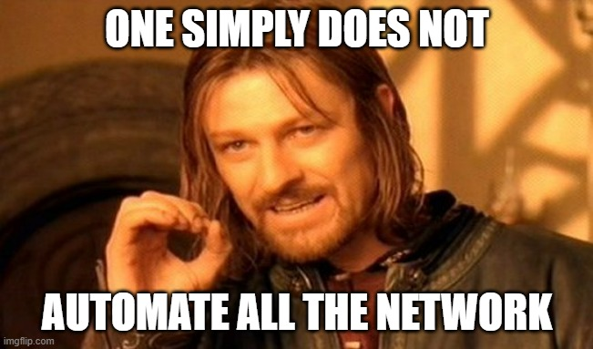

Slide 4
Real World Examples
Directions:
Right
Straight
Slight Left
Straight
Right
Right
Verification:
Did You Go Right?
Did You Go Straight?
Did You Go Slight Left?
Did You Go Straight?
Did You Go Right?
Did You Go Right?
Where are you?

Slide 5
Network examples
Commands
Validation

Slide 6
The building blocks for a successful automation journey

Slide 7
Step 1: Collect data
Documentation
What’s out there?
Inventory
Current configuration
As-built diagrams
State
What is it doing?
Status
Interfaces
Route peers/table
CDP/LLDP neighbors
MAC table
Protocol state

Slide 8
Challenges
Documentation is boring
Other higher-priority tasks
Lack of central repository
Brownfield environments
Data validity
Inaccuracy
Incomplete
Outdated
Complex environments
Multi-platform
Multi-vendor
Multi-cloud
SDN – Overlay/underlay
State is dynamic
Frequent changes might be needed
Scale
Lack of tools

Slide 9
Why Data Matters to automation
It’s your starting point.

Slide 10
Step 2: Make it happen
Intent
What is the target?
As-designed documentation
Policies
Best practices
Configuration requirements
Golden config/template
Automation
How can the Intent be achieved?
Scripting
Automation platforms
3rd party
Vendor solutions
Make the junior engineer do it

Slide 11
Challenges
Lack of consistency
Undefined intent
Brownfield environments
Resource limitations
Time
Budget
Skills
Insufficient visibility
Difficulty identifying needed changes
Complex environments
Multi-platform
Multi-vendor
Multi-cloud
SDN – Overlay/underlay

Slide 12
Why intent matters to automation
It’s your target

Slide 13
Step 3: What’s it doing now?
Assurance / Verification
Does the state match the intent?

Slide 14
Challenges
Undefined intent
Scale
Resource limitations
Time
Budget
Skills
Insufficient visibility
Difficulty identifying needed changes
Complex environments
Multi-platform
Multi-vendor
Multi-cloud
SDN – Overlay/underlay

Slide 15
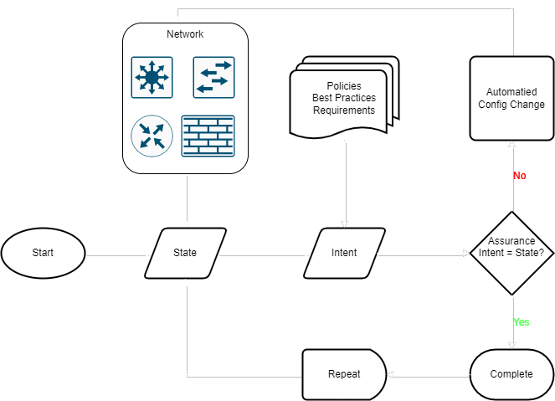
Closed-Loop Automation

Slide 16
Why assurance matters to automation
Confirms you’re on target.

Slide 17
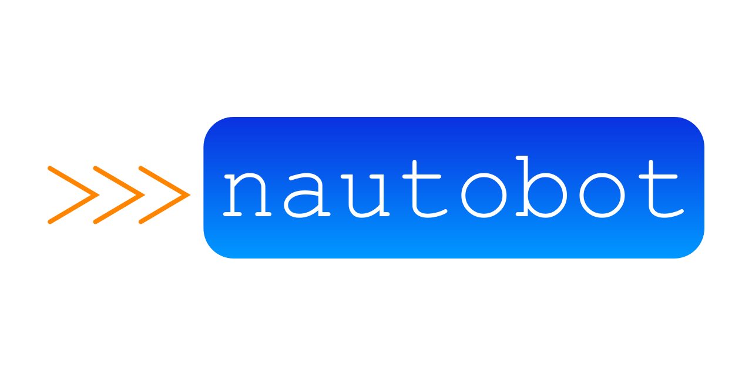
Tools that can help you get there
CENSORED

Slide 18
Questions?

Slide 19
Thank you!
Dan Kelcher
Dan.Kelcher@IPFabric.io
https://MyTechGnome.com
https://IPFabric.io
https://www.linkedin.com/in/dkelcher/
@Ipswitch

